Slide 1

NGS: Next Generation Sequencing
Much like ST:TNG this has been around for a while.

Slide 2
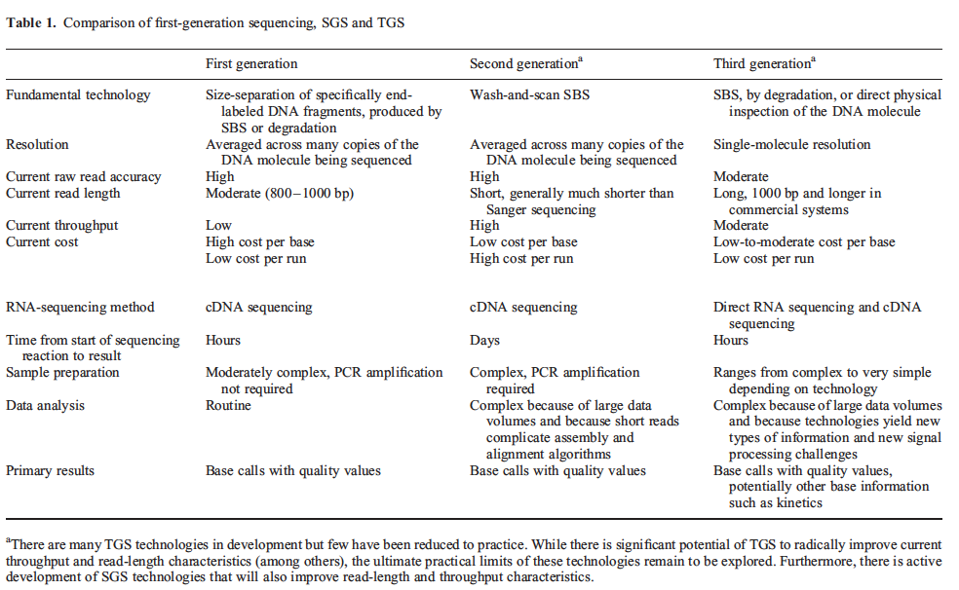
NGS: Next Generation Sequencing
Many technologies have worked, continual improvements
Schadt et al Human Molecular Genetics, 2010

Slide 3
NGS: Next Generation Sequencing
Many technologies have worked, continual improvements
One of many rows of ABI 3730xl - 96-capillary Sequencer - J Craig Venter Institute
Schadt et al Human Molecular Genetics, 2010

Slide 4
NGS: Next Generation Sequencing
Most popular right now: Illumina
Schadt et al Human Molecular Genetics, 2010

Slide 5
NGS increasingly used in combination/lieu of biochemical assays
Beyond DNA sequencing
Methylated DNA (epigenetics)
RNA-seq
transcriptome: all mRNA
Small RNA profiling
Ribo-seq
where ribosomes are bound, translation kinetics
RNA sequences converted to DNA with reverse transcriptase

Slide 6
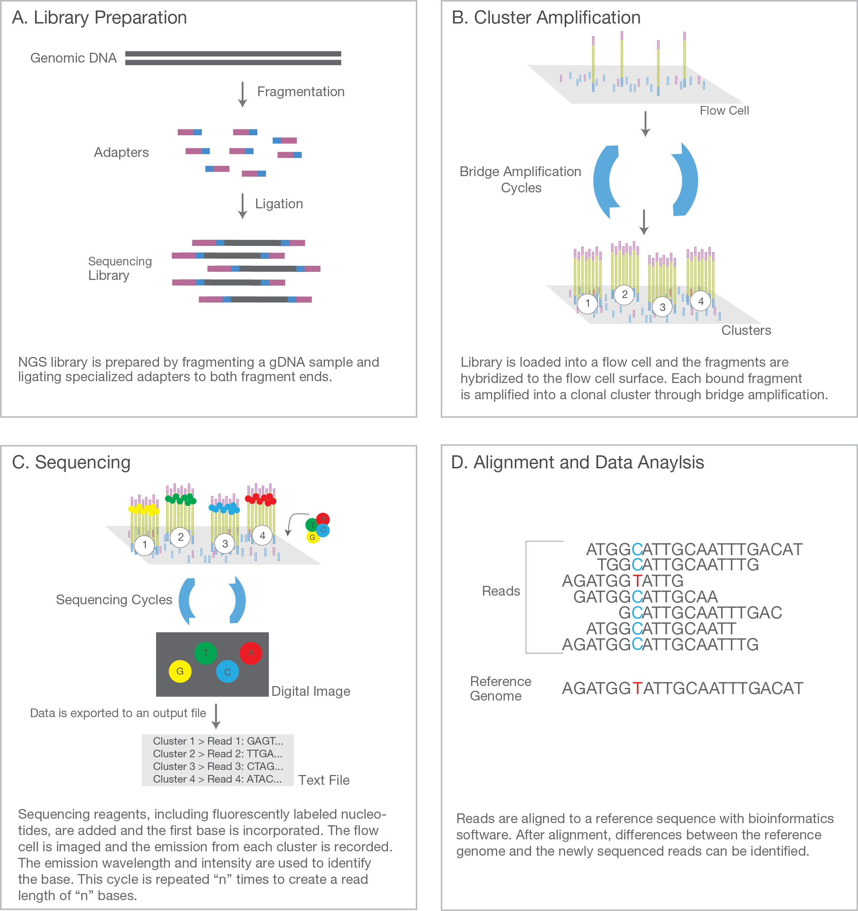
Illumina: lots of short DNA sequences
Cut up DNA and add adapters from a kit
Illumina sequencing introduction

Slide 7
Illumina: lots of short DNA sequences
Cut up DNA and add adapters from a kit
Adapter attaches to “flow cell” and PCR amplified into a cluster
Illumina sequencing introduction

Slide 8
Illumina: lots of short DNA sequences
Clusters light up for each base, computer records
Illumina sequencing introduction

Slide 9
Illumina: lots of short DNA sequences
Clusters light up for each base, computer records
Alignment and analysis
Illumina sequencing introduction

Slide 10
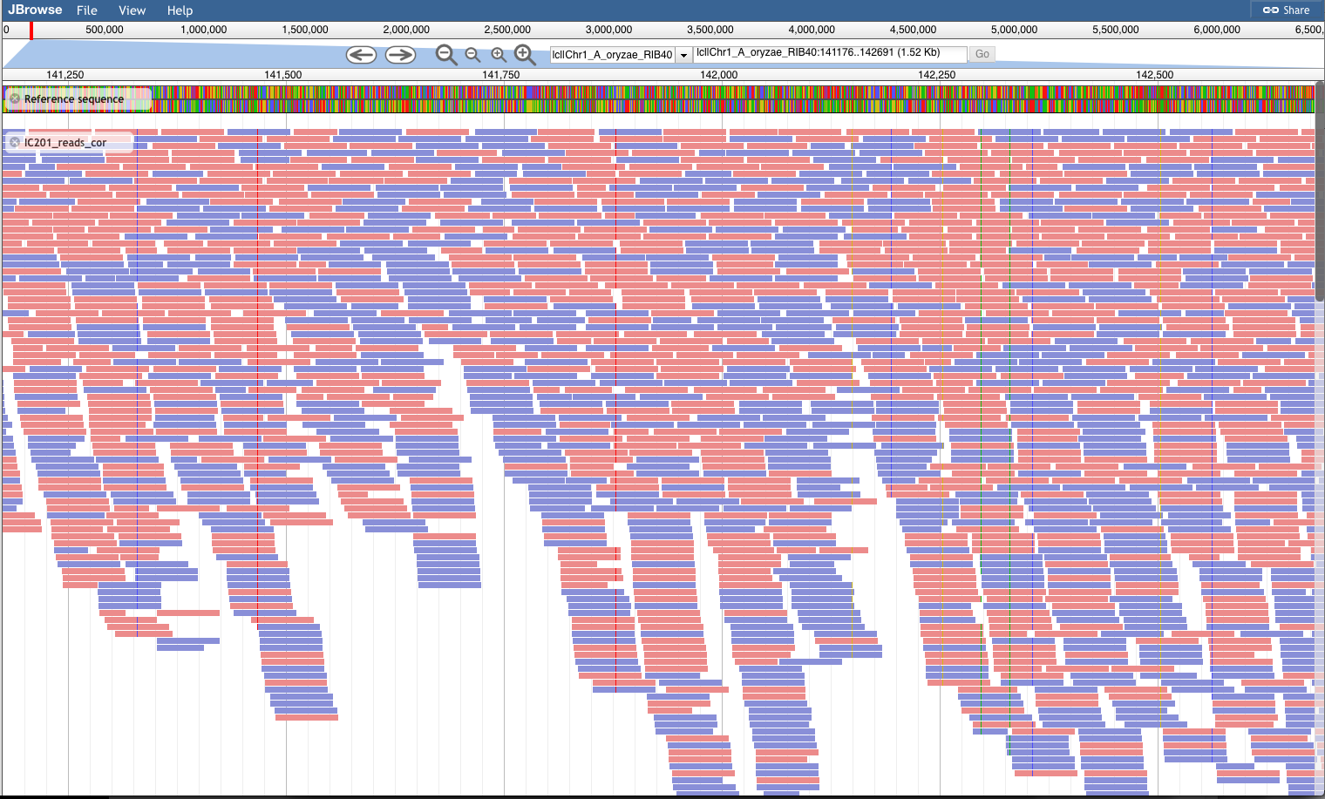
JBrowse: Visualization of aligned reads
Haploid fungus

Slide 11
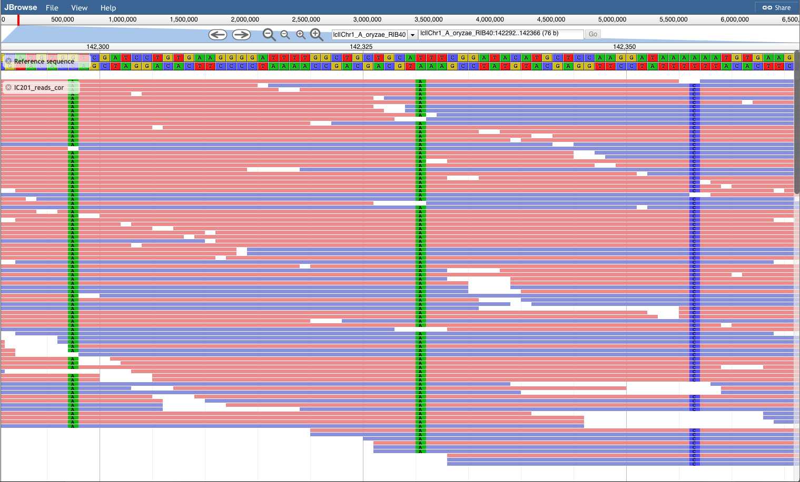
JBrowse: Visualization of aligned reads
Haploid fungus

Slide 12
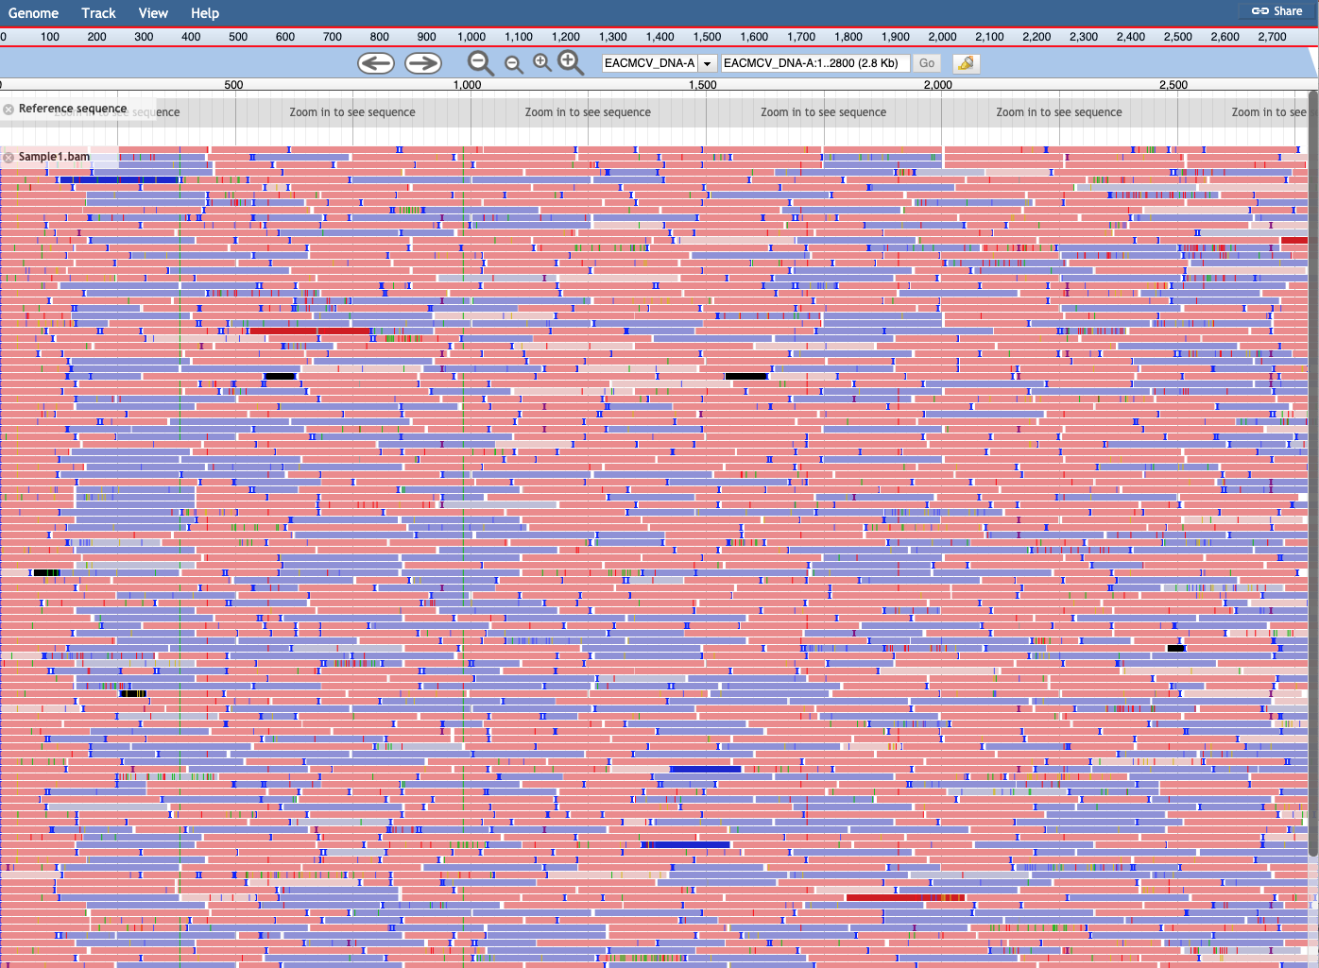
JBrowse: Visualization of aligned reads
Virus

Slide 13
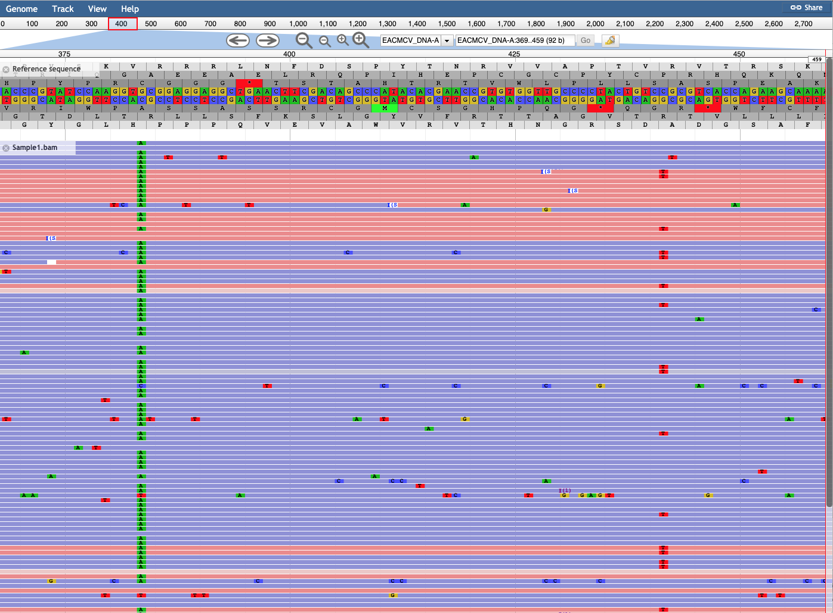
JBrowse: Visualization of aligned reads
Virus

Slide 14

Galaxy: one analysis platform
usegalaxy.org
Many tools available on galaxy but space is not unlimited (max 250 GB)
Accessible: more user-friendly than separately downloading and running each tool on your computer’s command line
Reproducible: analyses recorded, can be shared and re-run by others

Slide 15
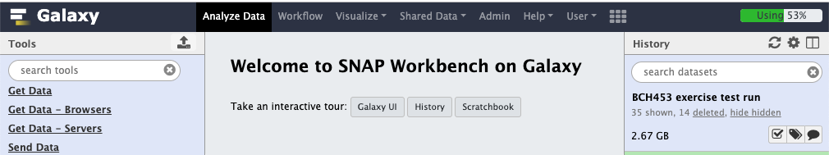
Galaxy Instance @NCSU
Include custom tools not yet available or deprecated (e.g. GATK) on public galaxy and have access to more disk space
Shorter queue times: Can utilize local computational resources or Galaxy instance can be packaged as a docker container (software bundle) that can run on your laptop or deployed in the cloud (e.g. AWS – Amazon Web Services or Google Cloud)
Security: Can deploy using secure services in the cloud or on a local network behind a firewall

Slide 16
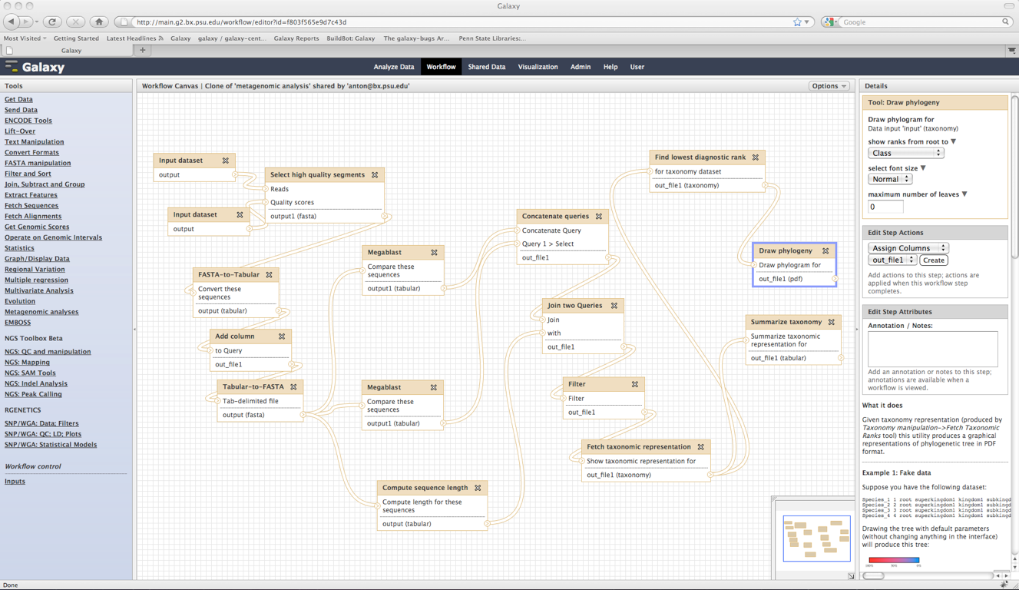
Visual analysis pipeline
Blankenberg, Galaxy Team

Slide 17

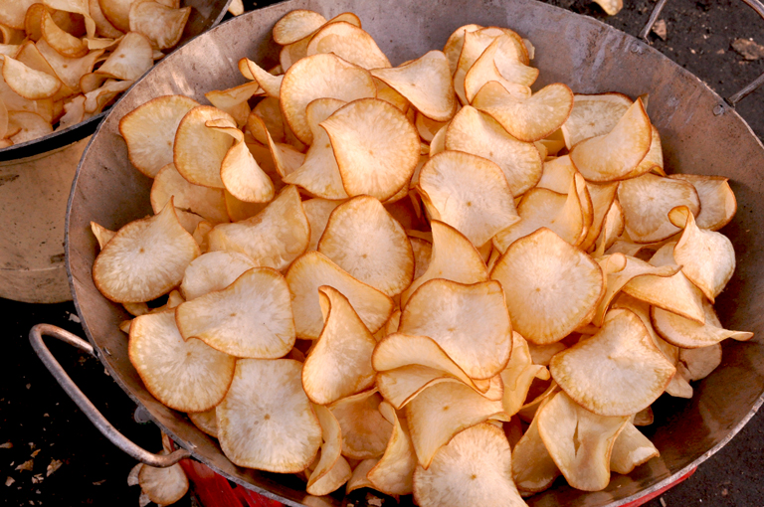

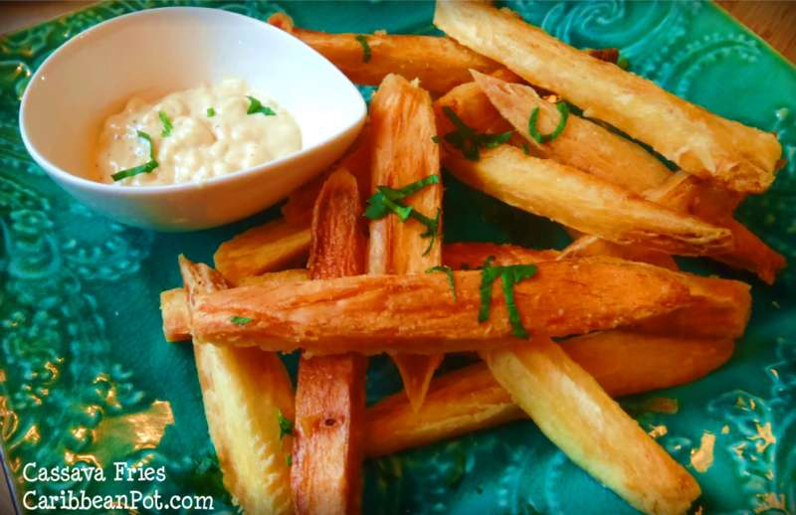

Our experiments: cassava mosaic disease
Cmumbe (wikimedia), peartreekitchen.com,
https://www.ohhowcivilized.com/bubble-tea/

Slide 18
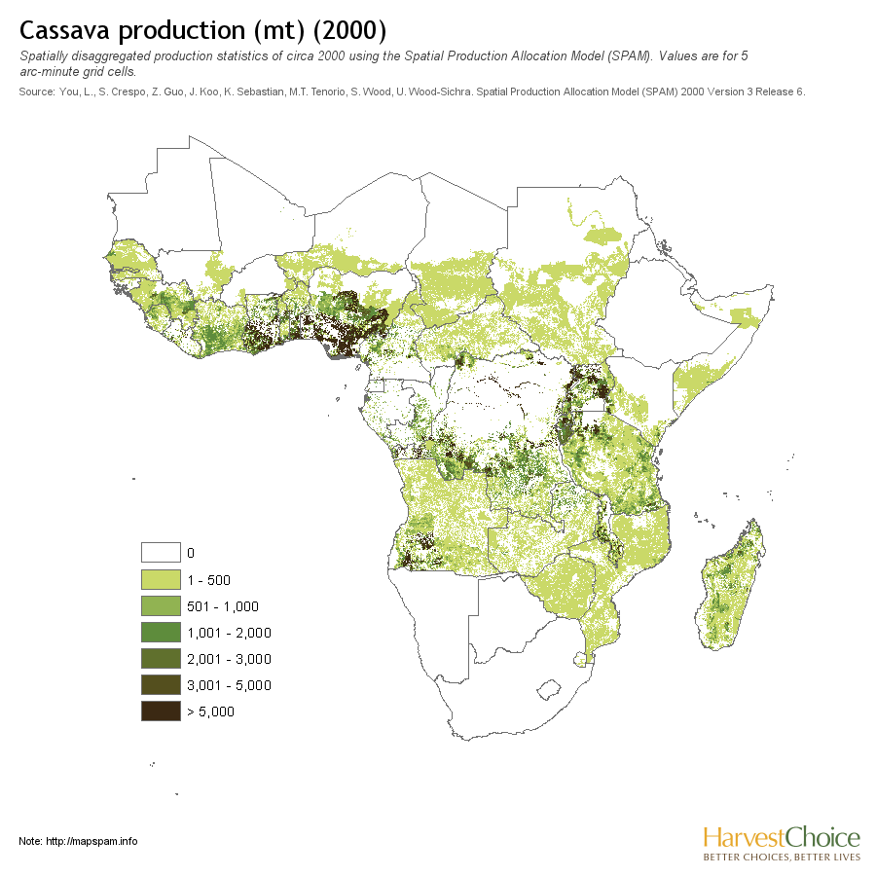
Our experiments: cassava mosaic disease

Slide 19
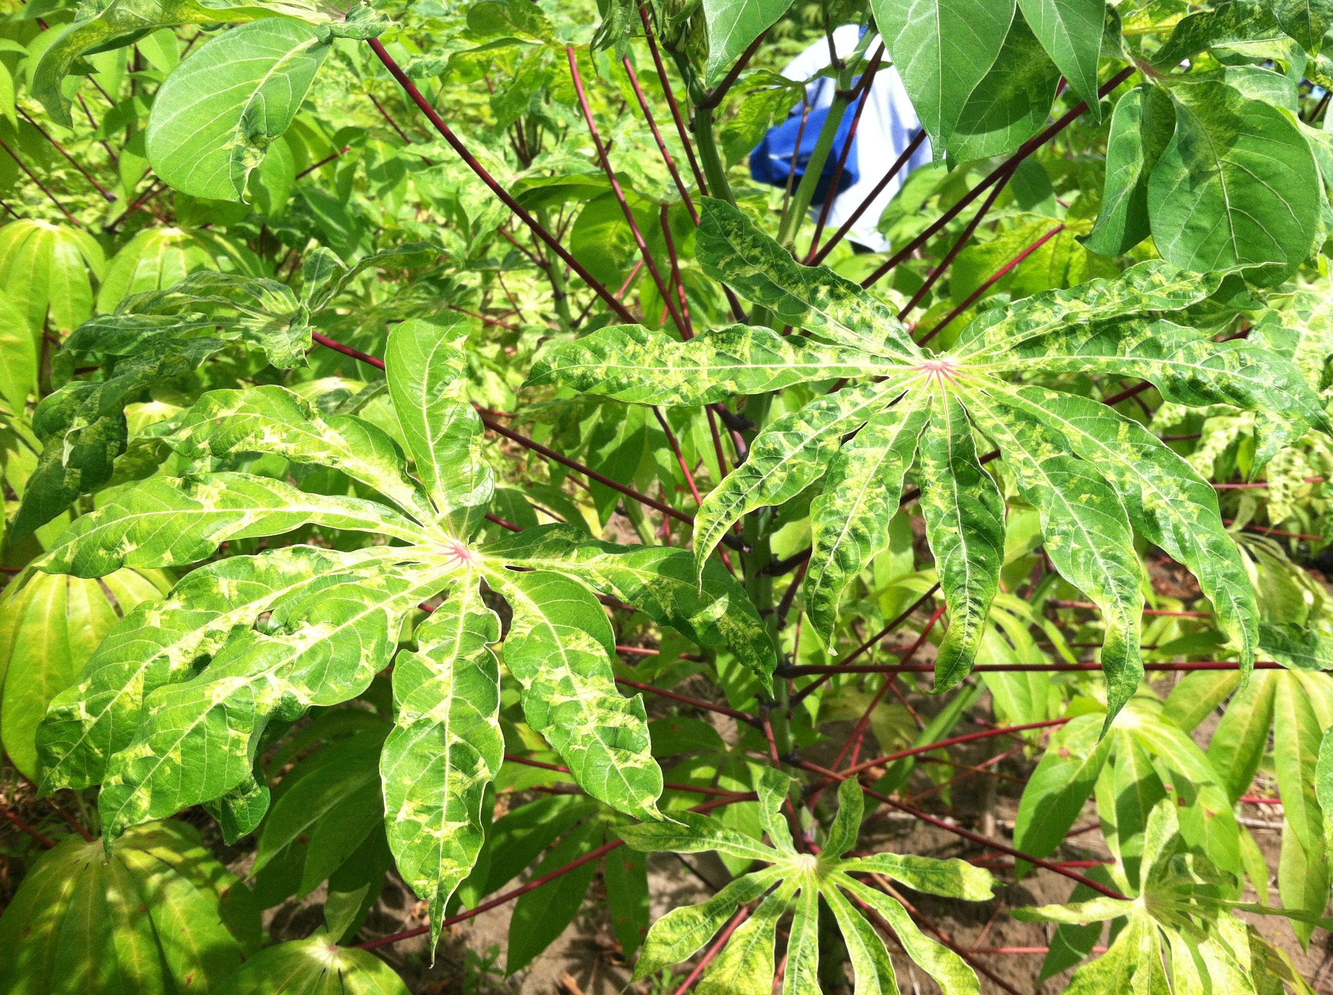
Our experiments: cassava mosaic disease
S. Duffy

Slide 20
Our experiments: cassava mosaic disease
Understand evolution in CMD-causing viruses
S. Duffy

Slide 21
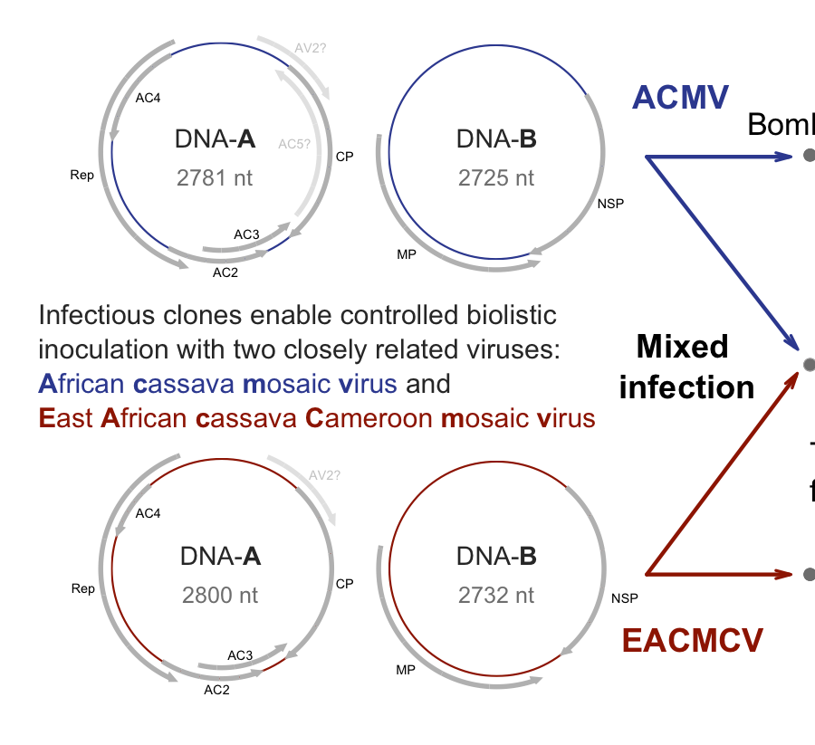
CMD caused by small DNA viruses
ACMV
African
cassava mosaic virus
NSP
EACMCV
East African
cassava mosaic Cameroon virus
NSP

Slide 22
Your data
Each of the libraries of sequences come from a plant infected by one of these viruses (ACMV or EACMCV).
You need to determine which virus (1 pt)
+ the most frequent sequence variant that arose during infection of that plant (2 pts)
+ the frequency of that variant in your library (2 pts).

Slide 23
This is one part of the analysis pipeline
Trim raw
reads
Align reads to
reference genomes
Call variants
Analyze differences
in diversity

Slide 24
This is one part of the analysis pipeline
Trim raw
reads
Align reads to
reference genomes
Call variants
Analyze differences
in diversity
BAM files

Slide 25
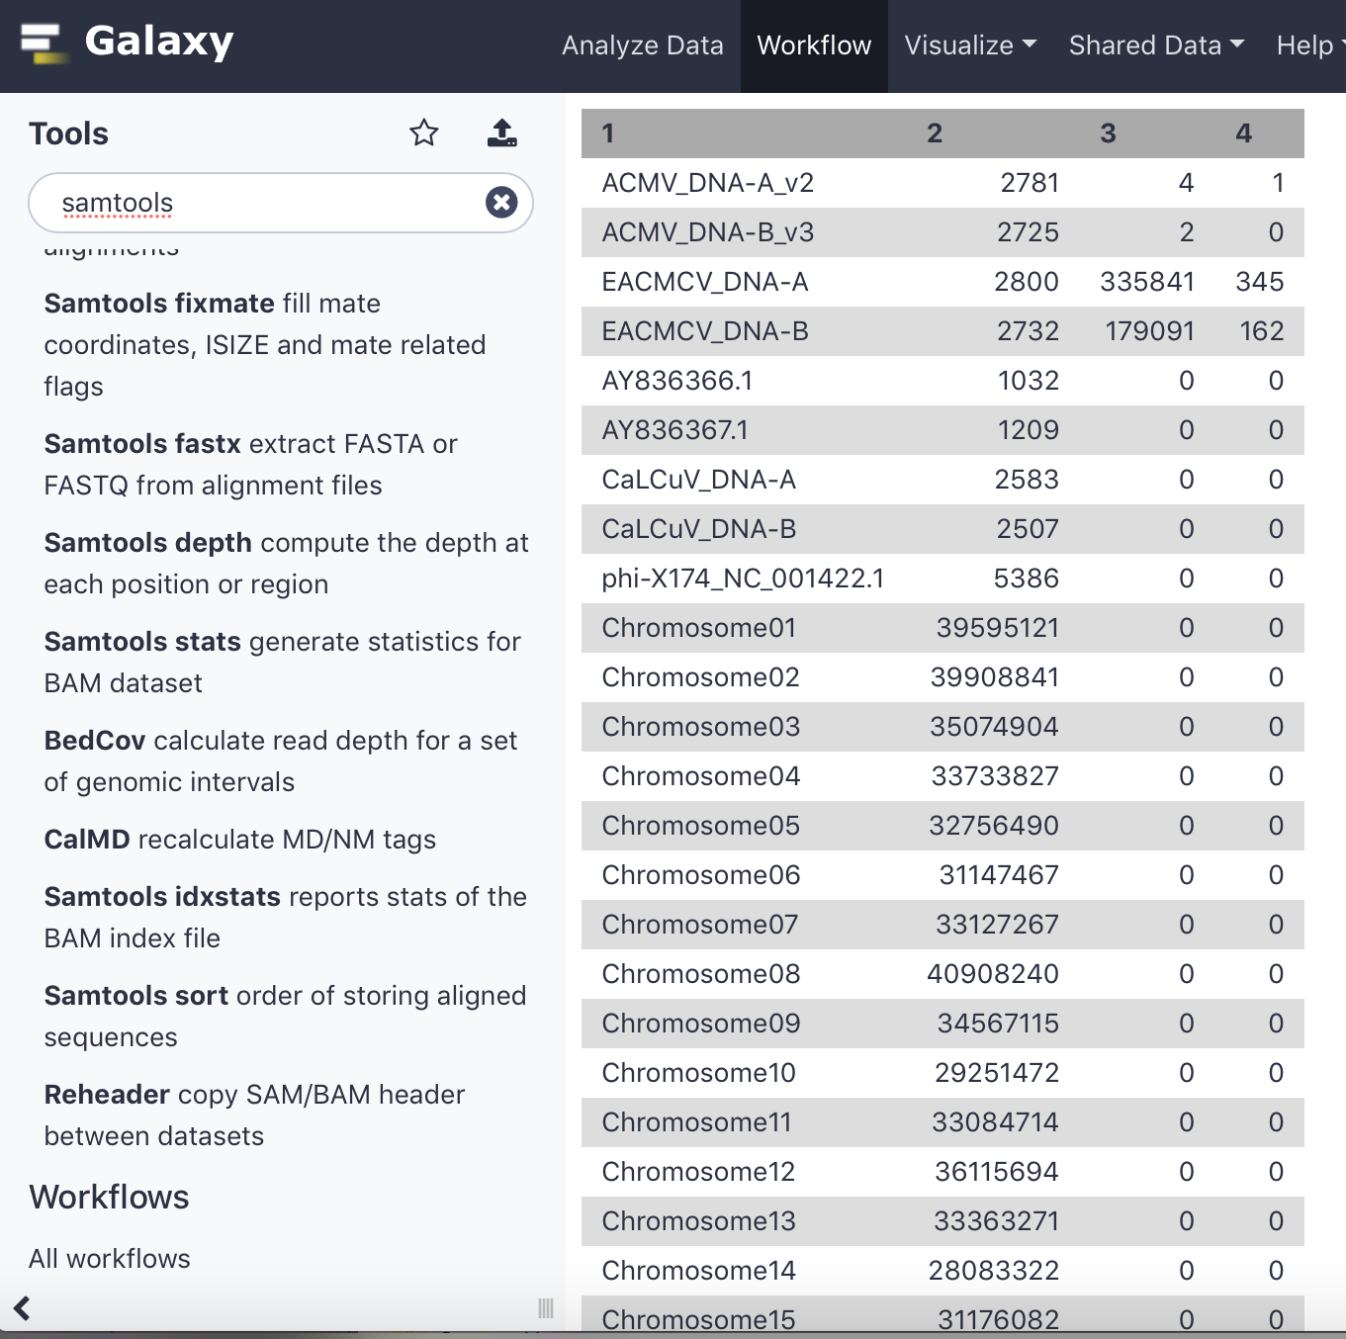
This is one part of the analysis pipeline
Trim raw
reads
Align reads to
reference genomes
Call variants
Analyze differences
in diversity
BAM files
Which virus: samtools idxstats

Slide 26
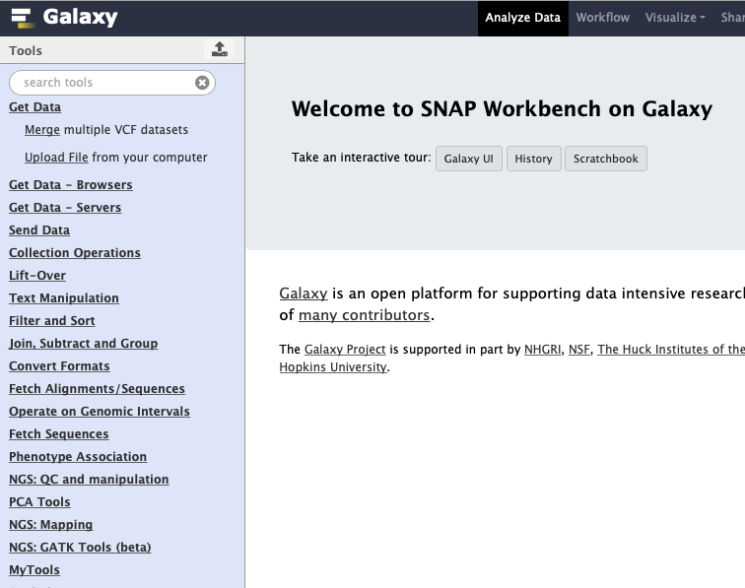
This is one part of the analysis pipeline
Import the reference sequence for the correct virus
.fasta file
Trim raw
reads
Align reads to
reference genomes
Call variants
Analyze differences
in diversity
BAM files

Slide 27
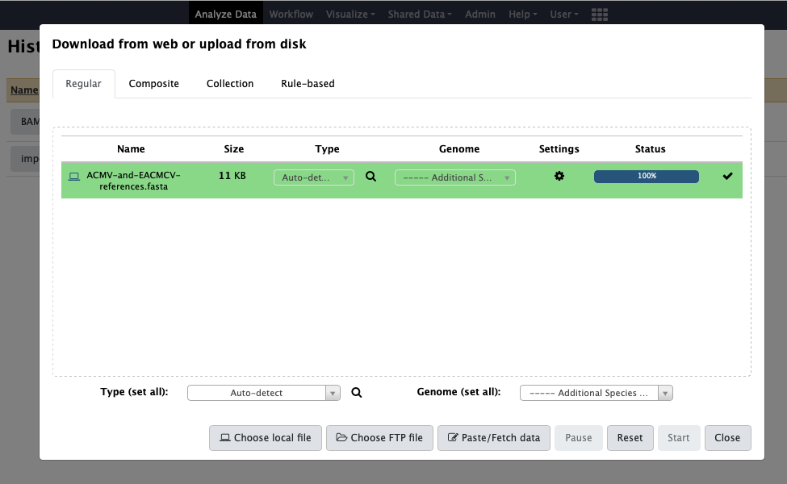
This is one part of the analysis pipeline
Import the reference sequence for the correct virus
.fasta file
Trim raw
reads
Align reads to
reference genomes
Call variants
Analyze differences
in diversity
BAM files

Slide 28
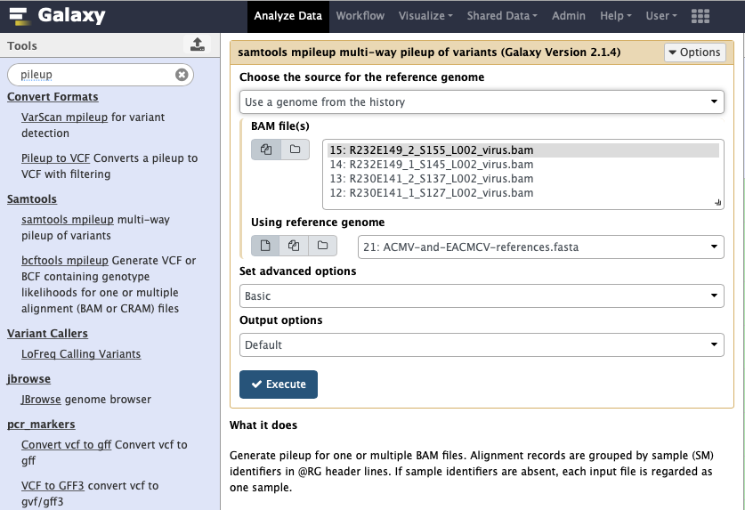
This is one part of the analysis pipeline
Import the reference sequence for the correct virus
.fasta file
Trim raw
reads
Align reads to
reference genomes
Call variants
Analyze differences
in diversity
Is the read variation at each site trustworthy?
samtools mpileup
BAM files

Slide 29
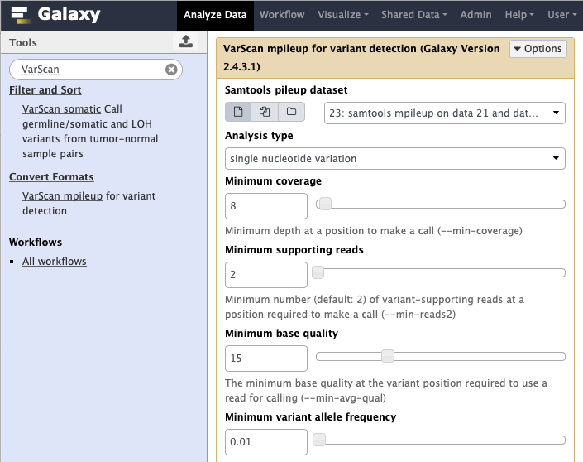
This is one part of the analysis pipeline
Import the reference sequence for the correct virus
.fasta file
Trim raw
reads
Align reads to
reference genomes
Call variants
Analyze differences
in diversity
Is the read variation at each site trustworthy?
samtools mpileup
BAM files
What SNVs, and at what frequencies? VarScan

Slide 30
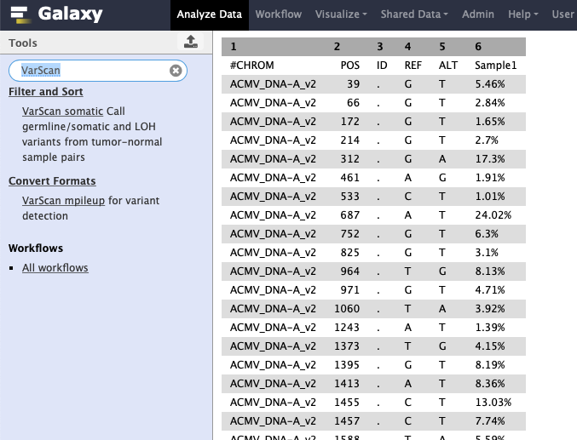
This is one part of the analysis pipeline
Import the reference sequence for the correct virus
.fasta file
Trim raw
reads
Align reads to
reference genomes
Call variants
Analyze differences
in diversity
Is the read variation at each site trustworthy?
samtools mpileup
BAM files
What SNVs, and at what frequencies? VarScan

Slide 31
Your assignment
Tutorial
galaxy_single_BAM_workflow-shared-with-links.pptx
Reference genome
ACMV-and-EACMCV-references.fasta
Answer sheet
answer sheet for genomics exercise.docx

