Slide 1
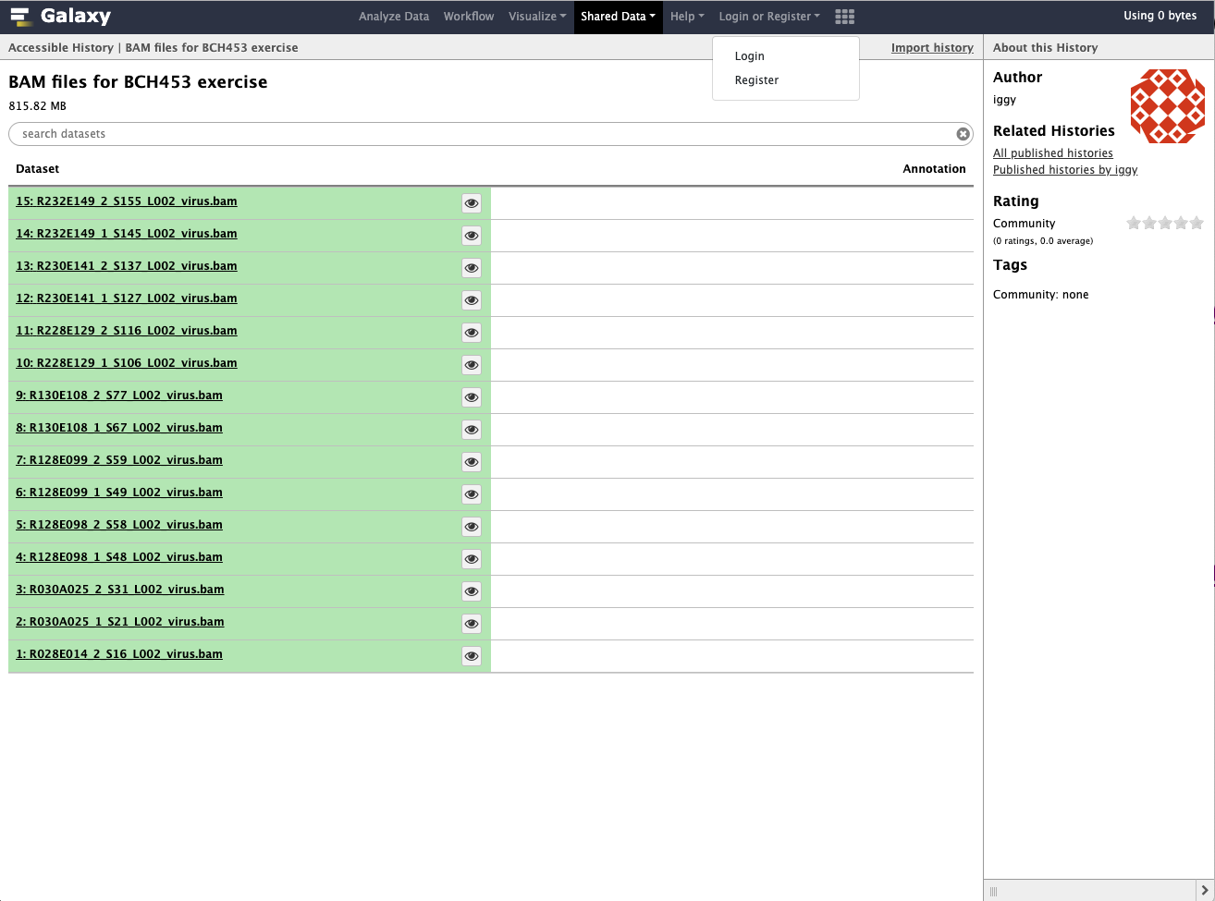
Login into your account
To import BAM files click on this link:
https://vclv99-241.hpc.ncsu.edu/u/iggy/h/bam-files-for-bch453-exercise-1

Slide 2
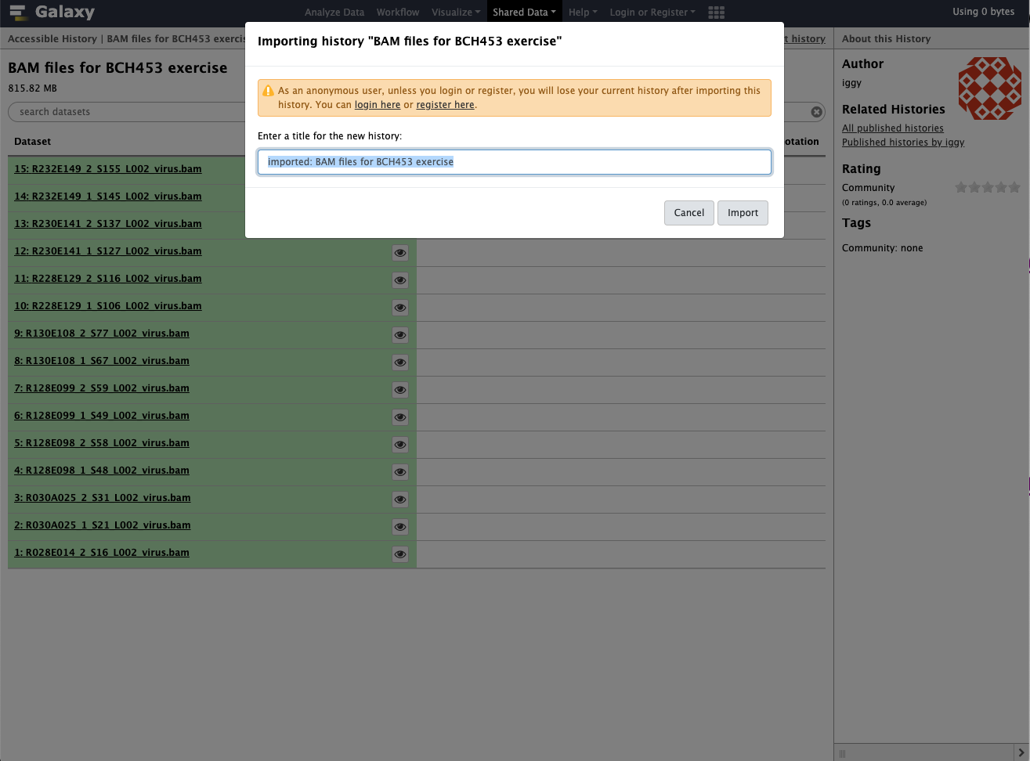
Import BAM files

Slide 3
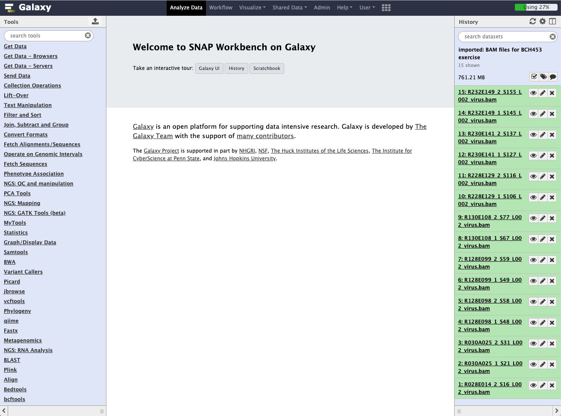
Shared files will be appear in a new history

Slide 4
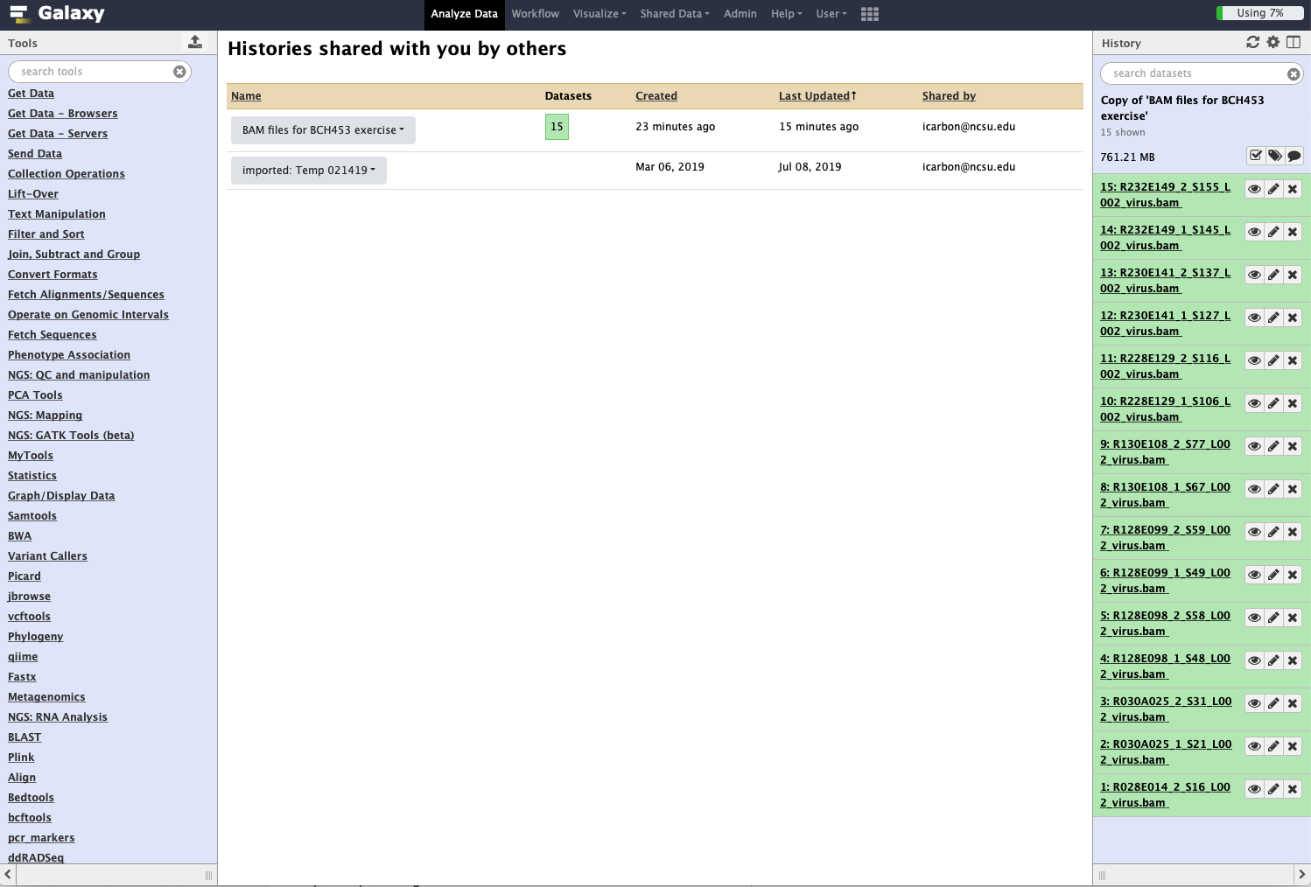
Click on Get Data. We will be uploading the viral reference genome.

Slide 5
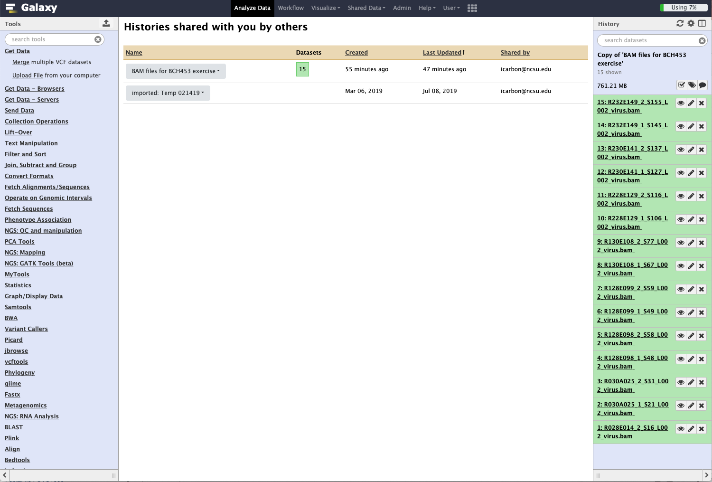
Click on Upload File

Slide 6
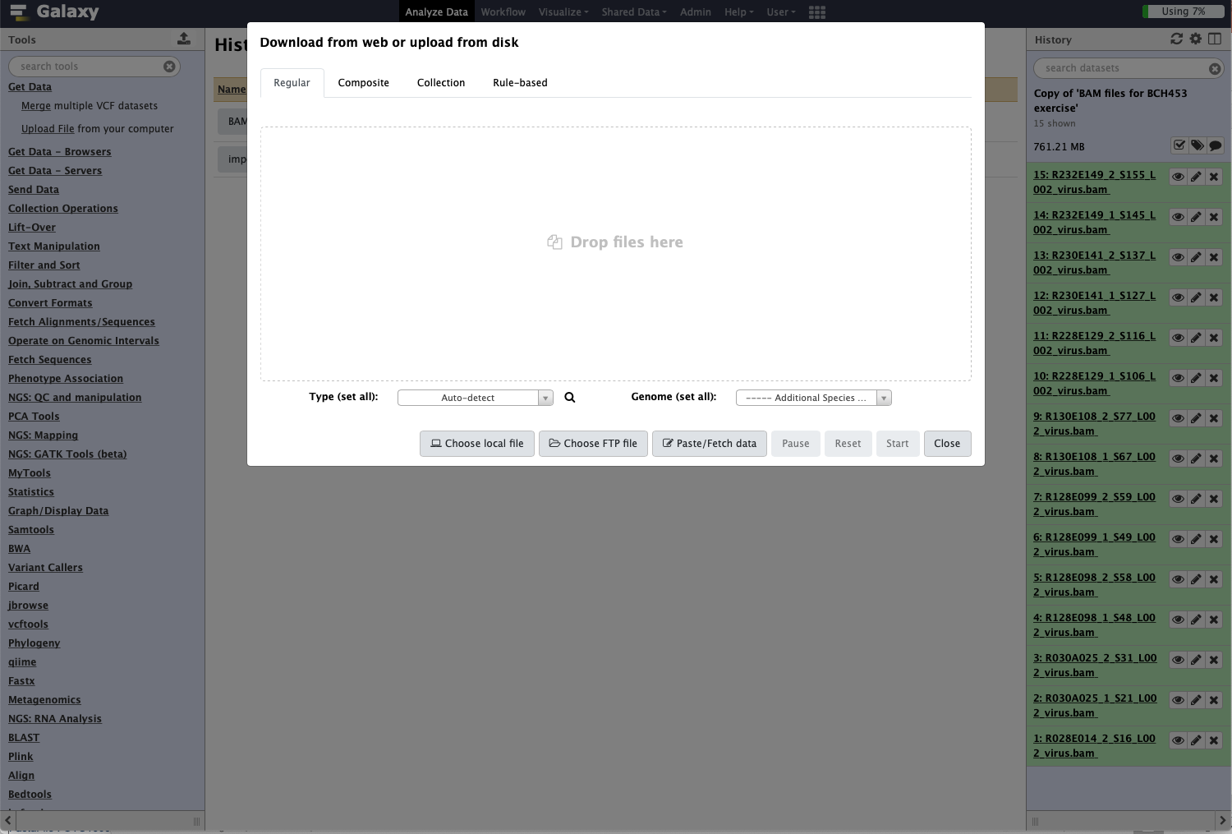
Drop the “ACMV-and-EACMCV-references.fasta” genome file into the window

Slide 7
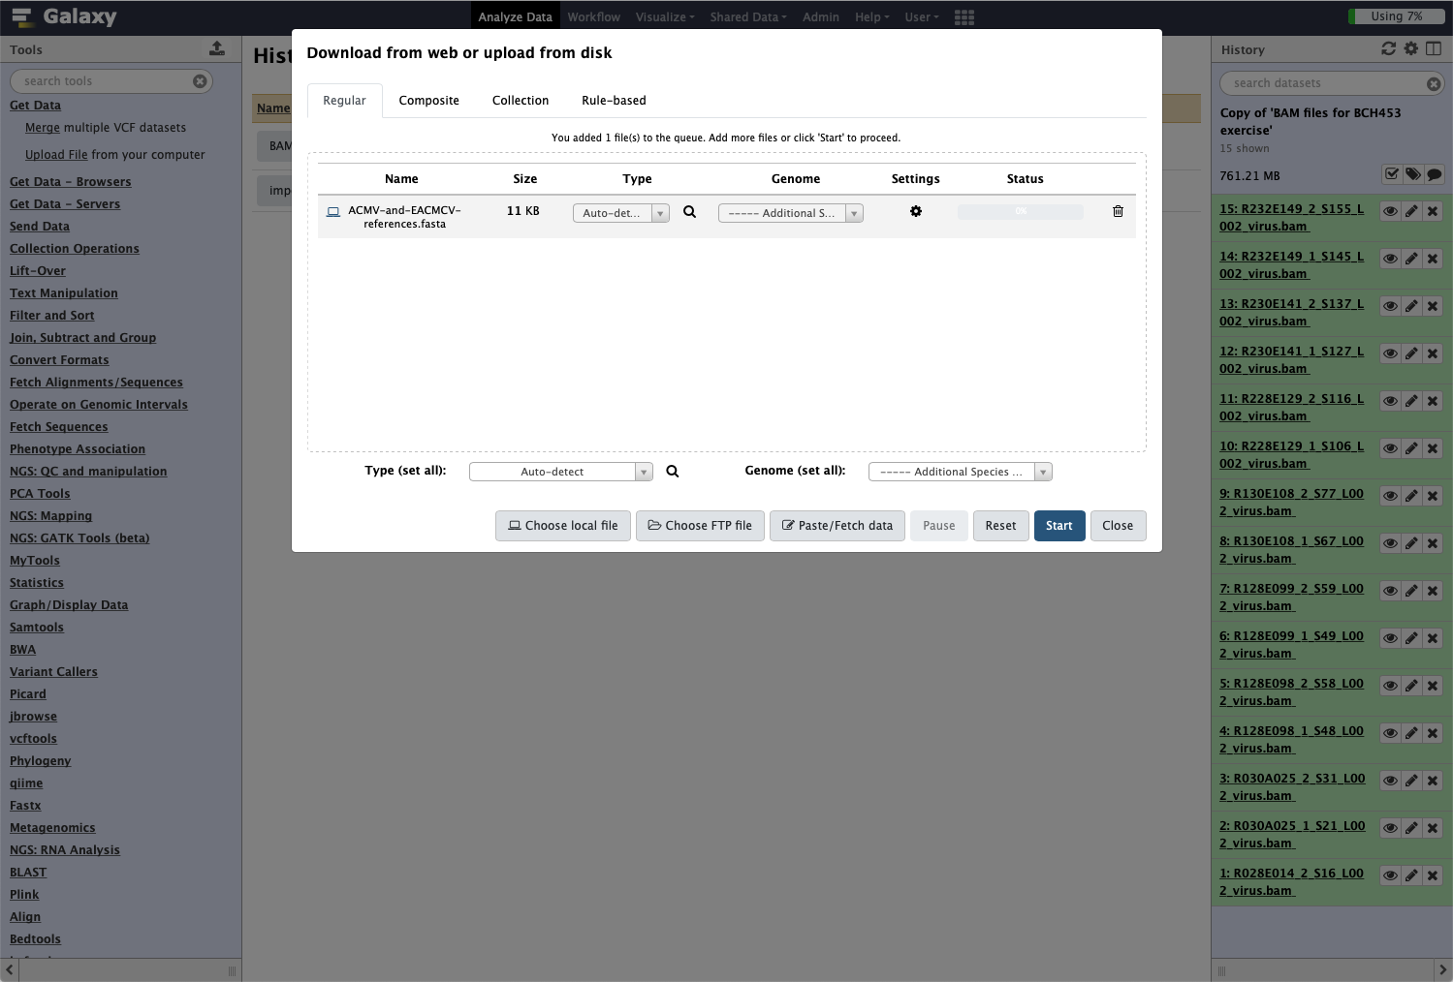
Click on Start to upload file

Slide 8
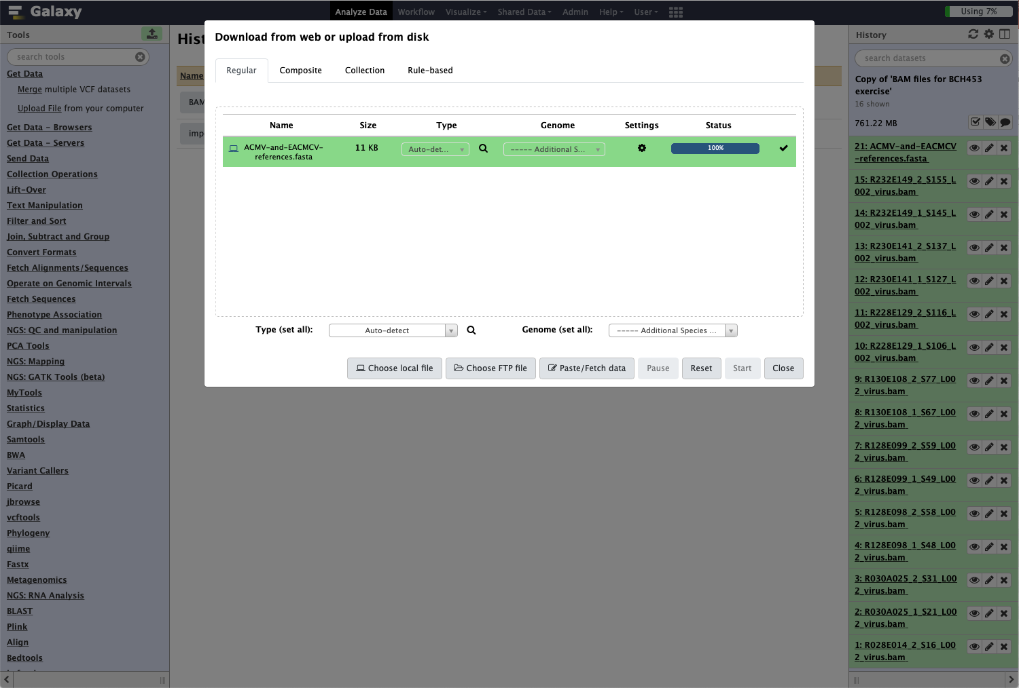
Click on Close when file uploading is done

Slide 9
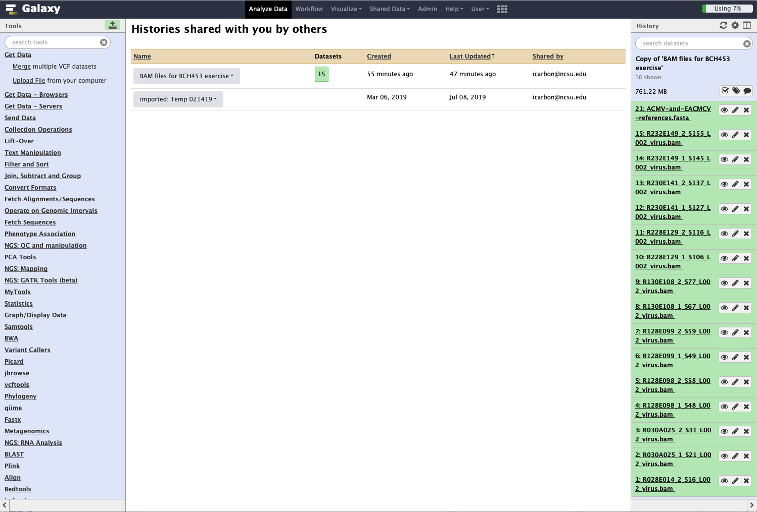
Uploaded file appears in history

Slide 10
To import workflow click on this link:
https://vclv99-241.hpc.ncsu.edu/u/iggy/w/copy-of-workflow-for-bam-collection-bch453

Slide 11
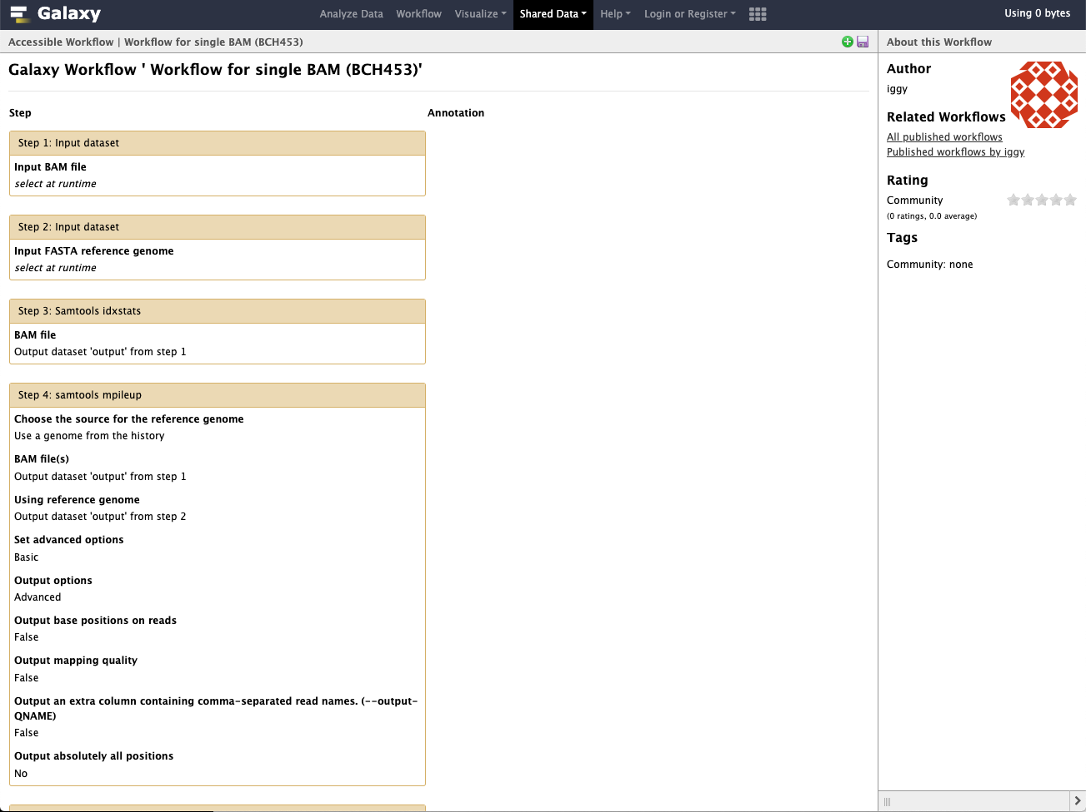
Click the green icon to import workflow

Slide 12

Click to import workflow

Slide 13
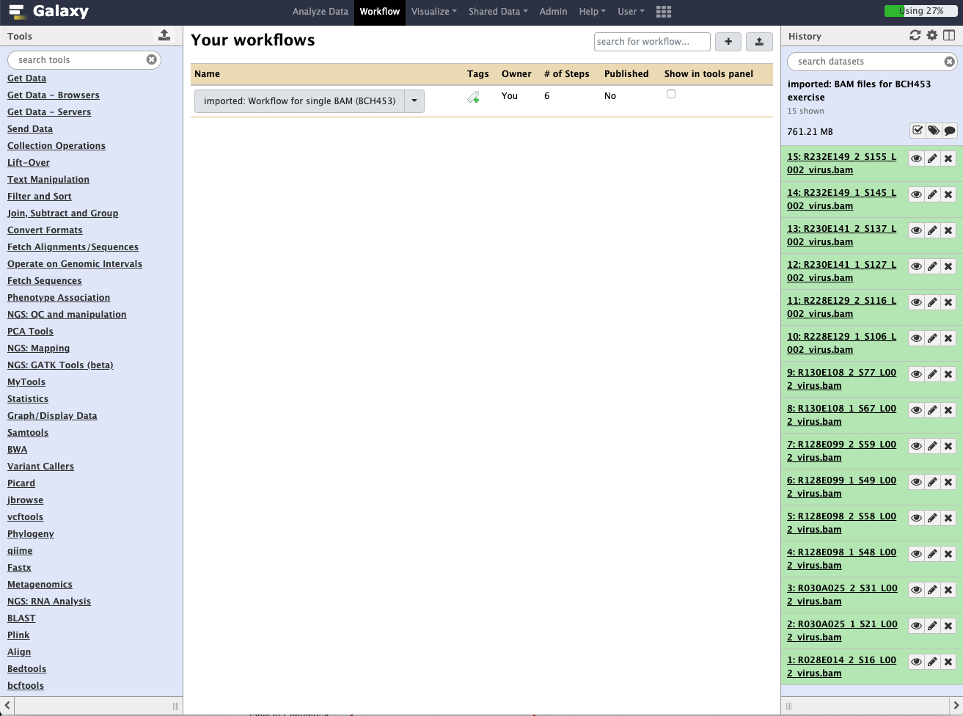
Click here to view options

Slide 14
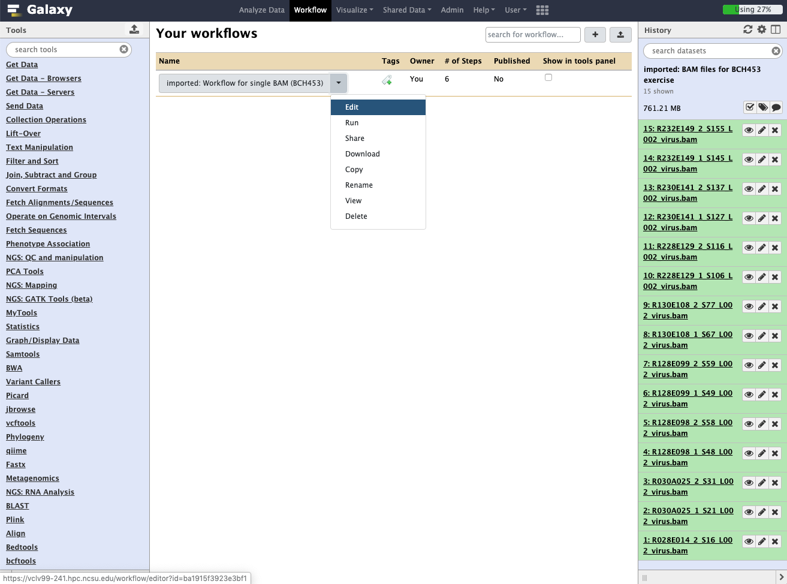
Select Edit to view workflow

Slide 15
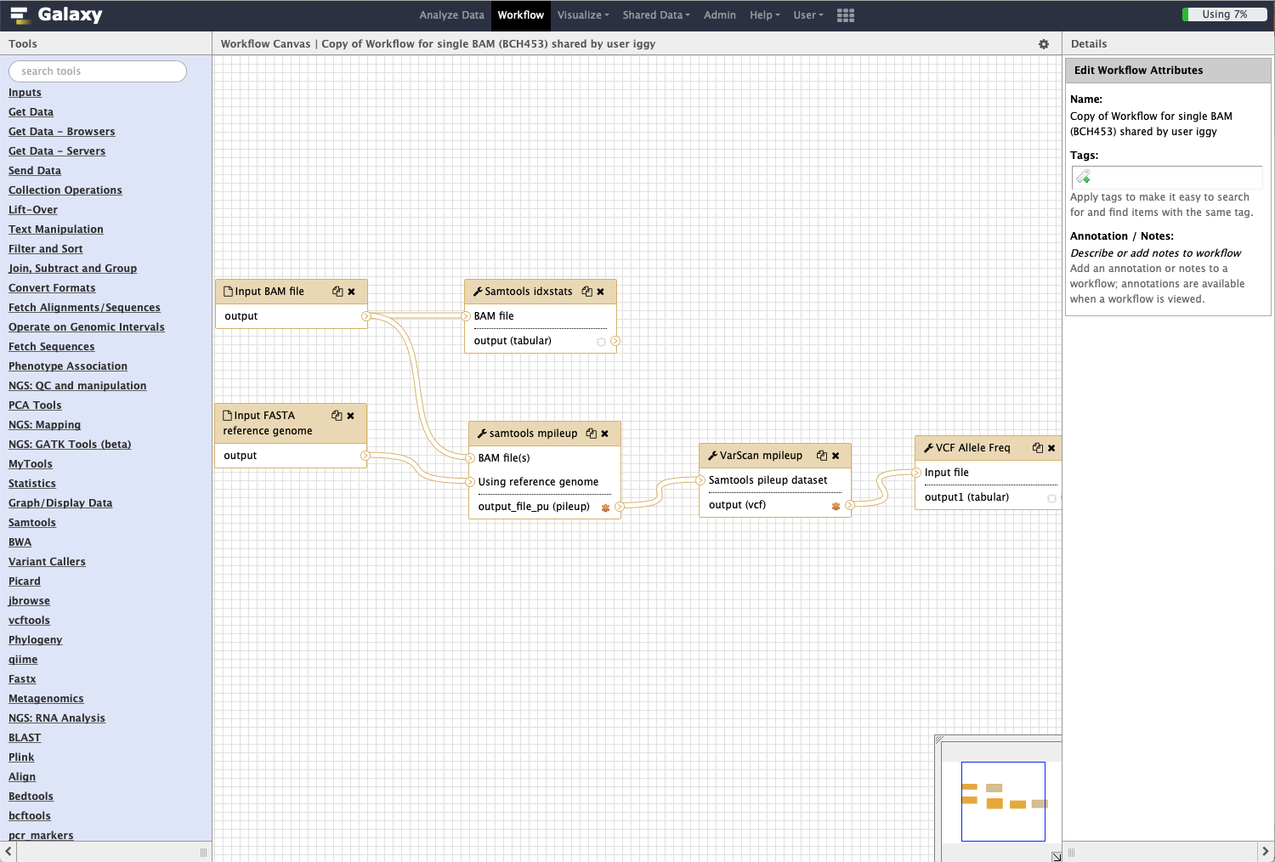
Click on gear icon to see options
Analysis pipeline starting with two input files (single BAM, reference genome) and ending with an allele frequency file
Workflow navigation pane

Slide 16
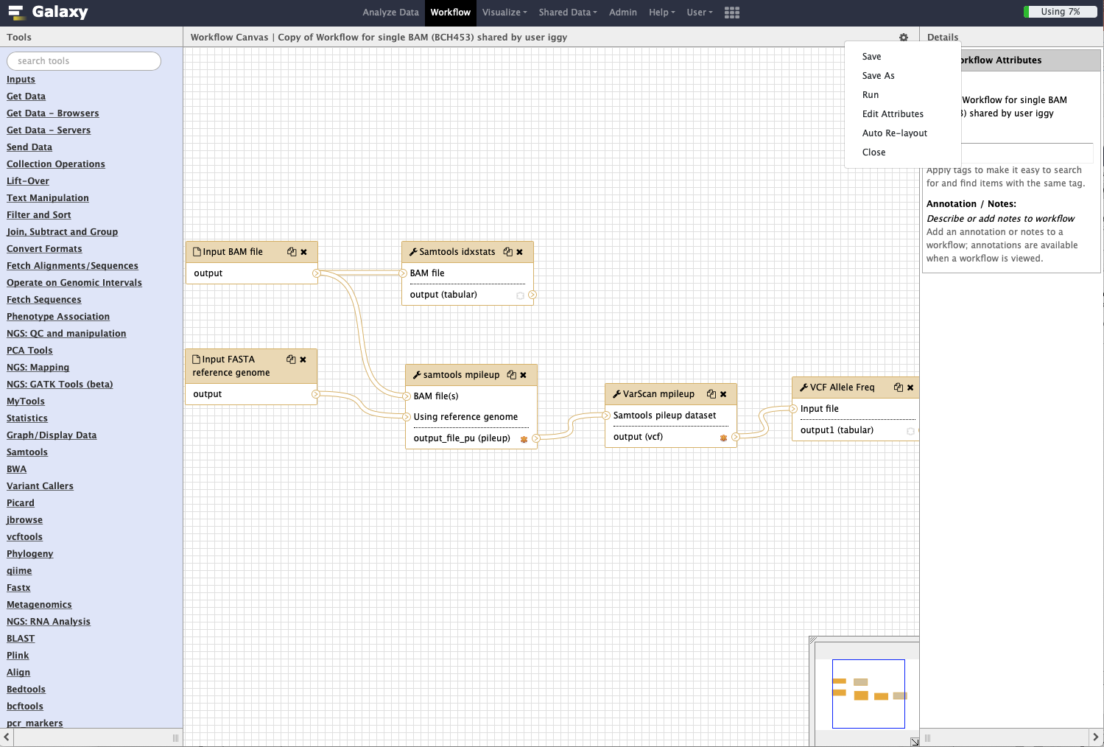
Run the workflow

Slide 17
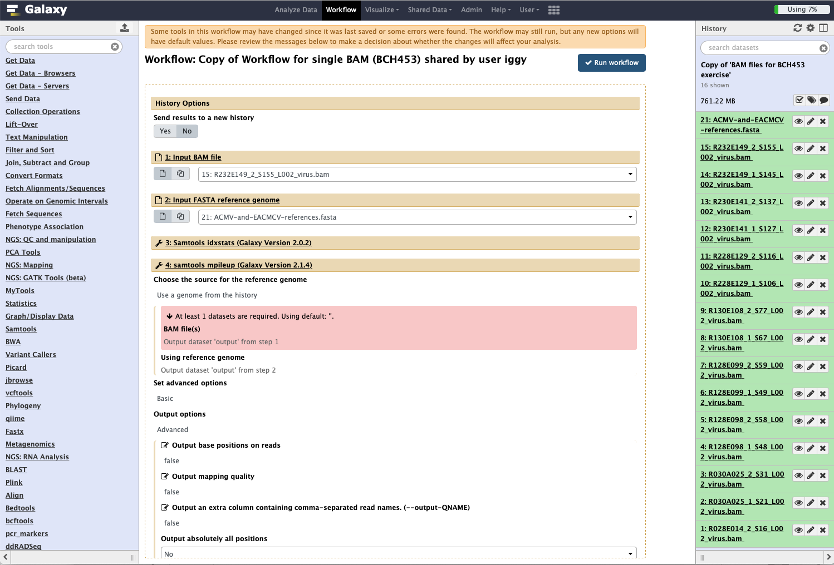
Warns that a file needs to be selected

Slide 18
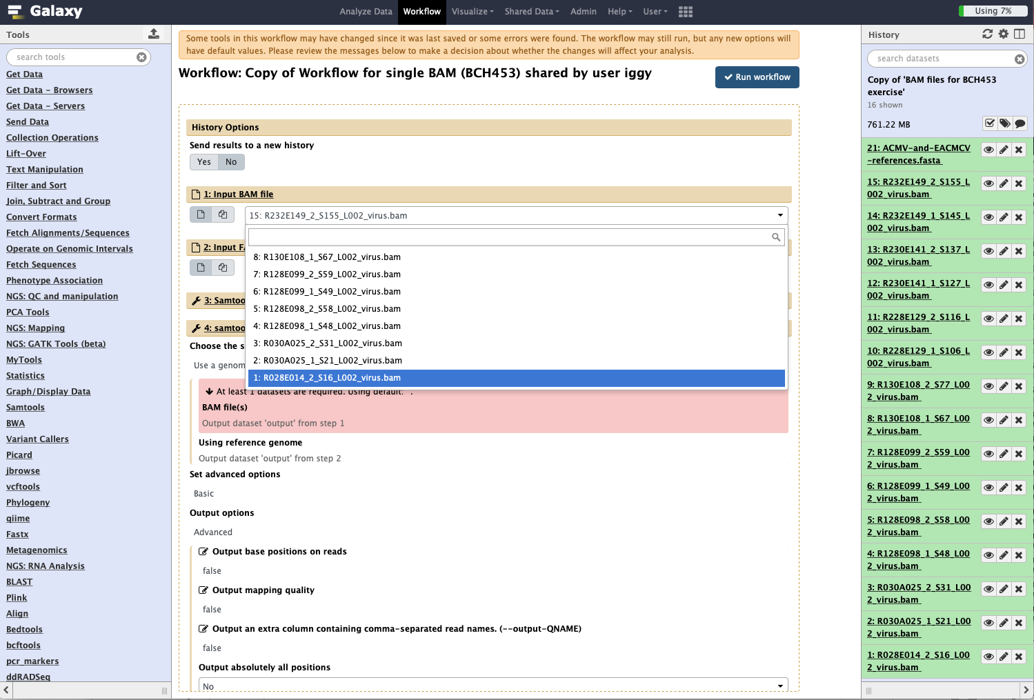
Select the first BAM file from the Input BAM file menu

Slide 19
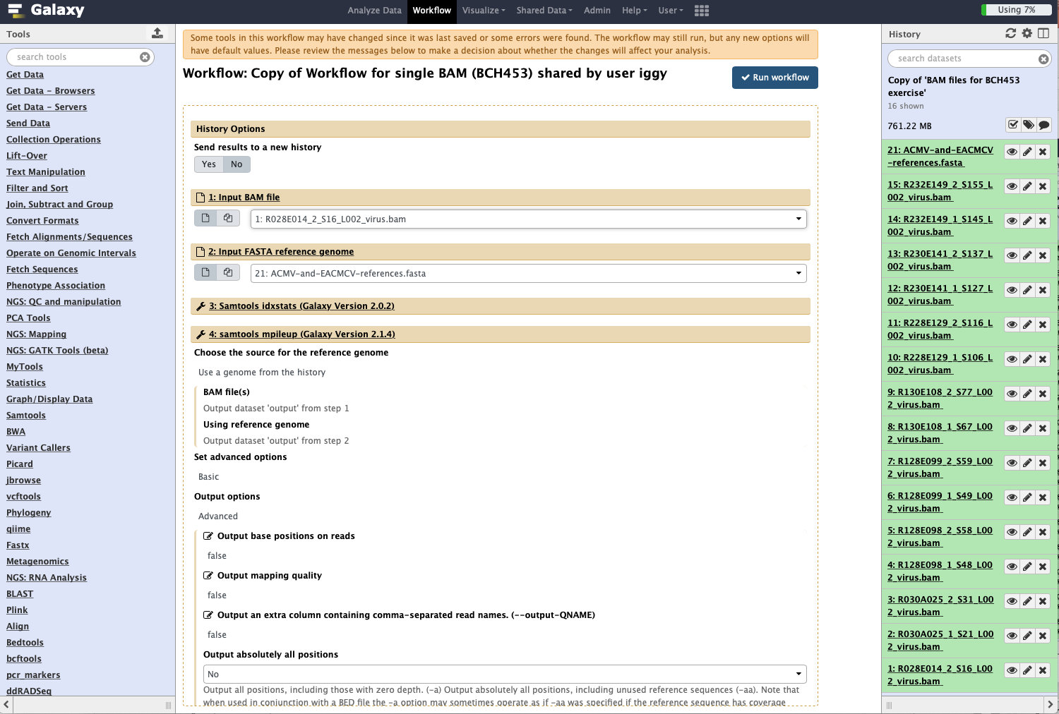
Run workflow

Slide 20
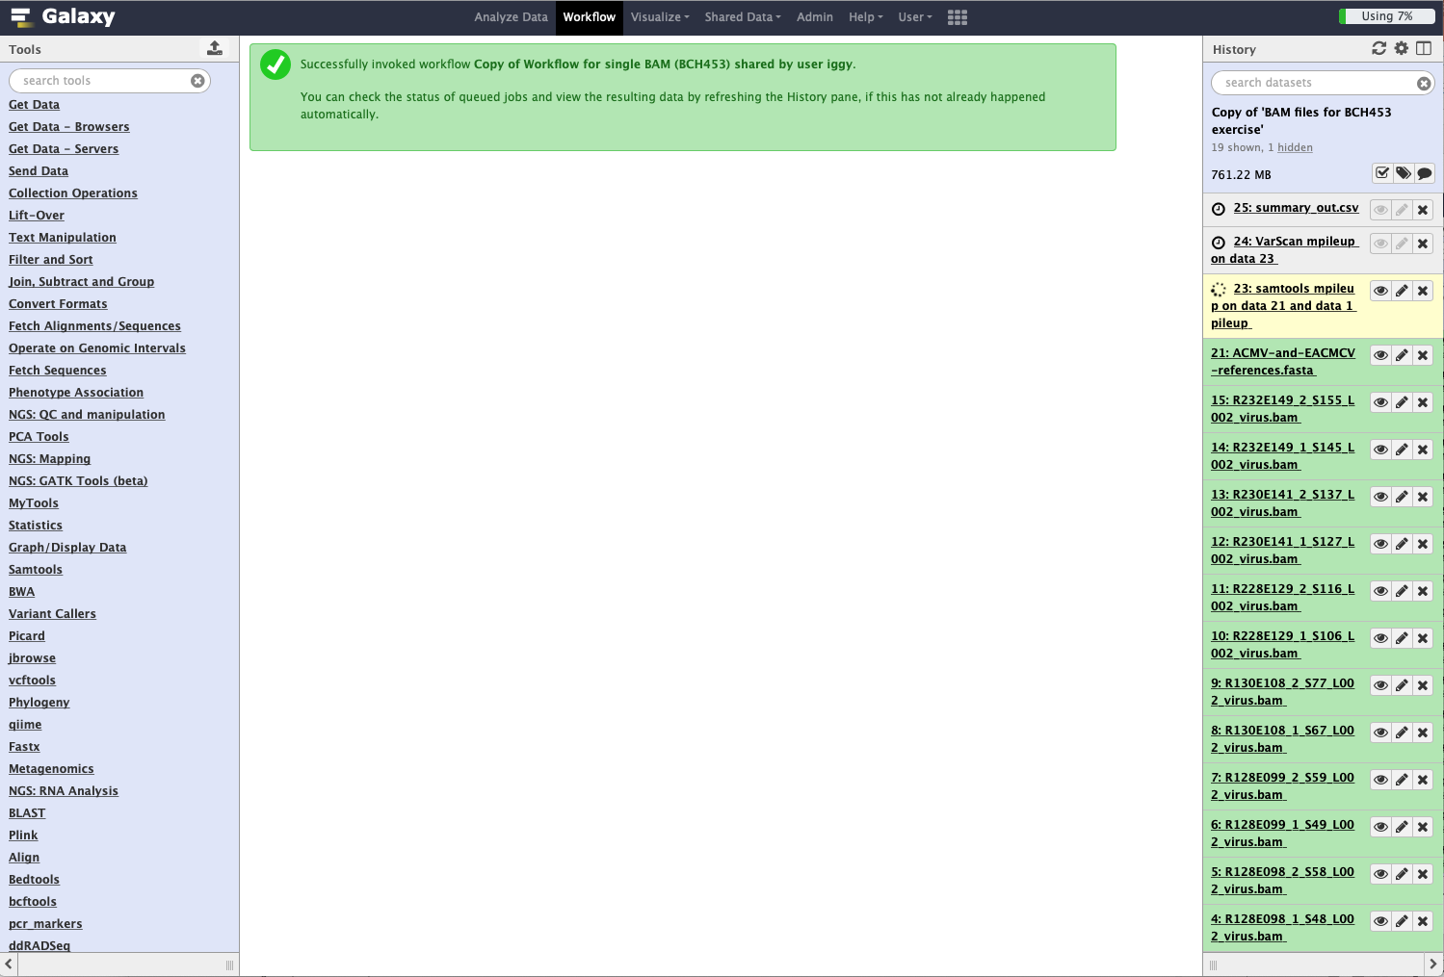
These jobs are in the queue
This job is currently running

Slide 21
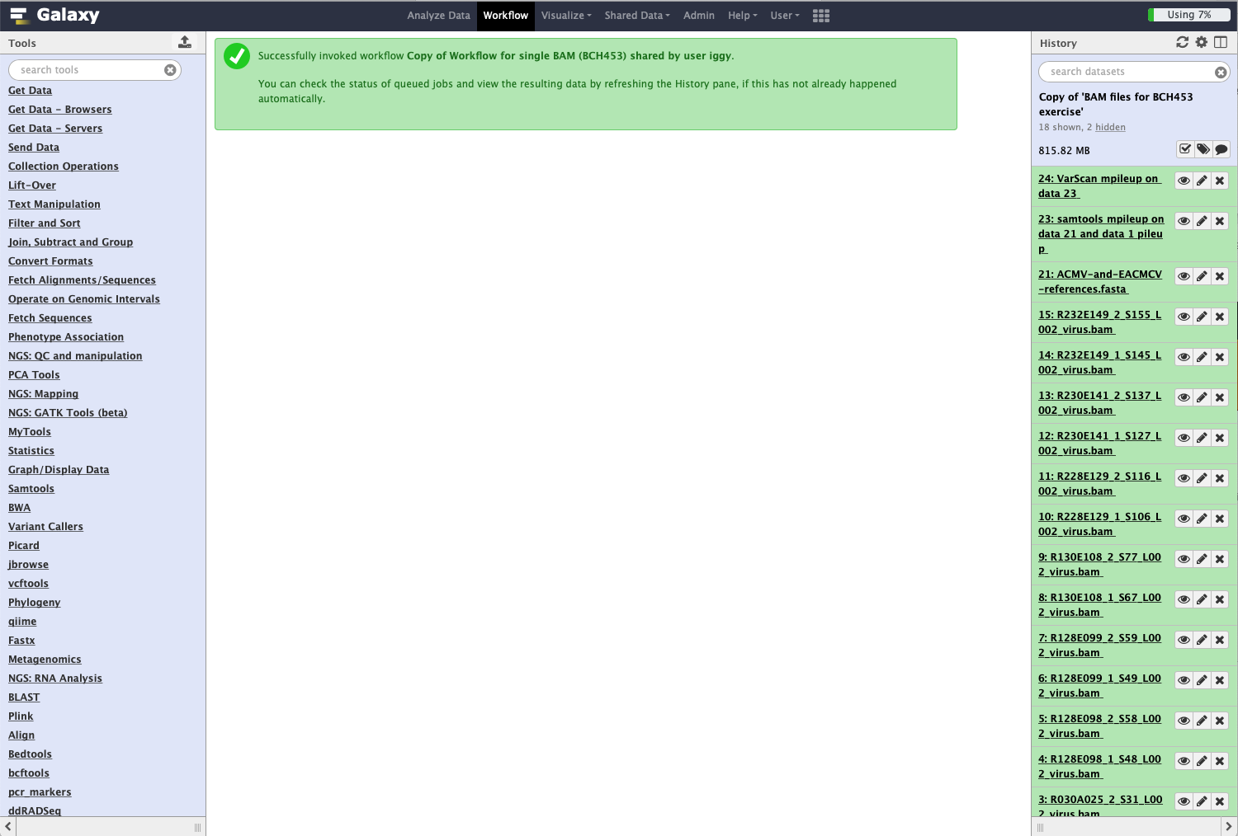
The workflow has successfully finished
Note two jobs are hidden in the history. You need to click here to unhide them

Slide 22
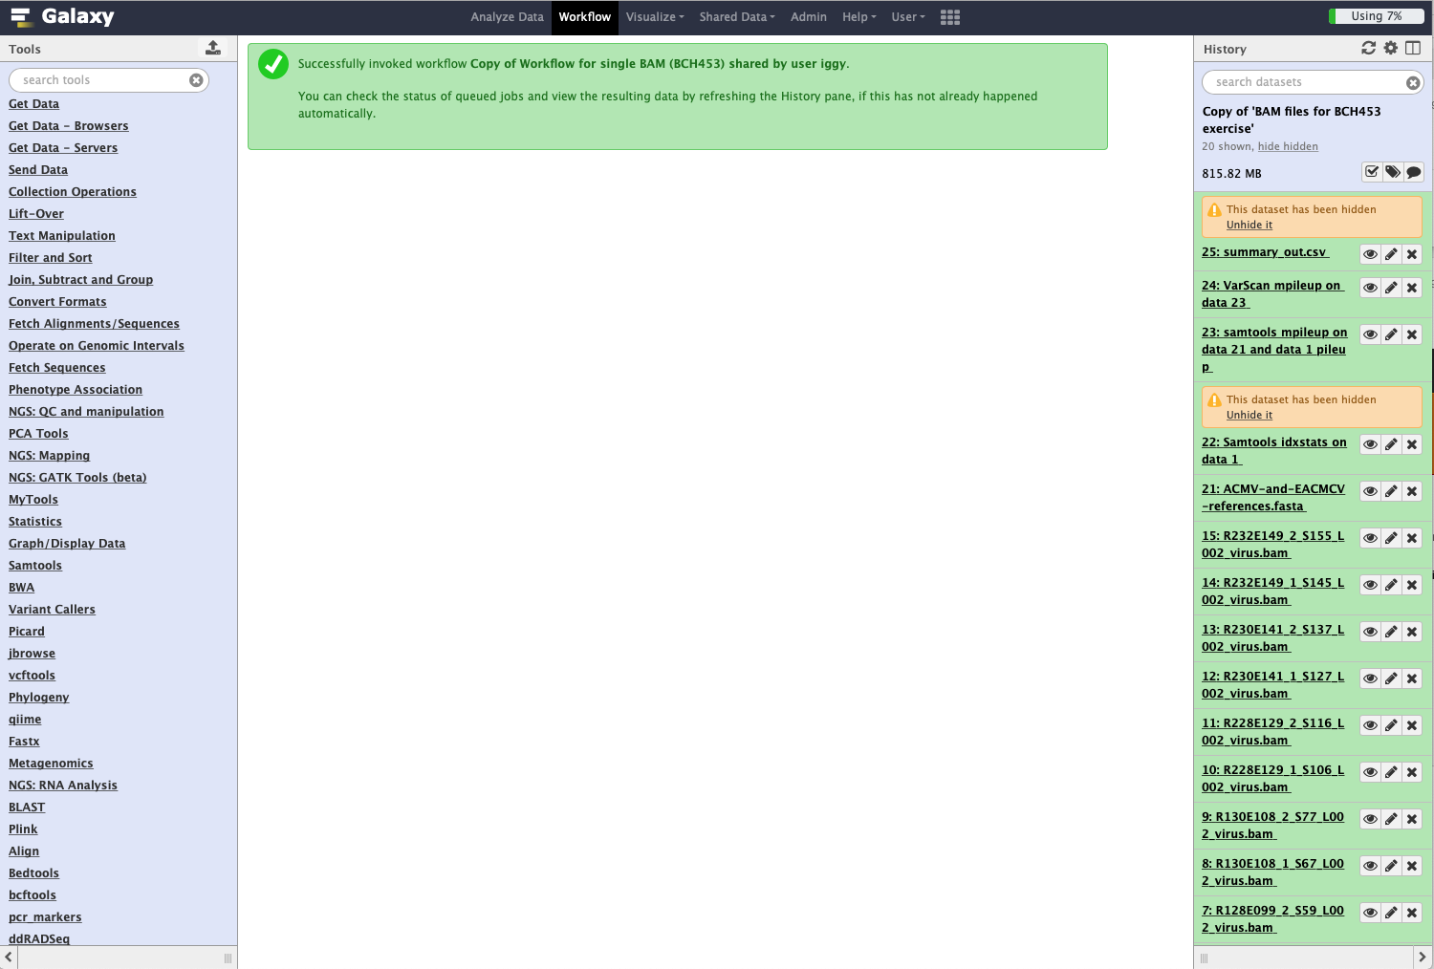
Hidden jobs are now visible

Slide 23
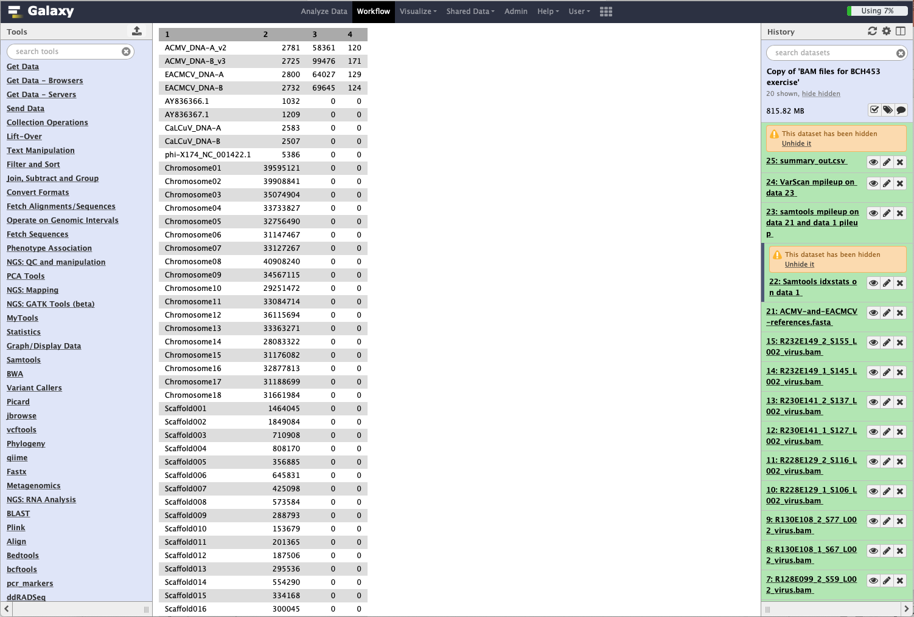
Column Description
---------------------------------------------------------------
1 Reference sequence identifier
2 Reference sequence length
3 Number of mapped reads
4 Number of placed but unmapped reads
(unmapped partners of mapped reads)
Click on the eye icon to view the results of samtools idxstats. Both ACMV and EACMCV are in sample 1

Slide 24

Column Description
---------------------------------------------------------------
1 Reference sequence identifier
2 Reference position
3 Identifier
4 Reference base (A,C,G,T,N)
5 Alternate base(s) – non-reference alleles
6 Sample name identifier
Click to view summary of allele frequencies for different SNPs in sample 1

Slide 25
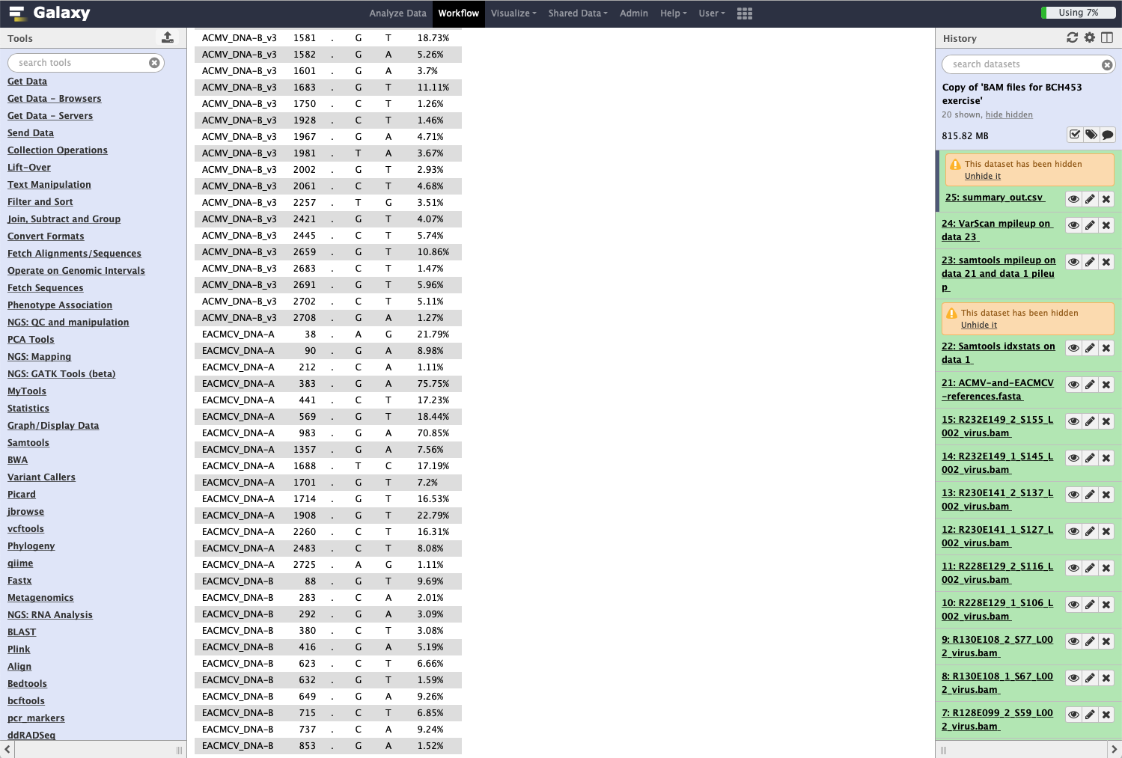
Most common SNP is a G → A transition in the EACMCV segment of sample 1

