Slide 1
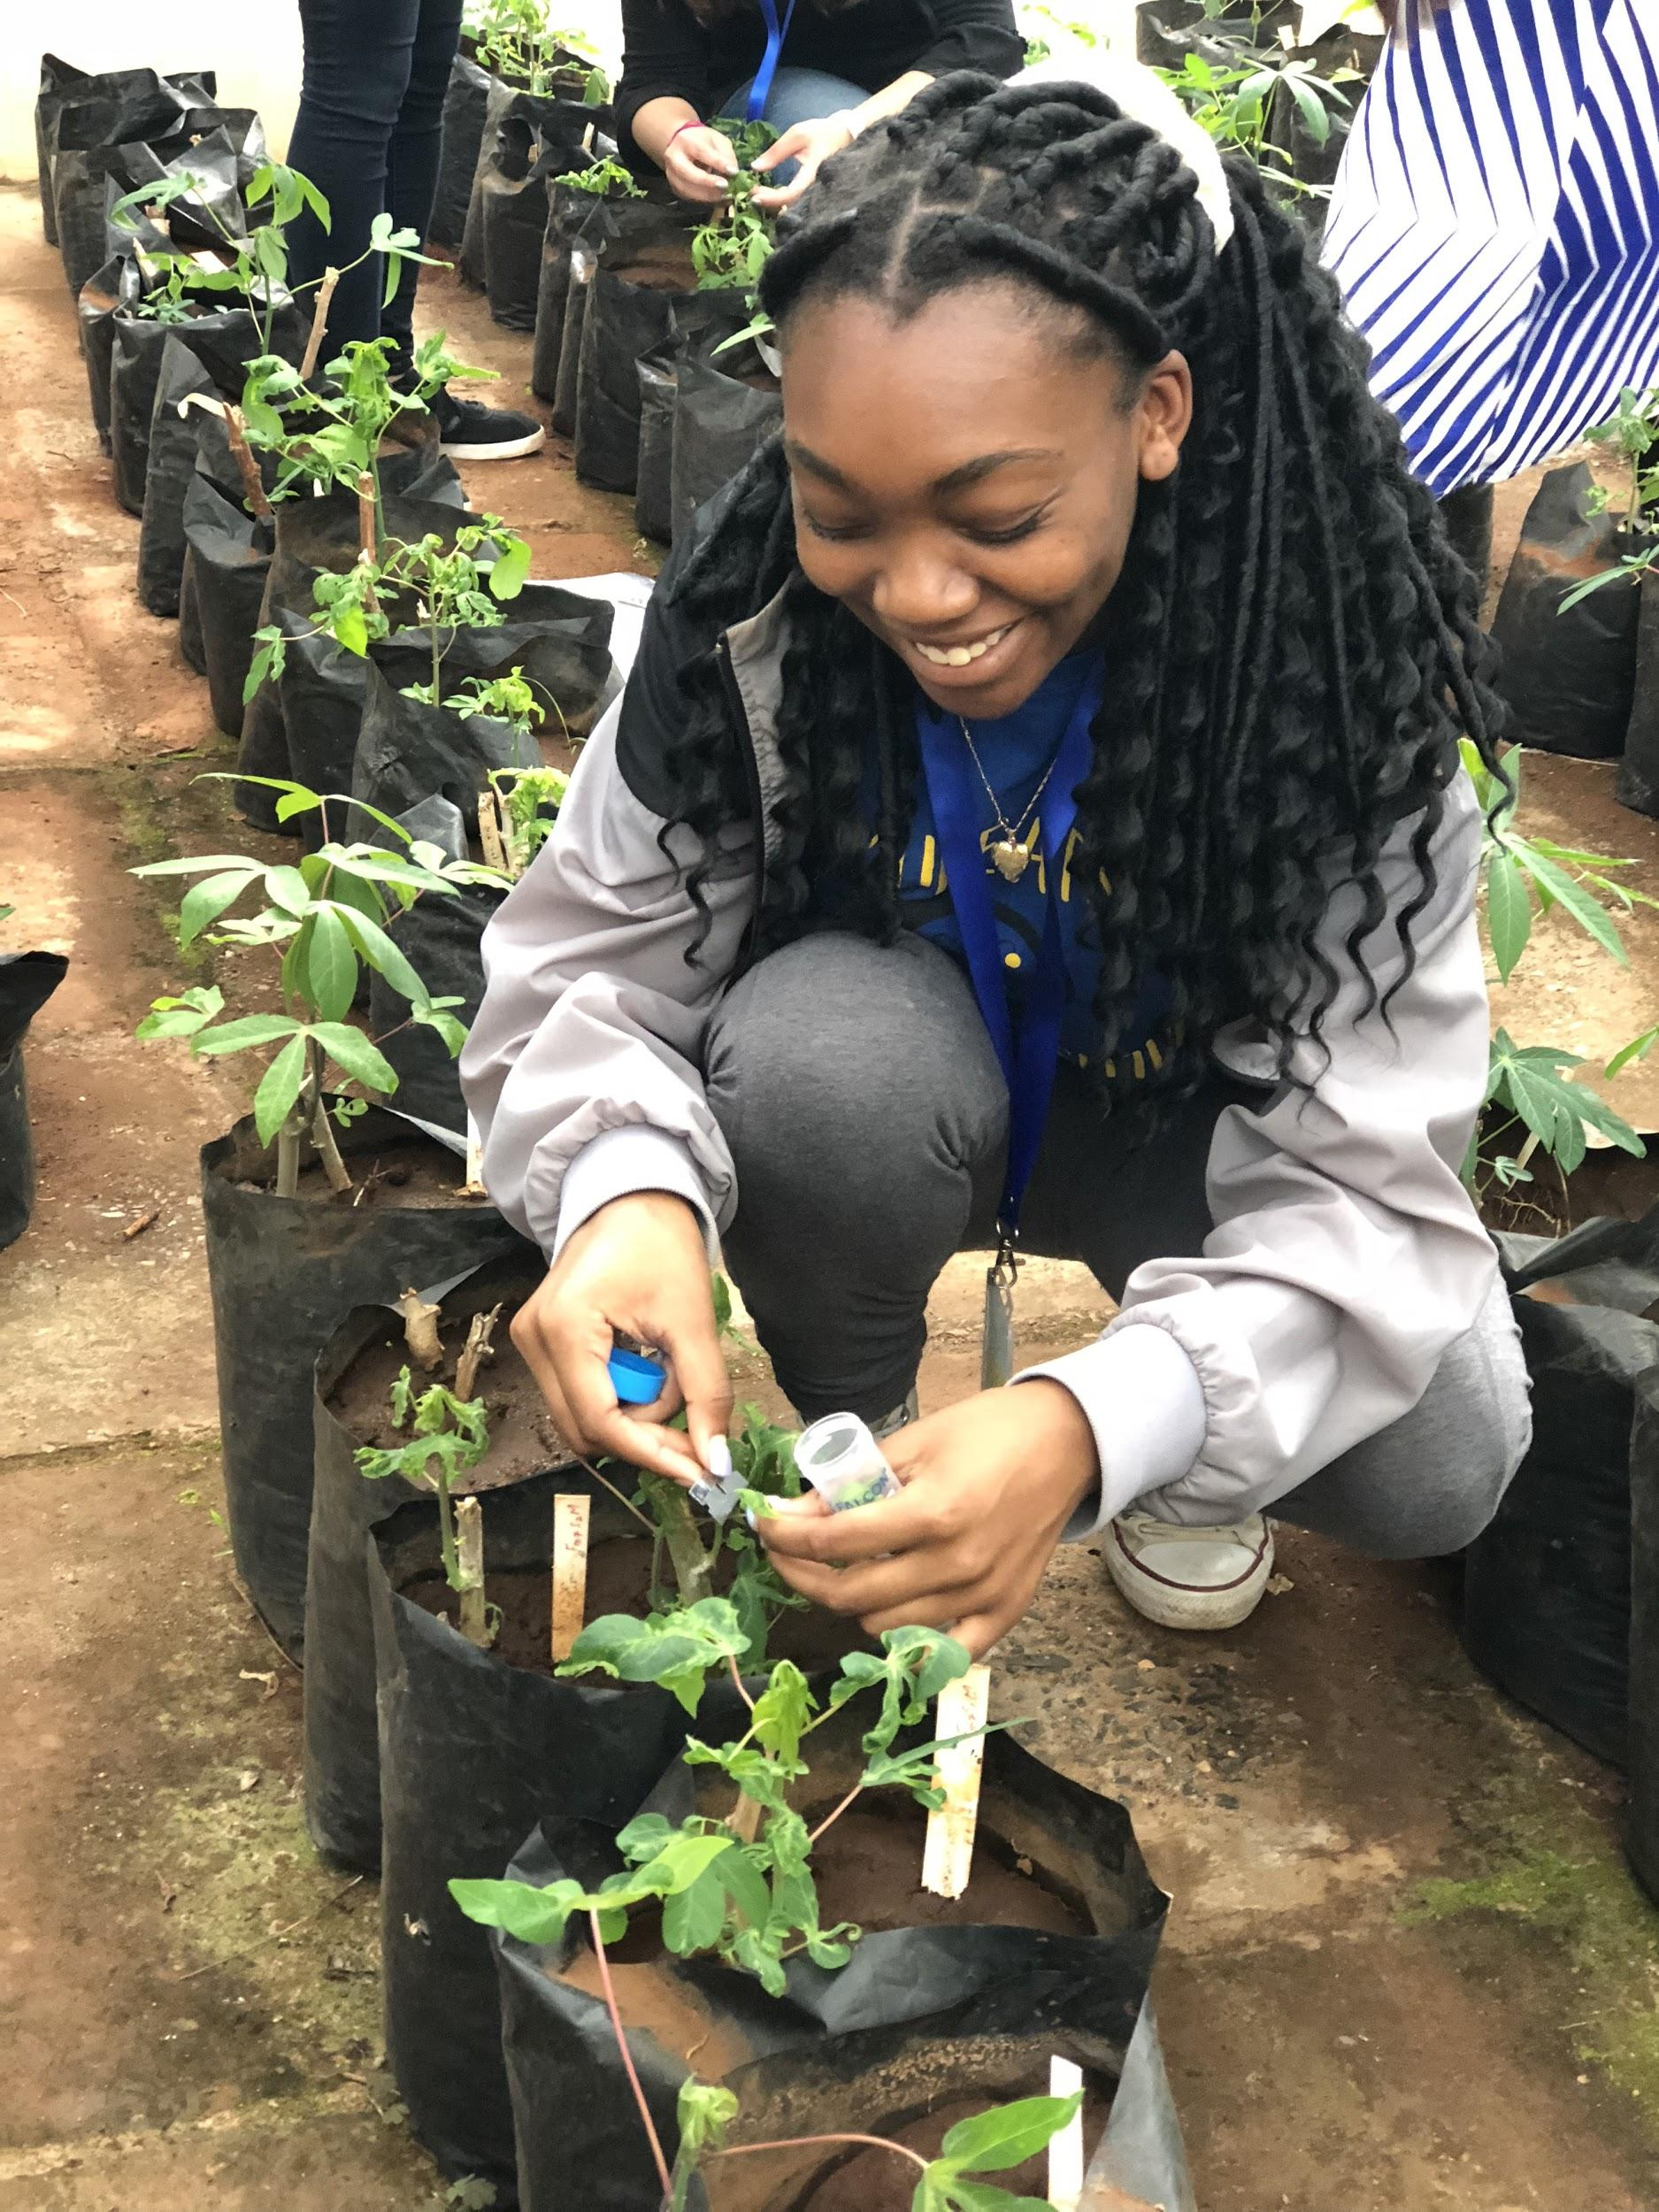
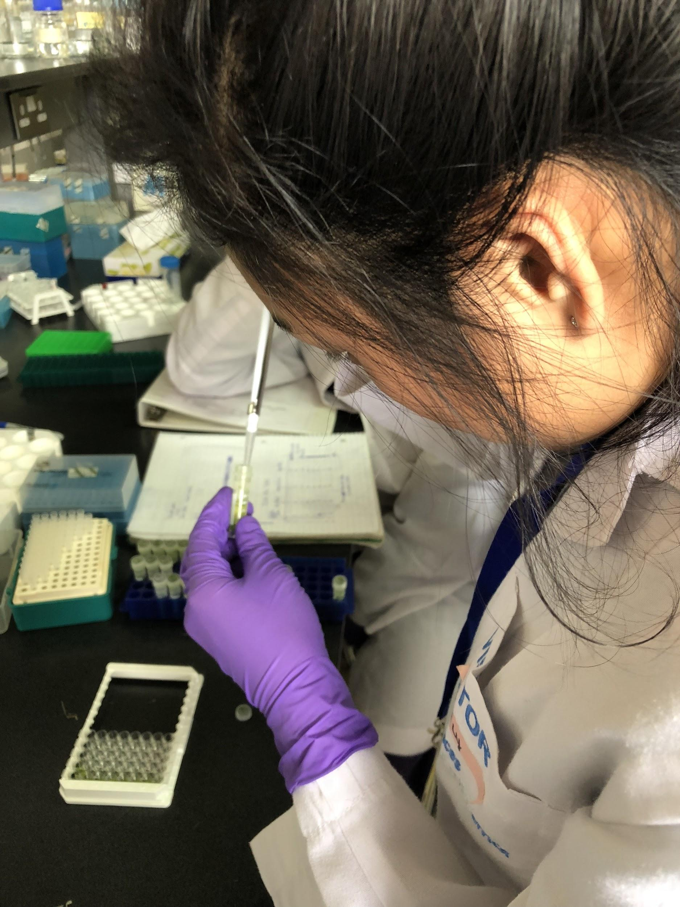
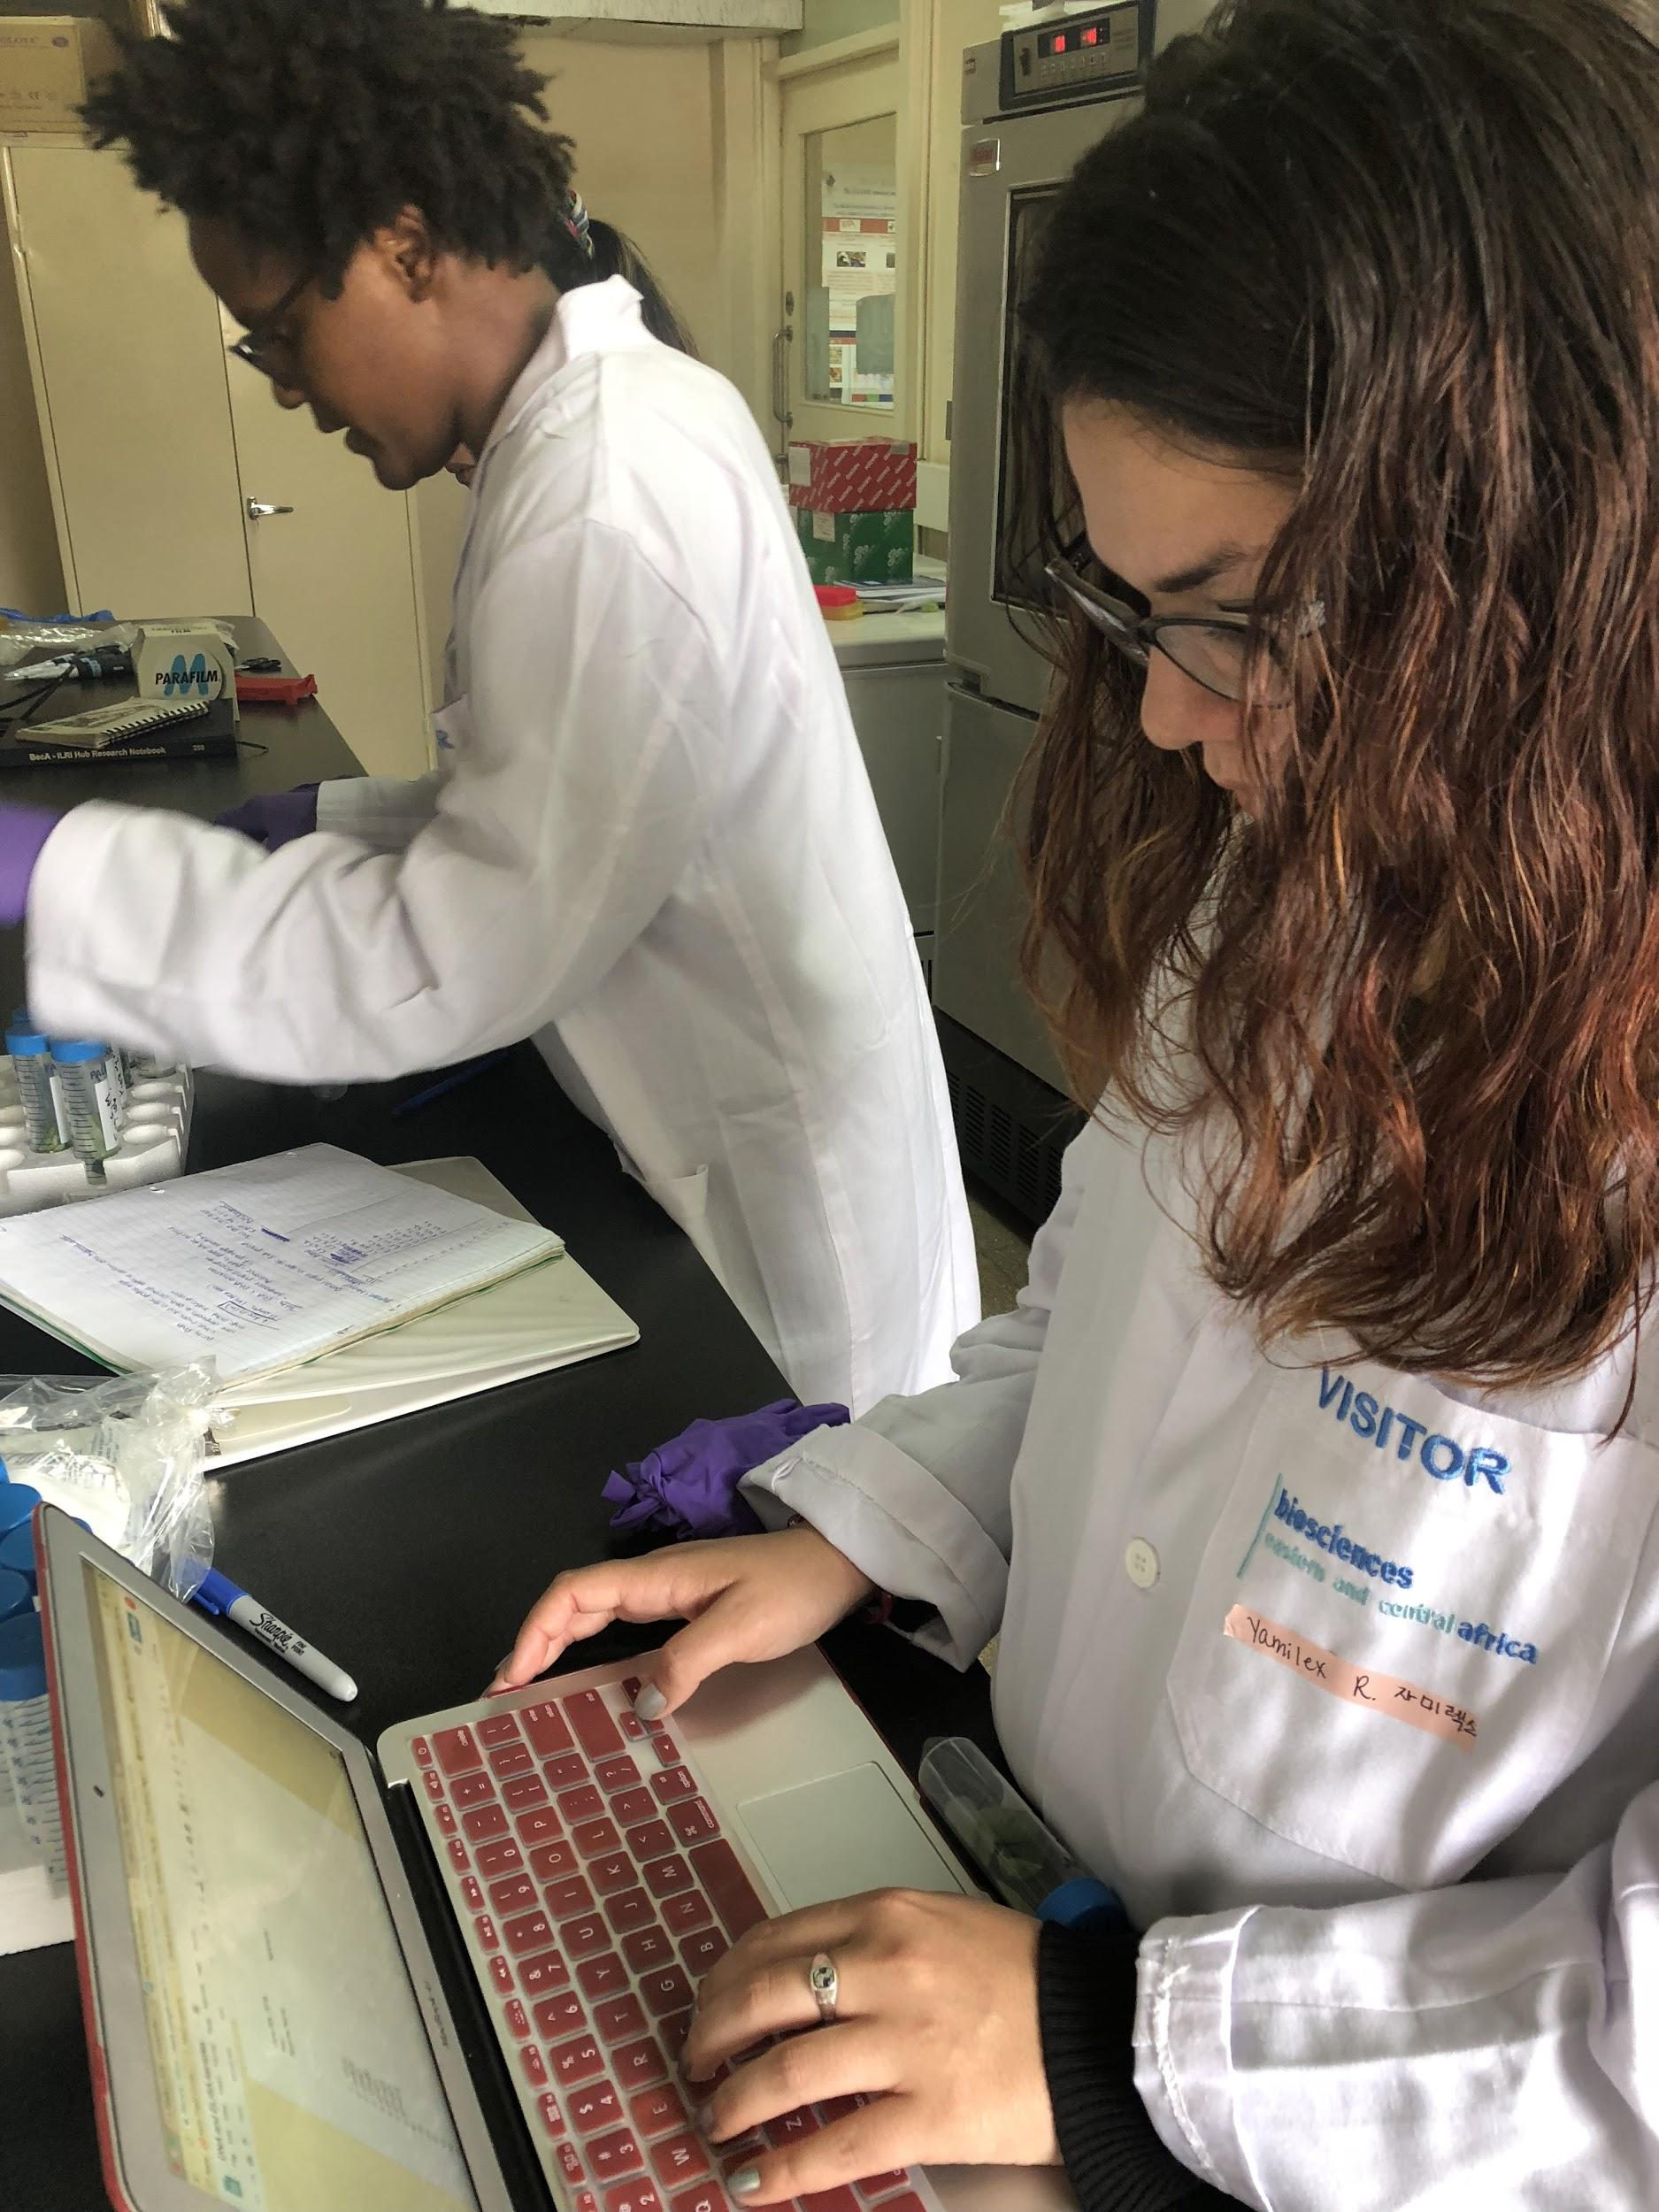
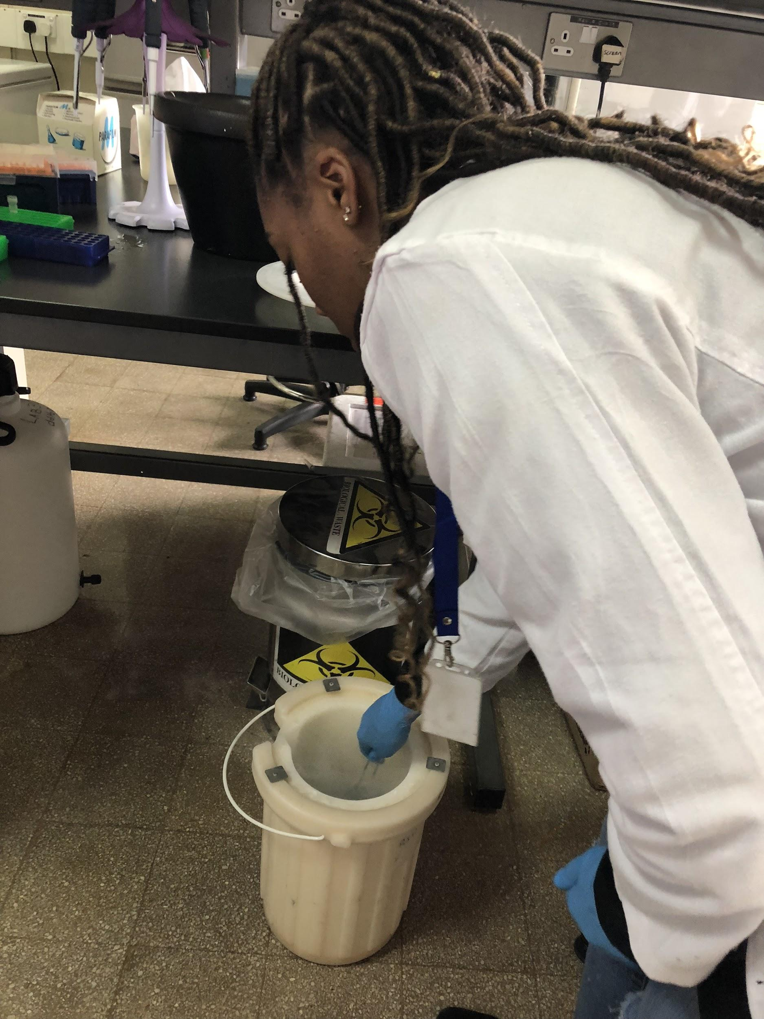
Cassava Mosaic Disease:
Two weeks in Kenya!
Ashley Yancey, Vanessa Ly, Ivori Schley, Yamilex Rosado and Bria Massey (from left clock wise)

Slide 2
Disclaimer: The undergraduate students prepared this presentation on their own, they were told to prepare a presentation for our weekly meeting via Skype (Thursdays from 9-11 am ET). And they were asked to present it to the whole group. It was also brought to their attention that they have only five minutes to present. They came up with this presentation and did a superb job. It has been edited (slightly) by Anna Dye and Trino Ascencio-Ibanez.

Slide 3
Cassava Mosaic Disease:
Two weeks in Kenya!
Vanessa Ly, Bria Massey, Ivori Schley, Ashley Yancey, and Yamilex Rosado

Slide 4
Experiment Objectives
Collect samples from JKUAT (symptomatic & asymptomatic)
Perform analysis
Construct DNA Libraries for sequencing in North Carolina
Evaluate viral evolution in begomoviruses

Slide 5
While In Kenya...
What we did:
What we planned:
Limitations/Setbacks
Made group summary of project description
Collected samples from Greenhouse (JKUAT and Rod’s samples from ILRI greenhouse)
DNA Purification & RNA Purification
Virion Nucleic Acids Purification
ELISA (sandwich & strip method)
Gel Electrophoresis
DNA/RNA Nanodrop
PCR
RCA
qPCR
Whitefly Rearing
DNA purification with Aphids
Data Analysis on PCR
Samples Collected
DNA/RNA Purification
ELISA
PCR
RCA
Whitefly Rearing
Lost 2013 samples from JKUAT
Negative Results from PCR
Sealing tape for plates defective, loss of samples
Inconclusive Results from Immunological Detections
Notes:
Before coming to Kenya, we a plan in place for what we would be doing over these 2 weeks. This plan consisted of:...(bullet points)
Collecting Field Samples from JKUAT
2 Separate years: 2015 & 2017
ELISA
Sandwich method
Stick Method
DNA/RNA Purification
PCR
RCA
Virion Purification

Slide 6
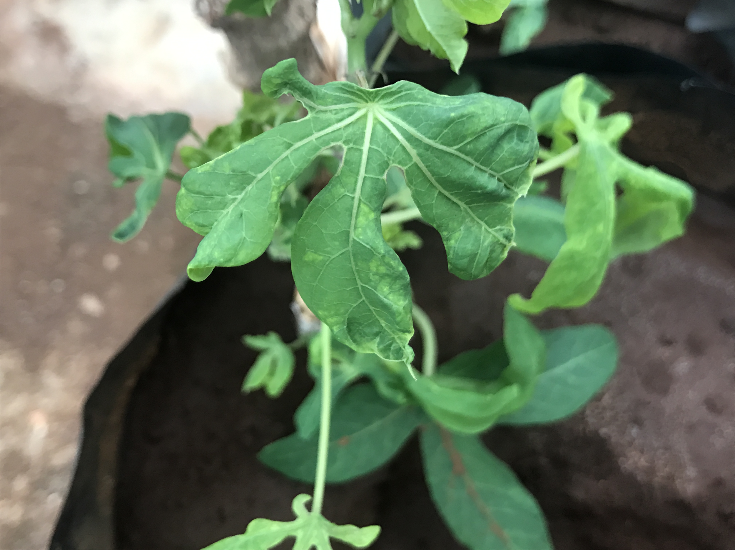
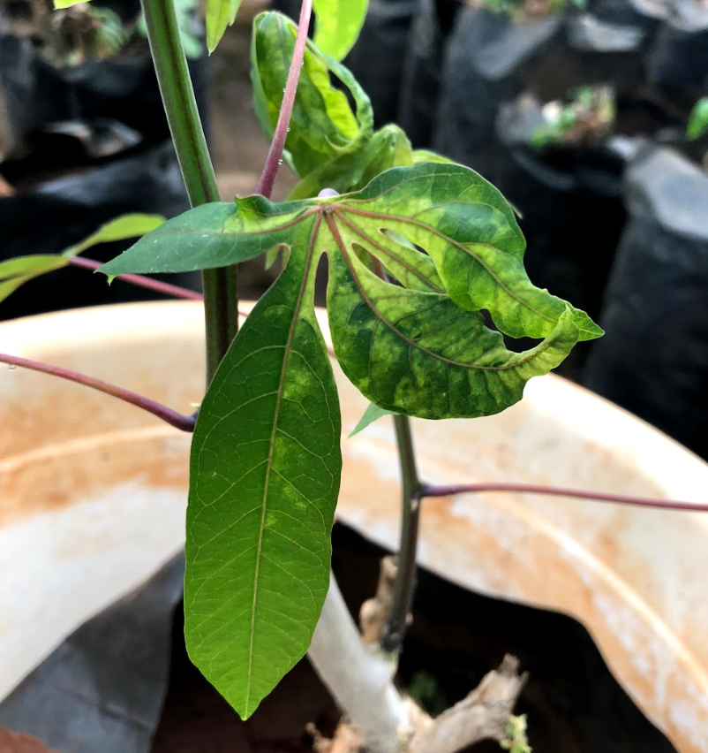
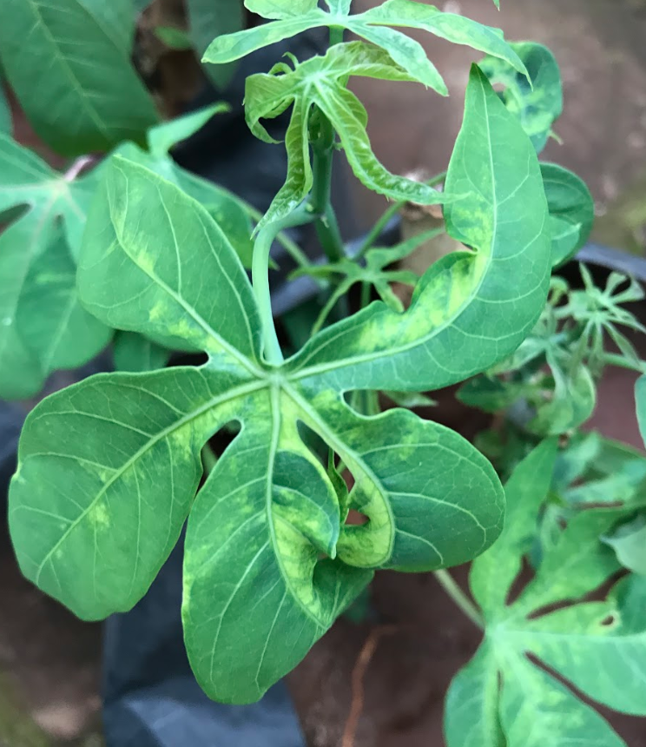
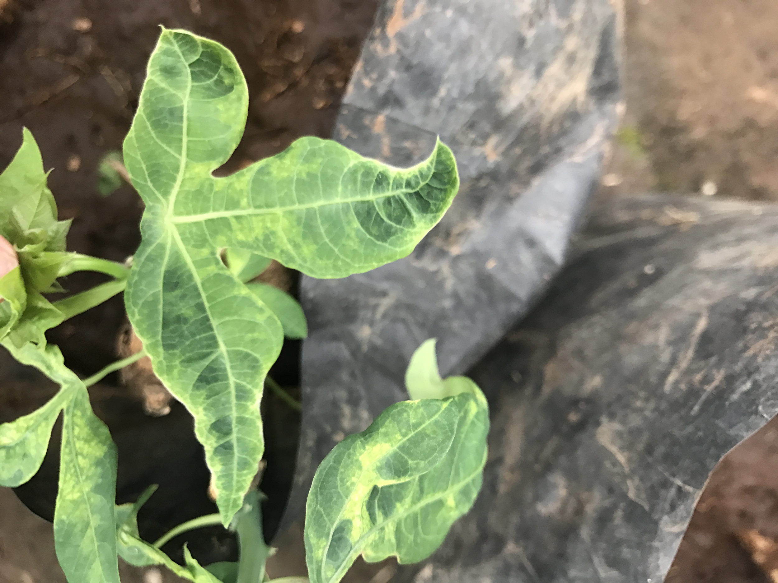
Sample Collection
Coastal, Western, and Eastern are 2015 samples
2017
Eastern
Coastal
Western
Notes:
Discuss Collection from 4 different regions in Kenya and 2 different years. Also, original sample collection (unknown status).

Slide 7
After Sample Collection…
Immuno Detections
NUCLEIC ACIDS ISOLATION
VIRION NUCLEIC ACID PURIFICATION
STRIP METHOD
DNA
RNA
ELISA
Nanodrop
RCA
Gel Electrophoresis
PCR
qPCR
Nanodrop
All Samples
Aliquots for Shipping
Gel Electrophoresis
Data Analysis
Notes:
This is a description of the methodology we performed. Not what we will we doing for each of the samples

Slide 8
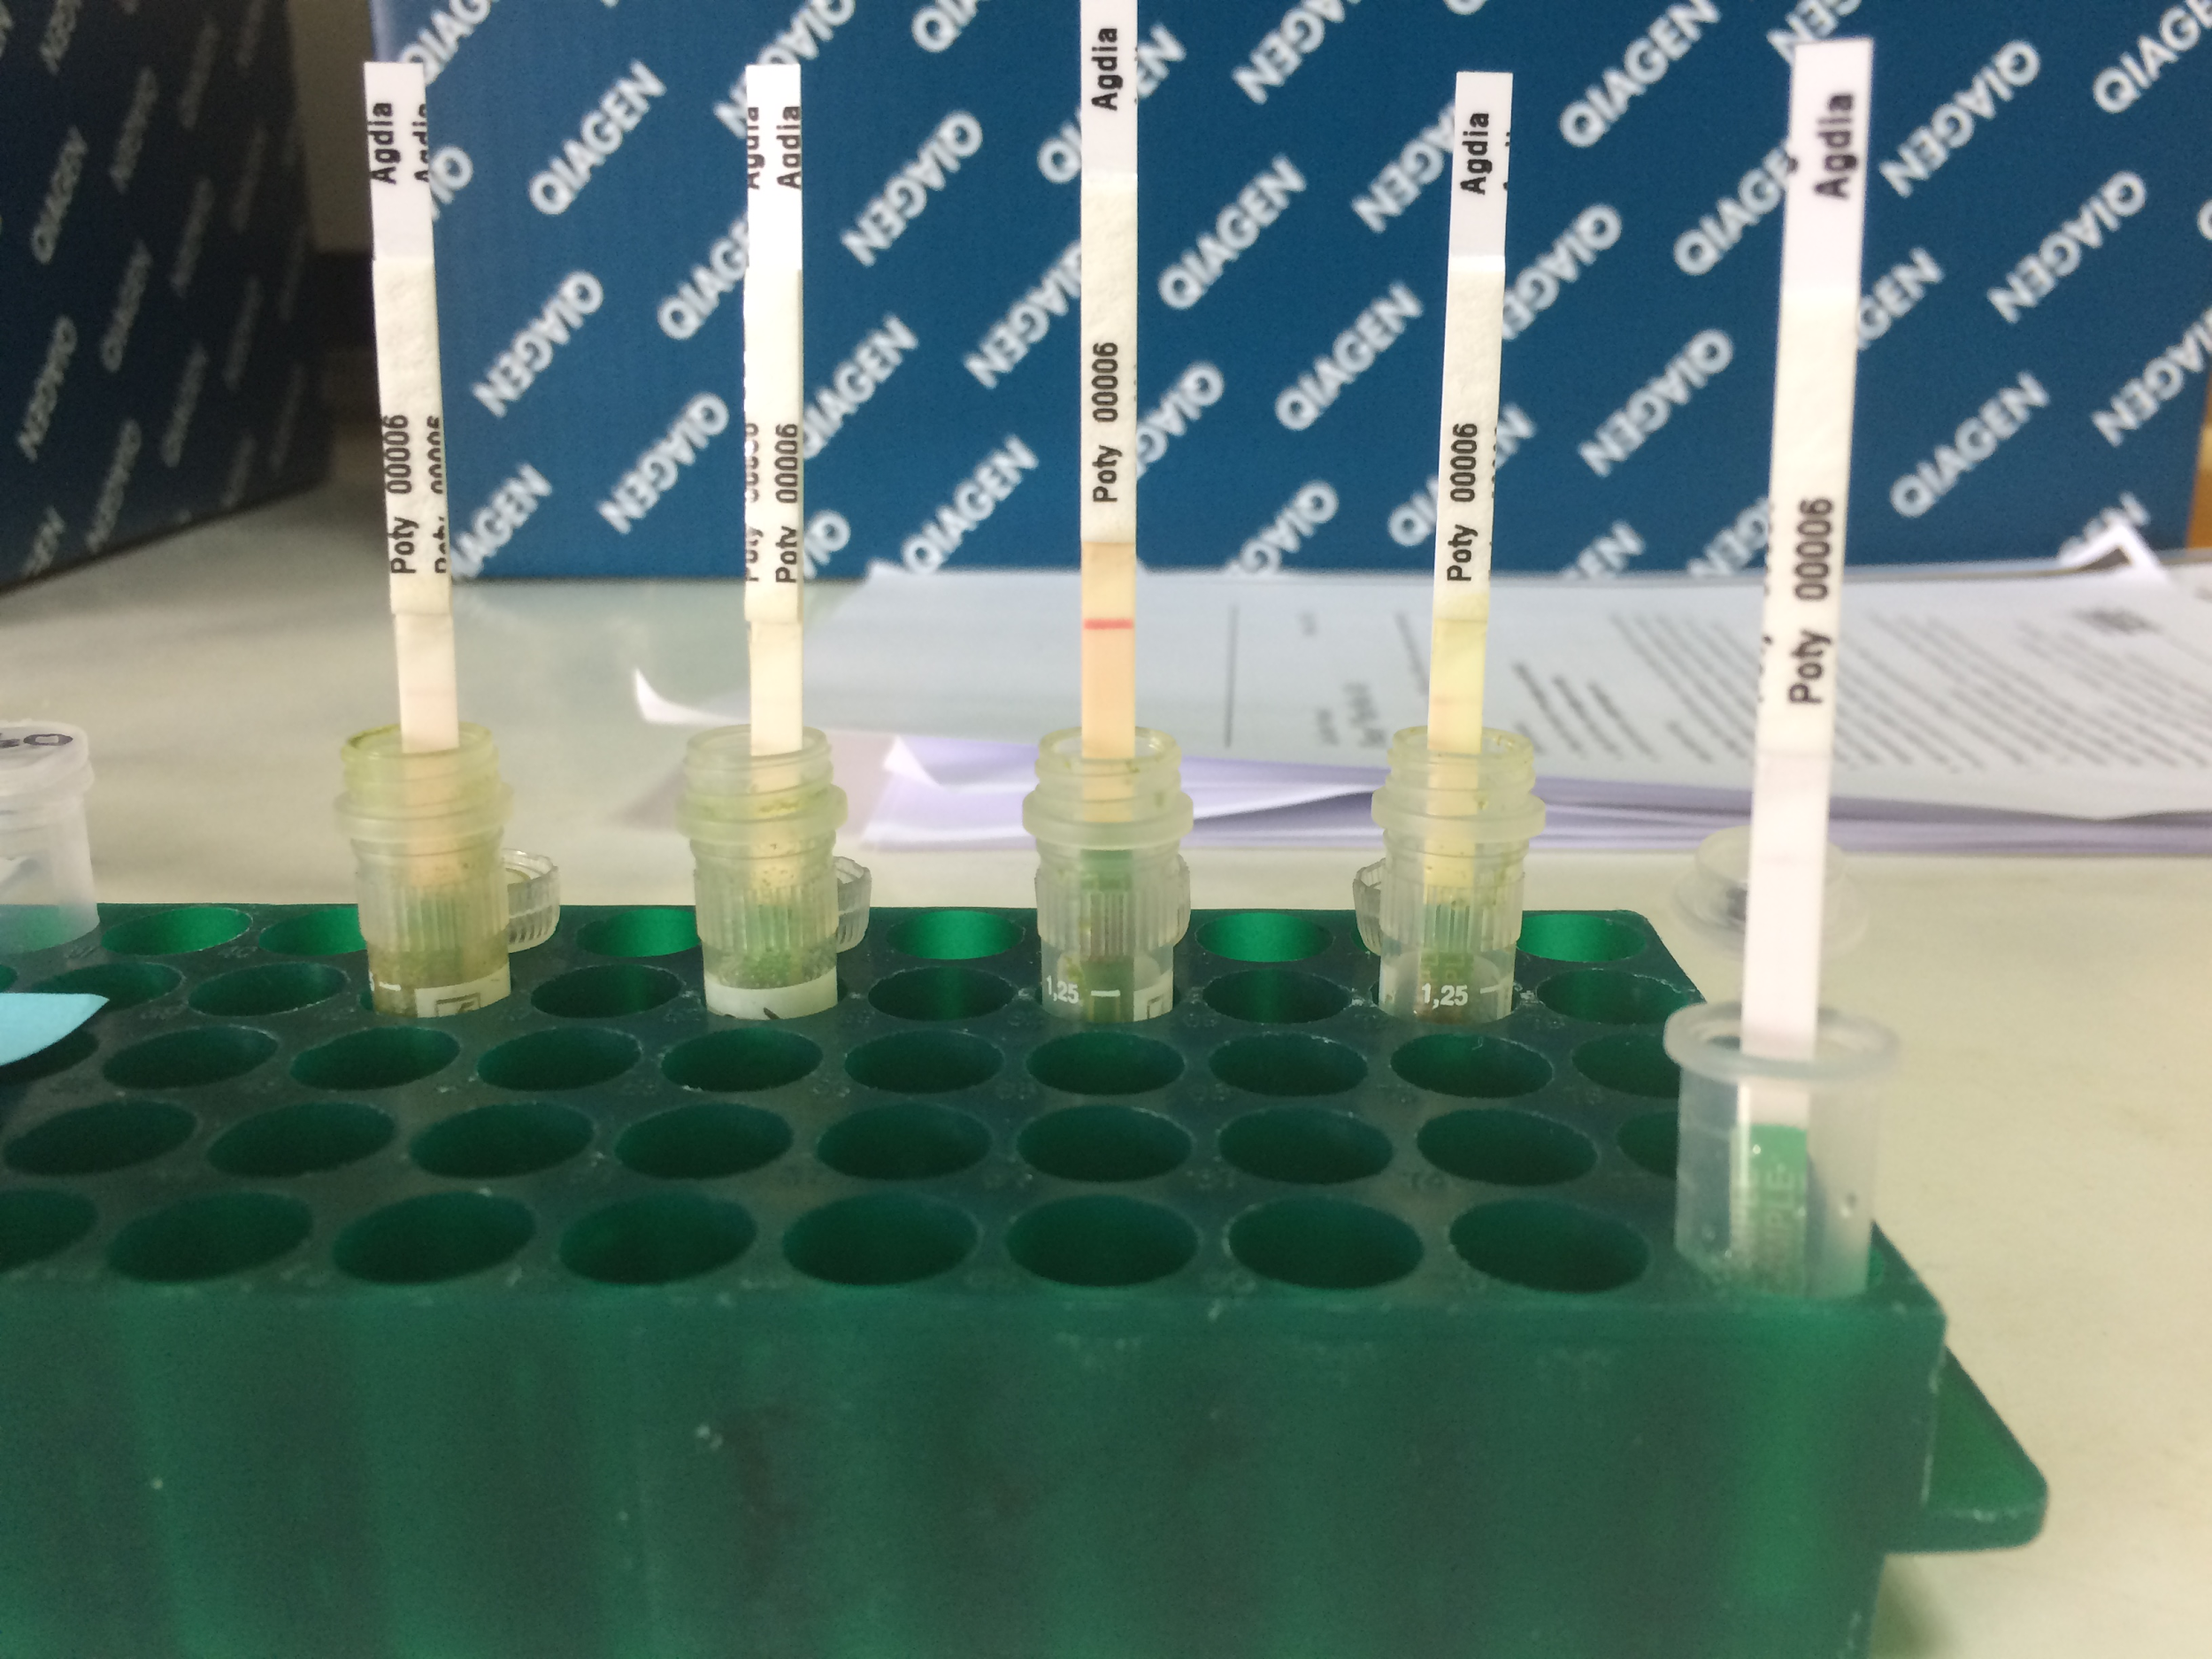
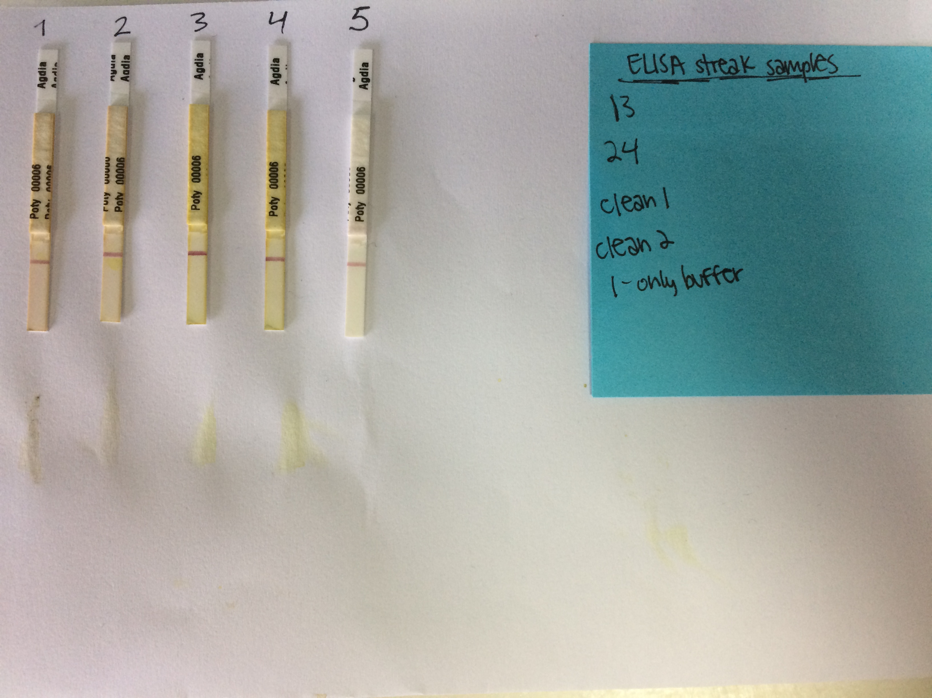
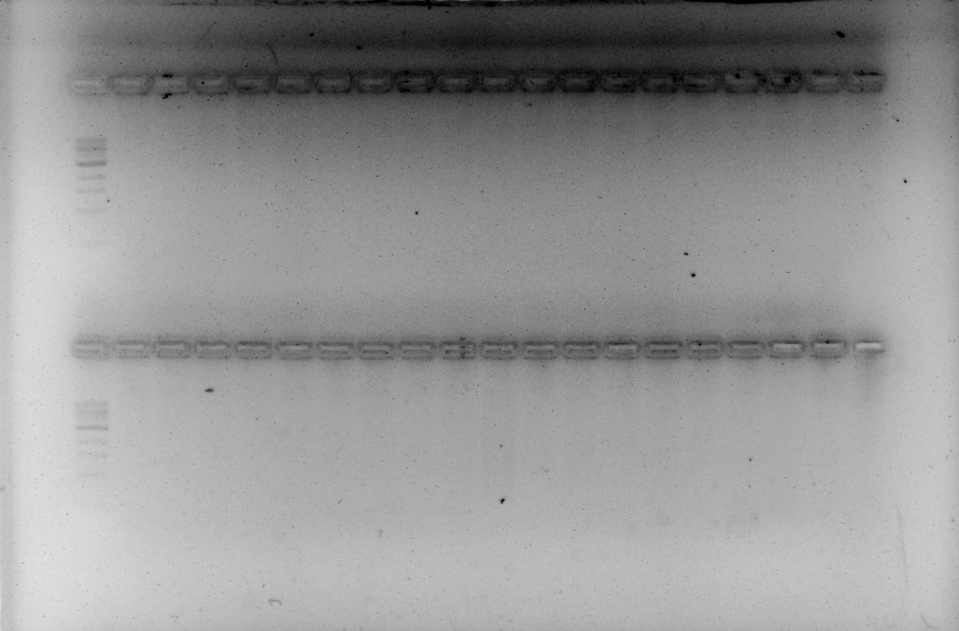
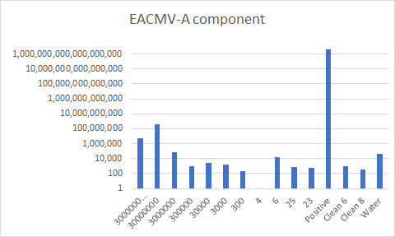
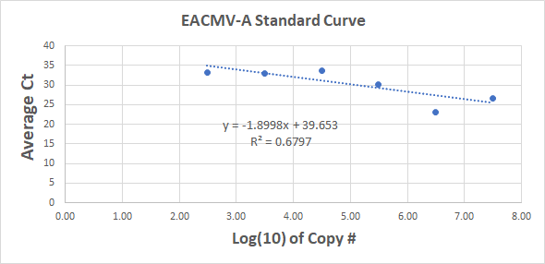
Results
ELISA (Stick Method)
EACMV PCR
ACMV PCR
Data Analysis (qPCR)
DNA Purification Gel Electrophoresis
Notes:
Why did our gels fail?
-contaminantion
(PCR & qPCR): From our results, we can conclude that our data shows negative for EACMV (A component). Our expected data should reflect a decreasing bar graph (copy # decreasing) representing a standard curve used to measure our PCR data. The “Positive” was extremely concentrated, resulting in high copy #. Our “Positive” should not be higher than DNA sample in well B5 (Dilution: 30000000), but yields concentrations greater than twice the amount. Samples 6, 25 and 23 is greater than Clean 6 and 8. We can infer that EACMVA is not present in these samples.

Slide 9
Results
Unfortunately, the PCRs didn’t work, we did
something wrong with the reaction ☹
The immunological results were inconclusive:
One method said yes, the other said no.
ELISA (Stick Method)
EACMV PCR
ACMV PCR
Our qPCR data is not perfect but we had a linear
regression that could be used to estimate viral
titers.
The total DNA purifications worked really well !!!
Data Analysis (qPCR)
DNA Purification Gel Electrophoresis
Notes:
Why did our gels fail?
-contaminantion
(PCR & qPCR): From our results, we can conclude that our data shows negative for EACMV (A component). Our expected data should reflect a decreasing bar graph (copy # decreasing) representing a standard curve used to measure our PCR data. The “Positive” was extremely concentrated, resulting in high copy #. Our “Positive” should not be higher than DNA sample in well B5 (Dilution: 30000000), but yields concentrations greater than twice the amount. Samples 6, 25 and 23 is greater than Clean 6 and 8. We can infer that EACMVA is not present in these samples.

Slide 10
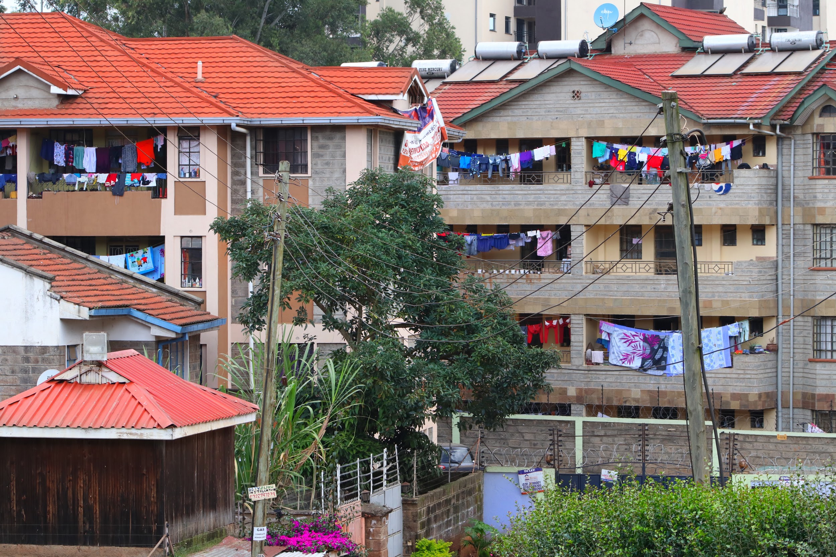
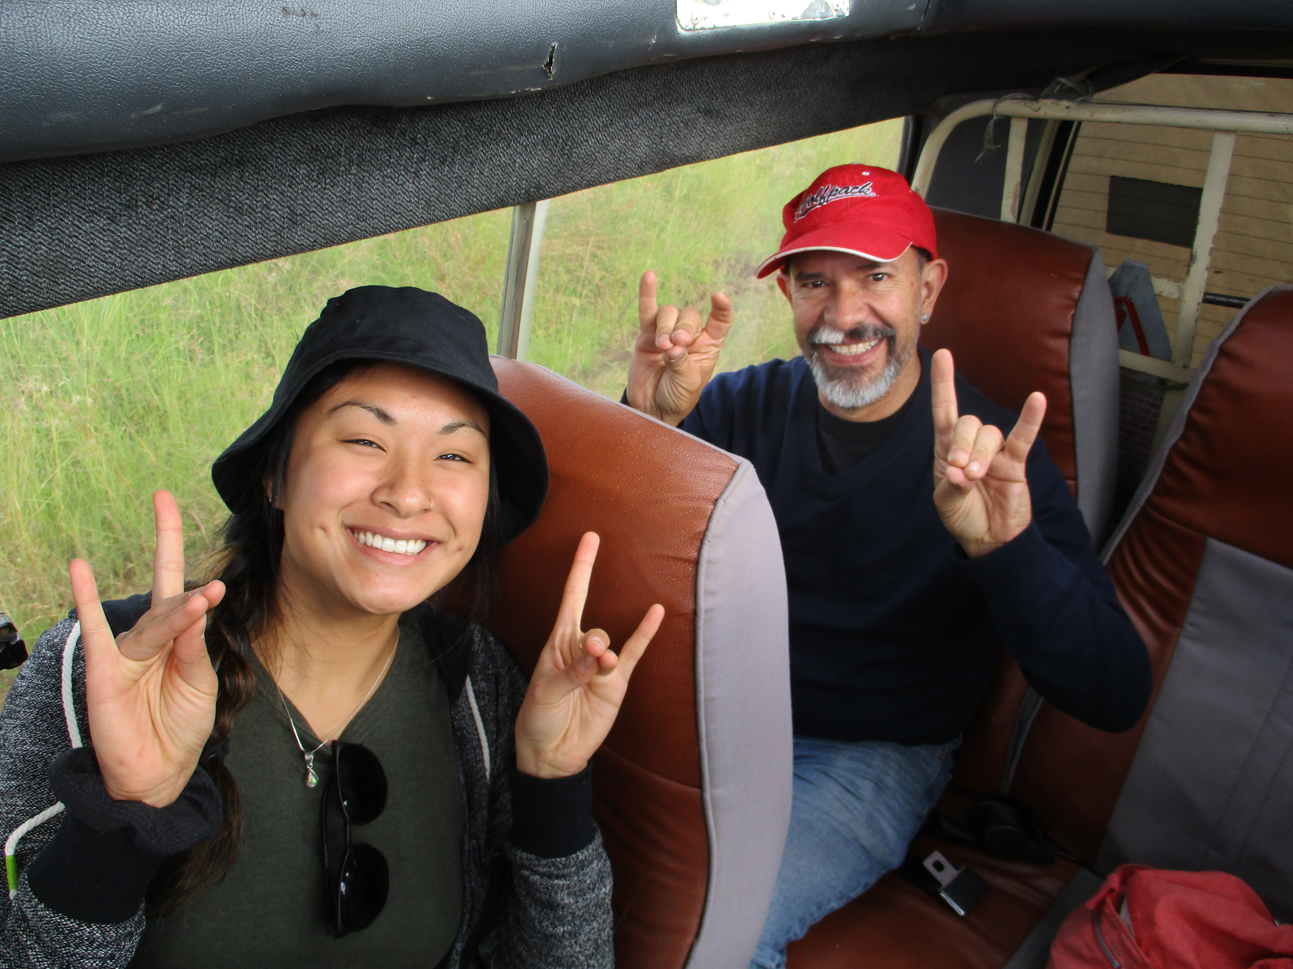
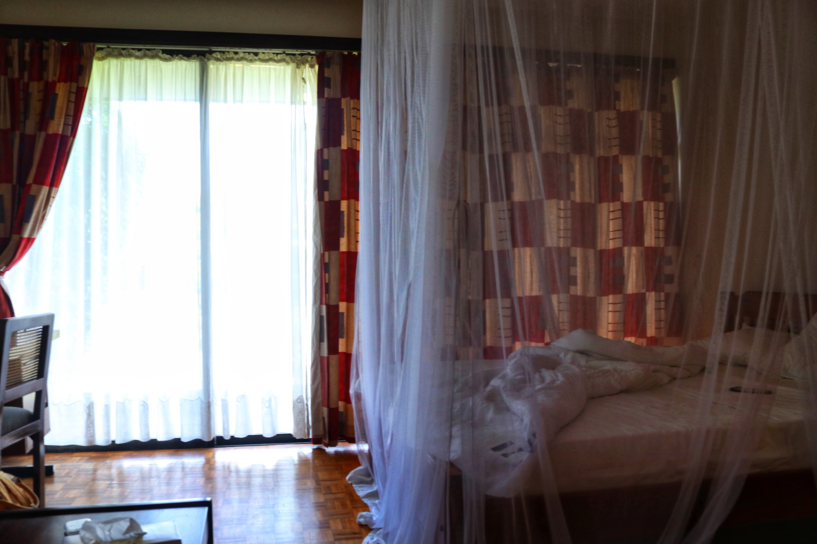
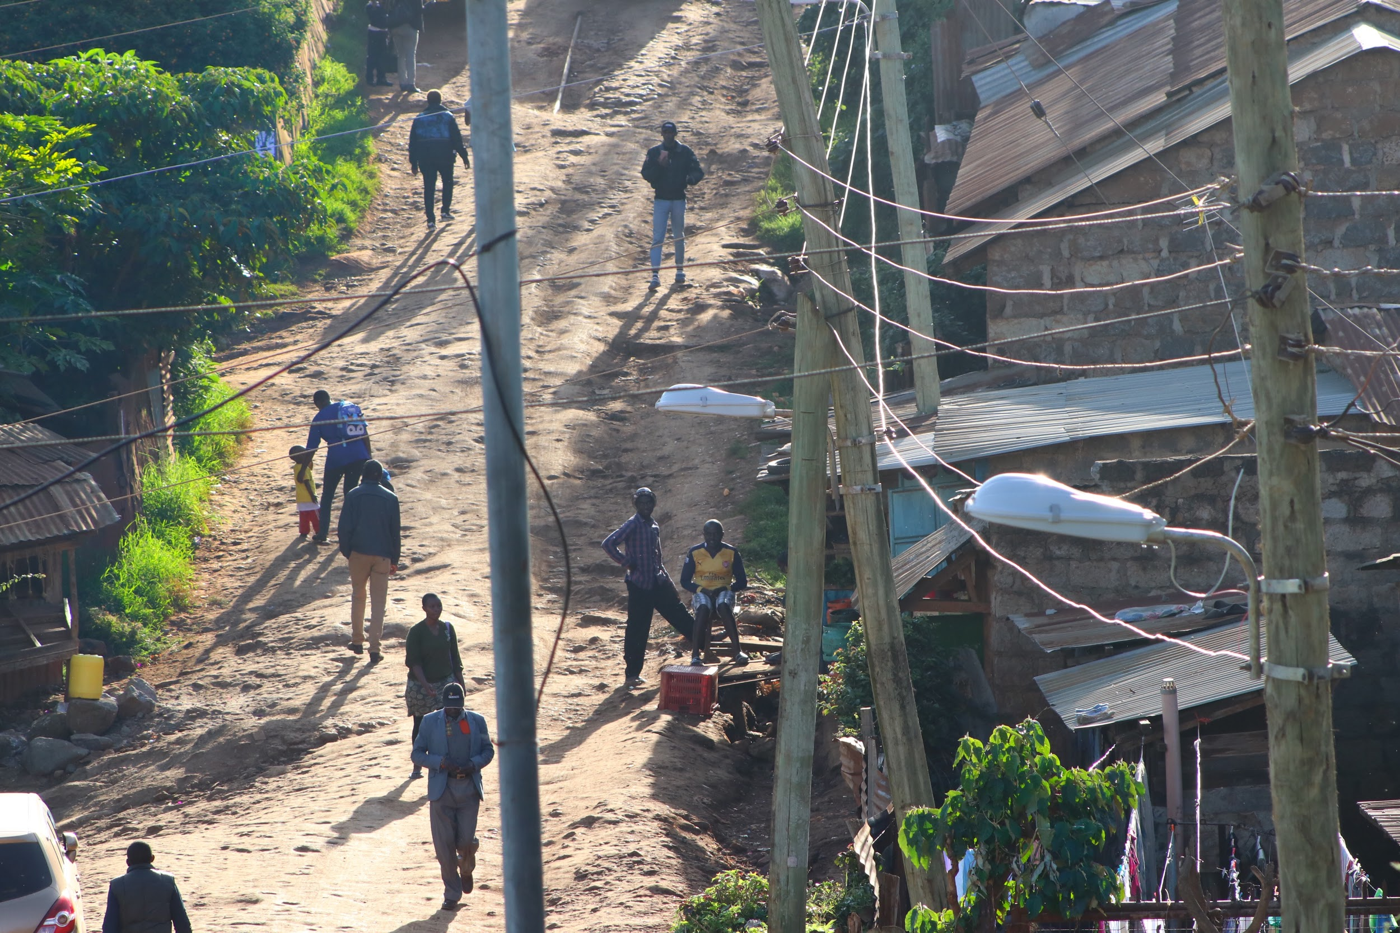
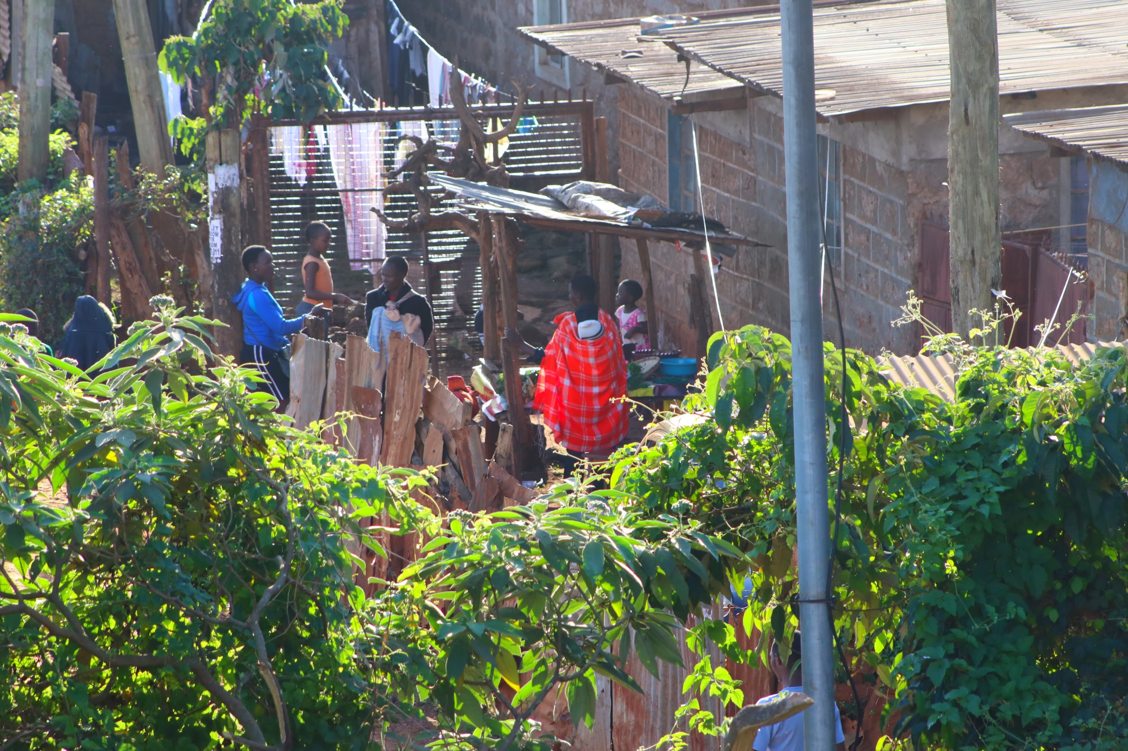
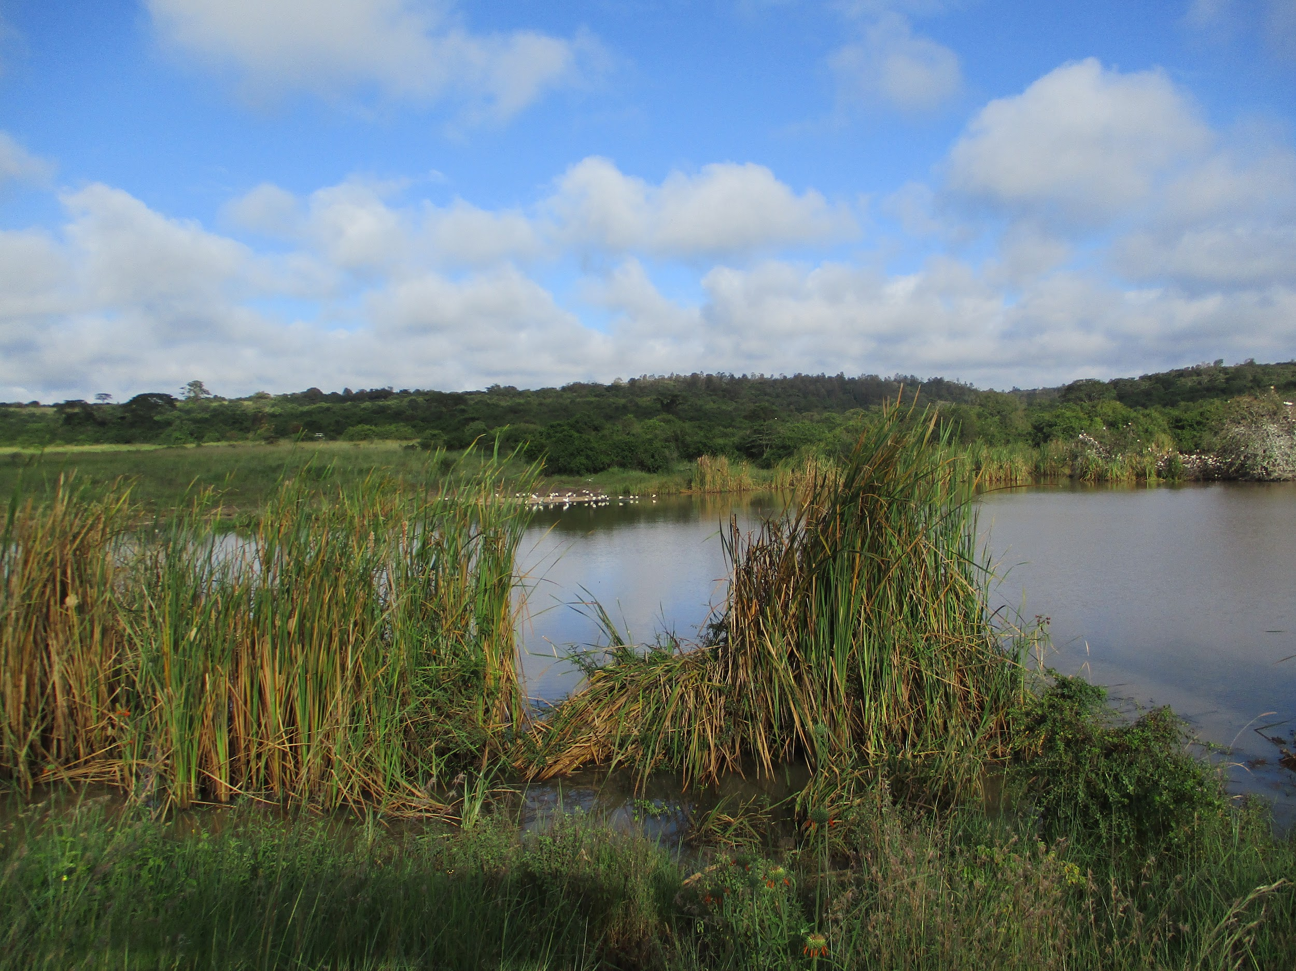
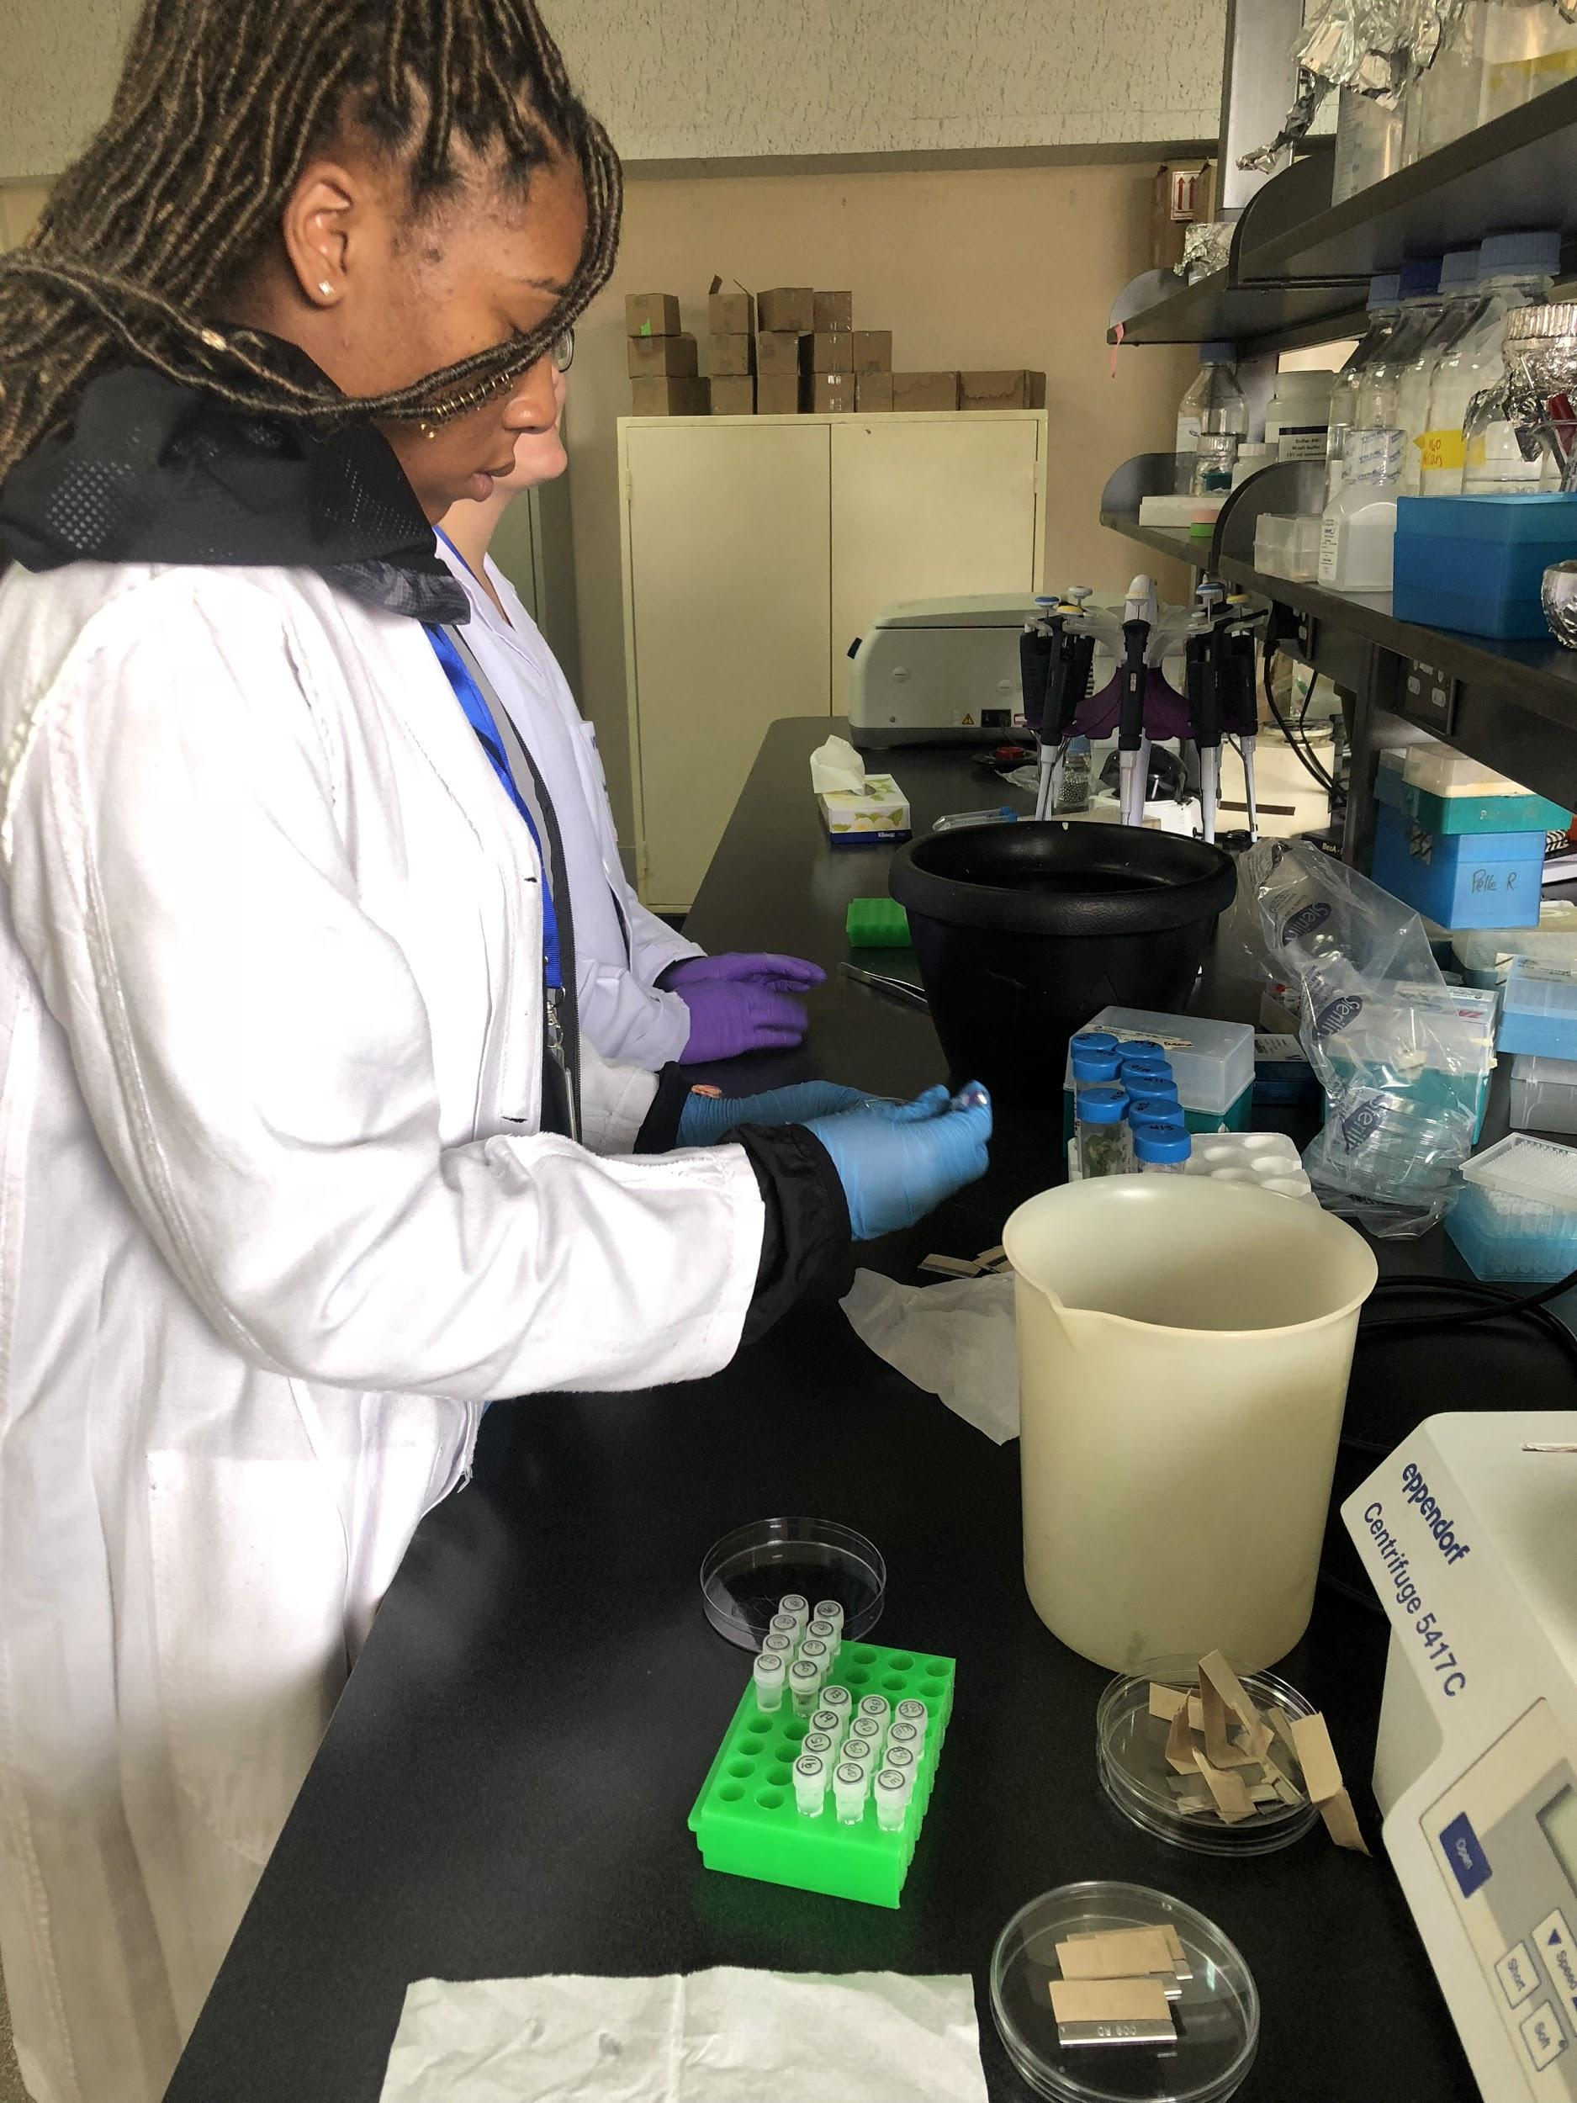
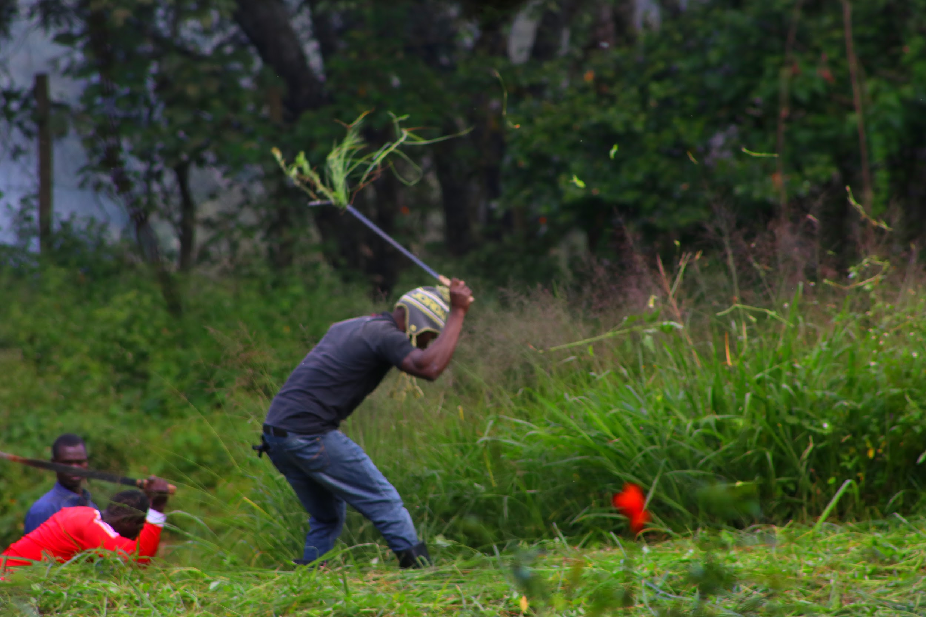
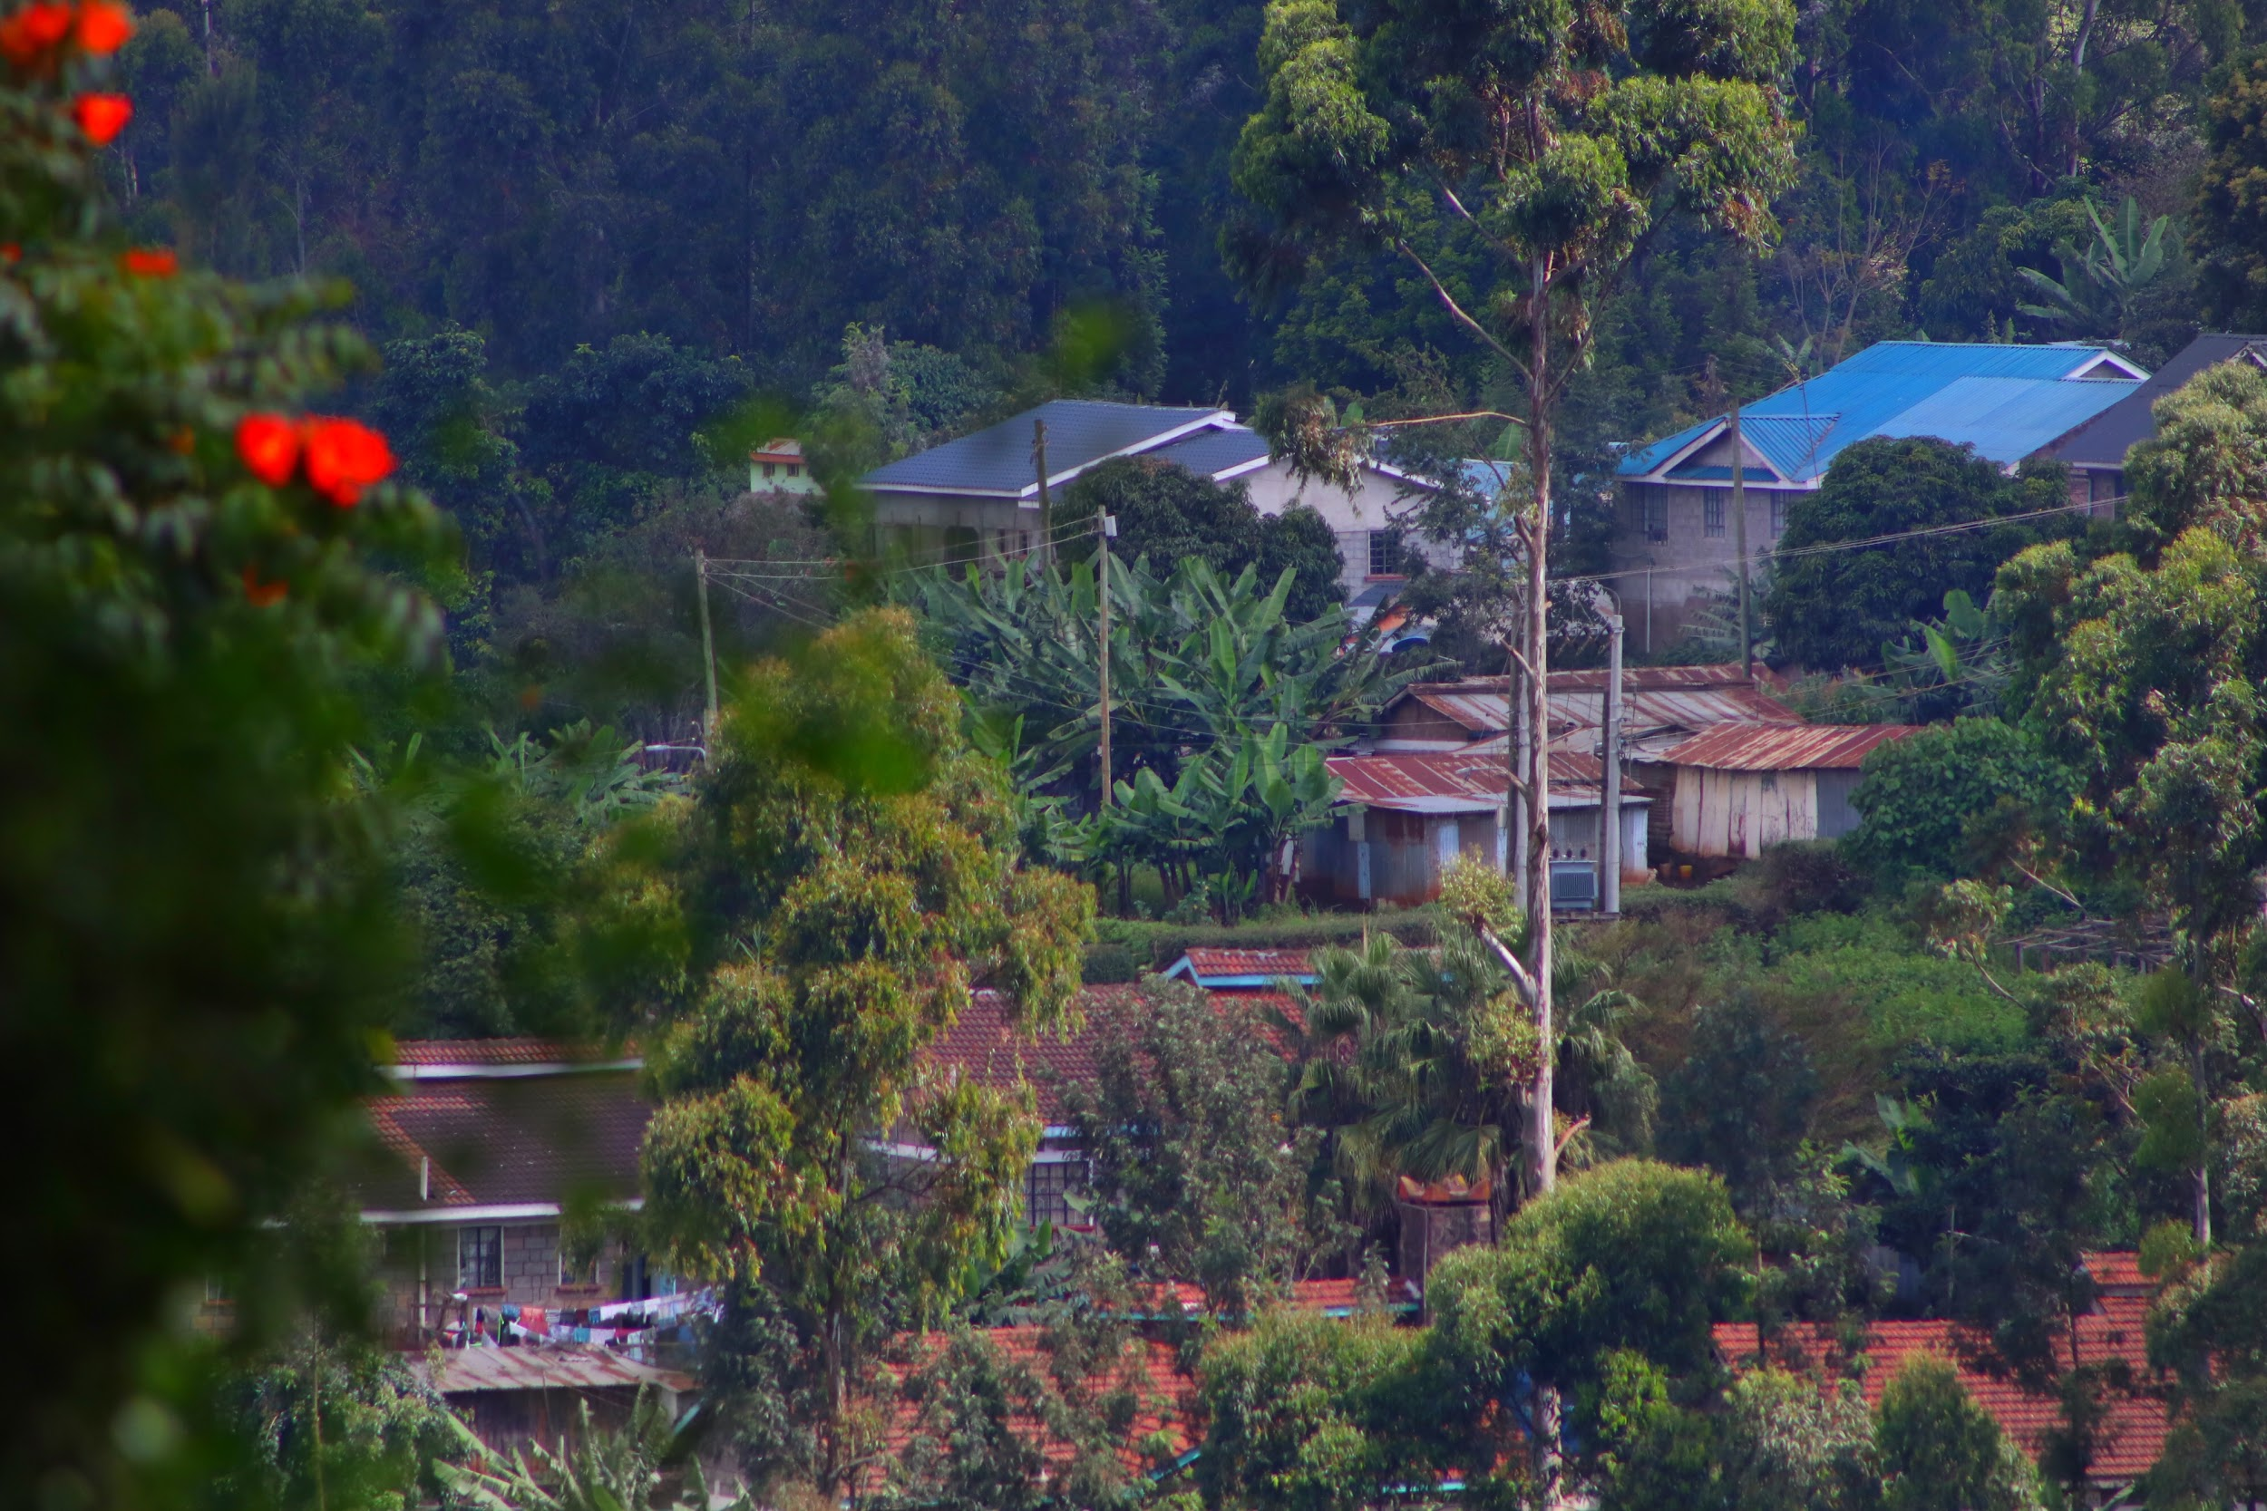
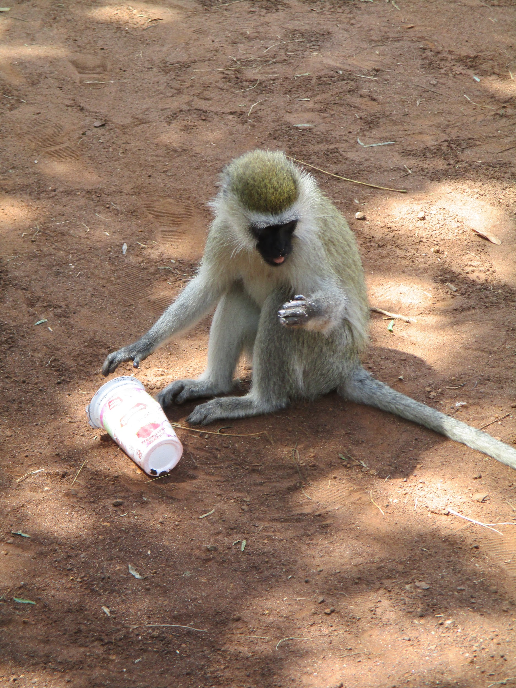
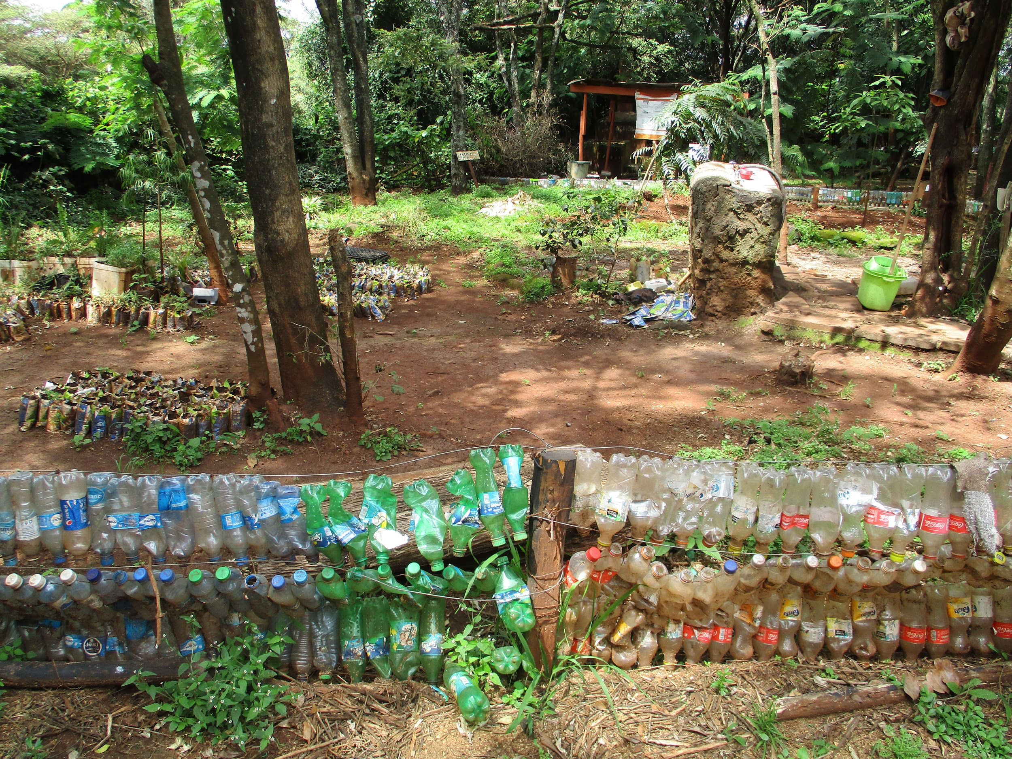
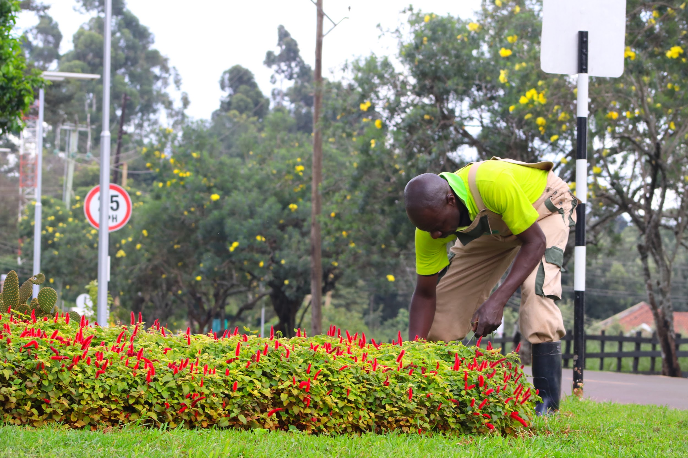
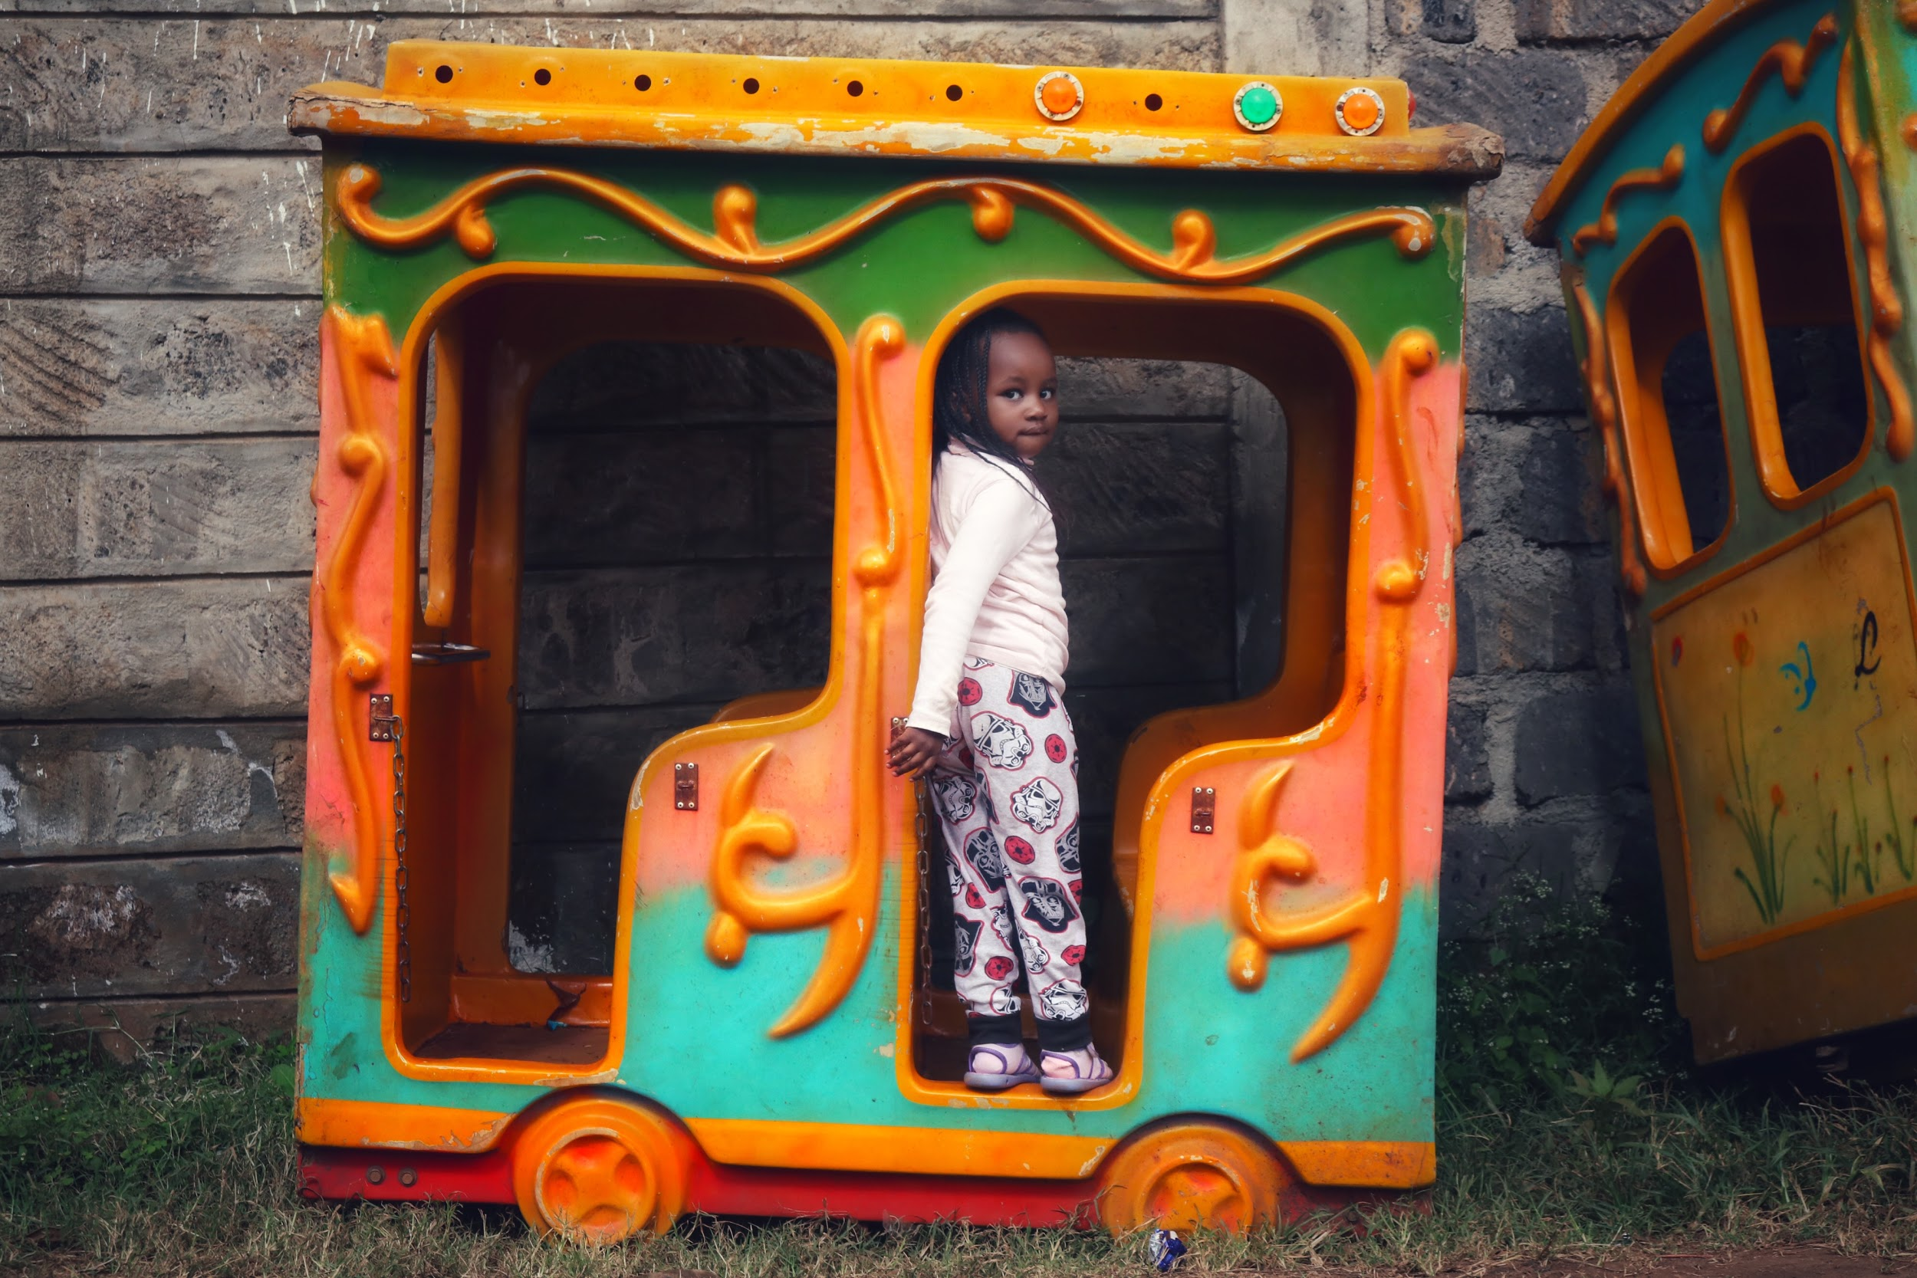
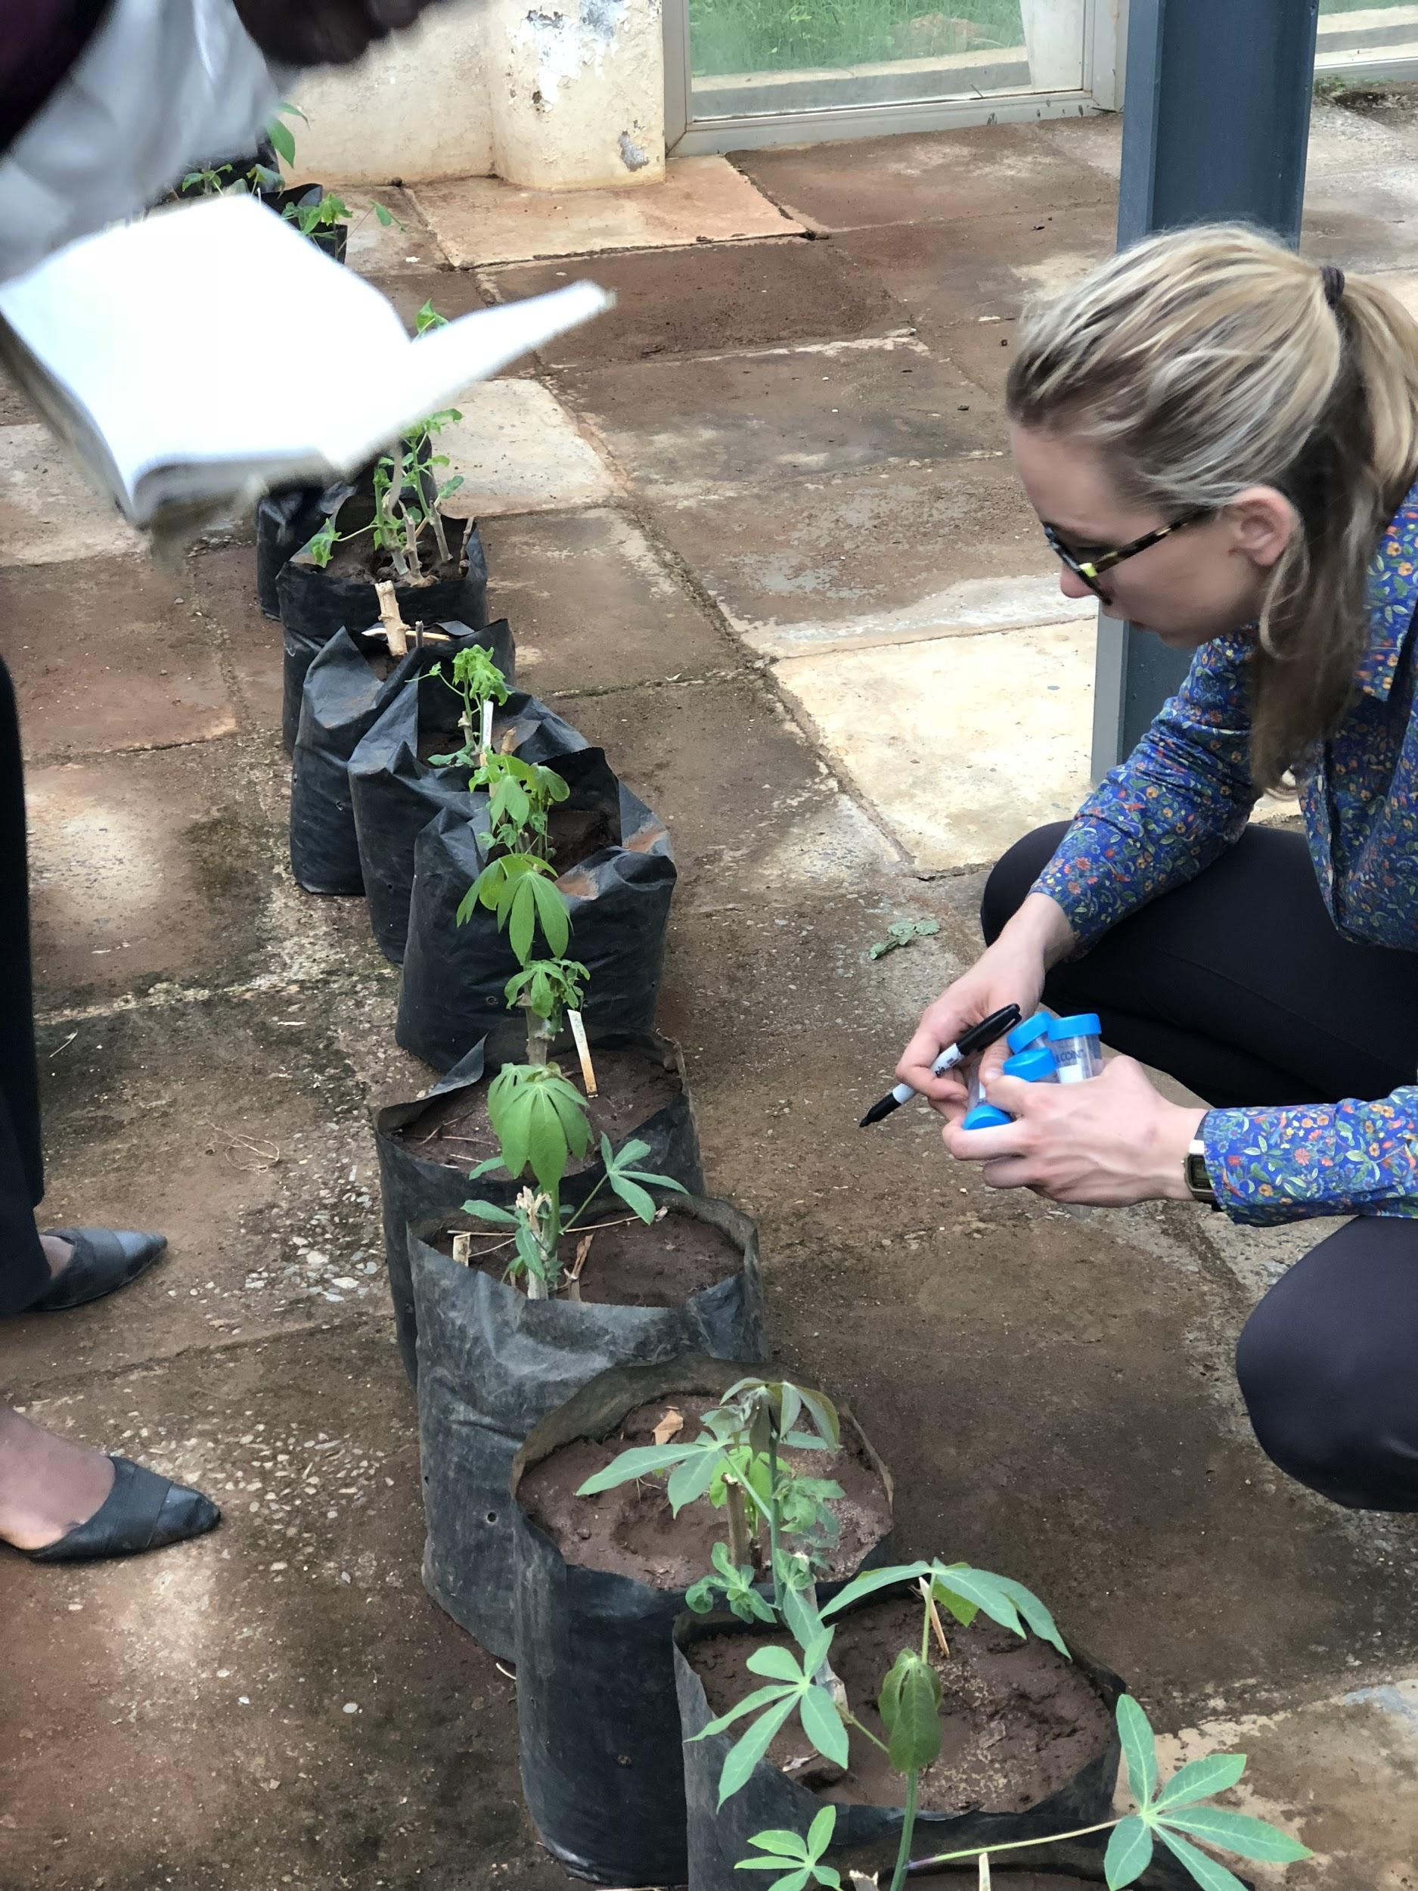
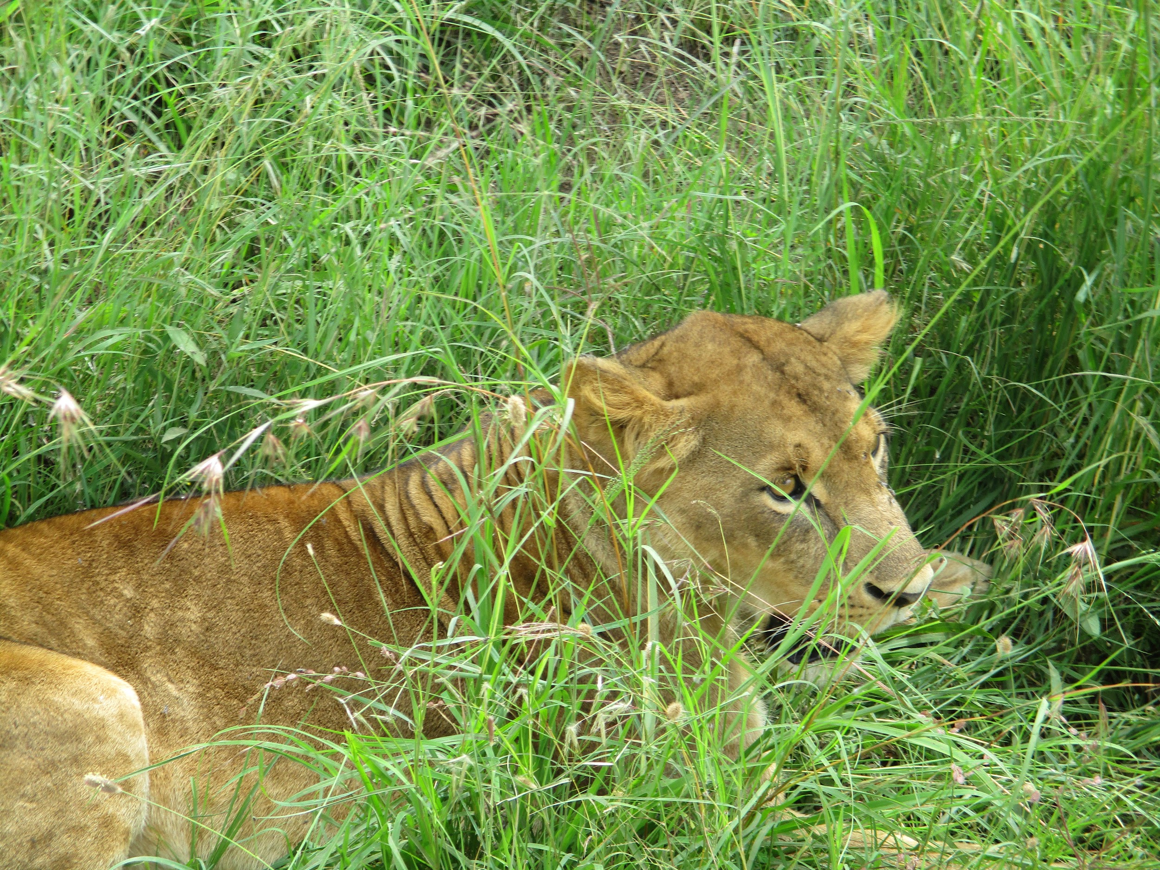
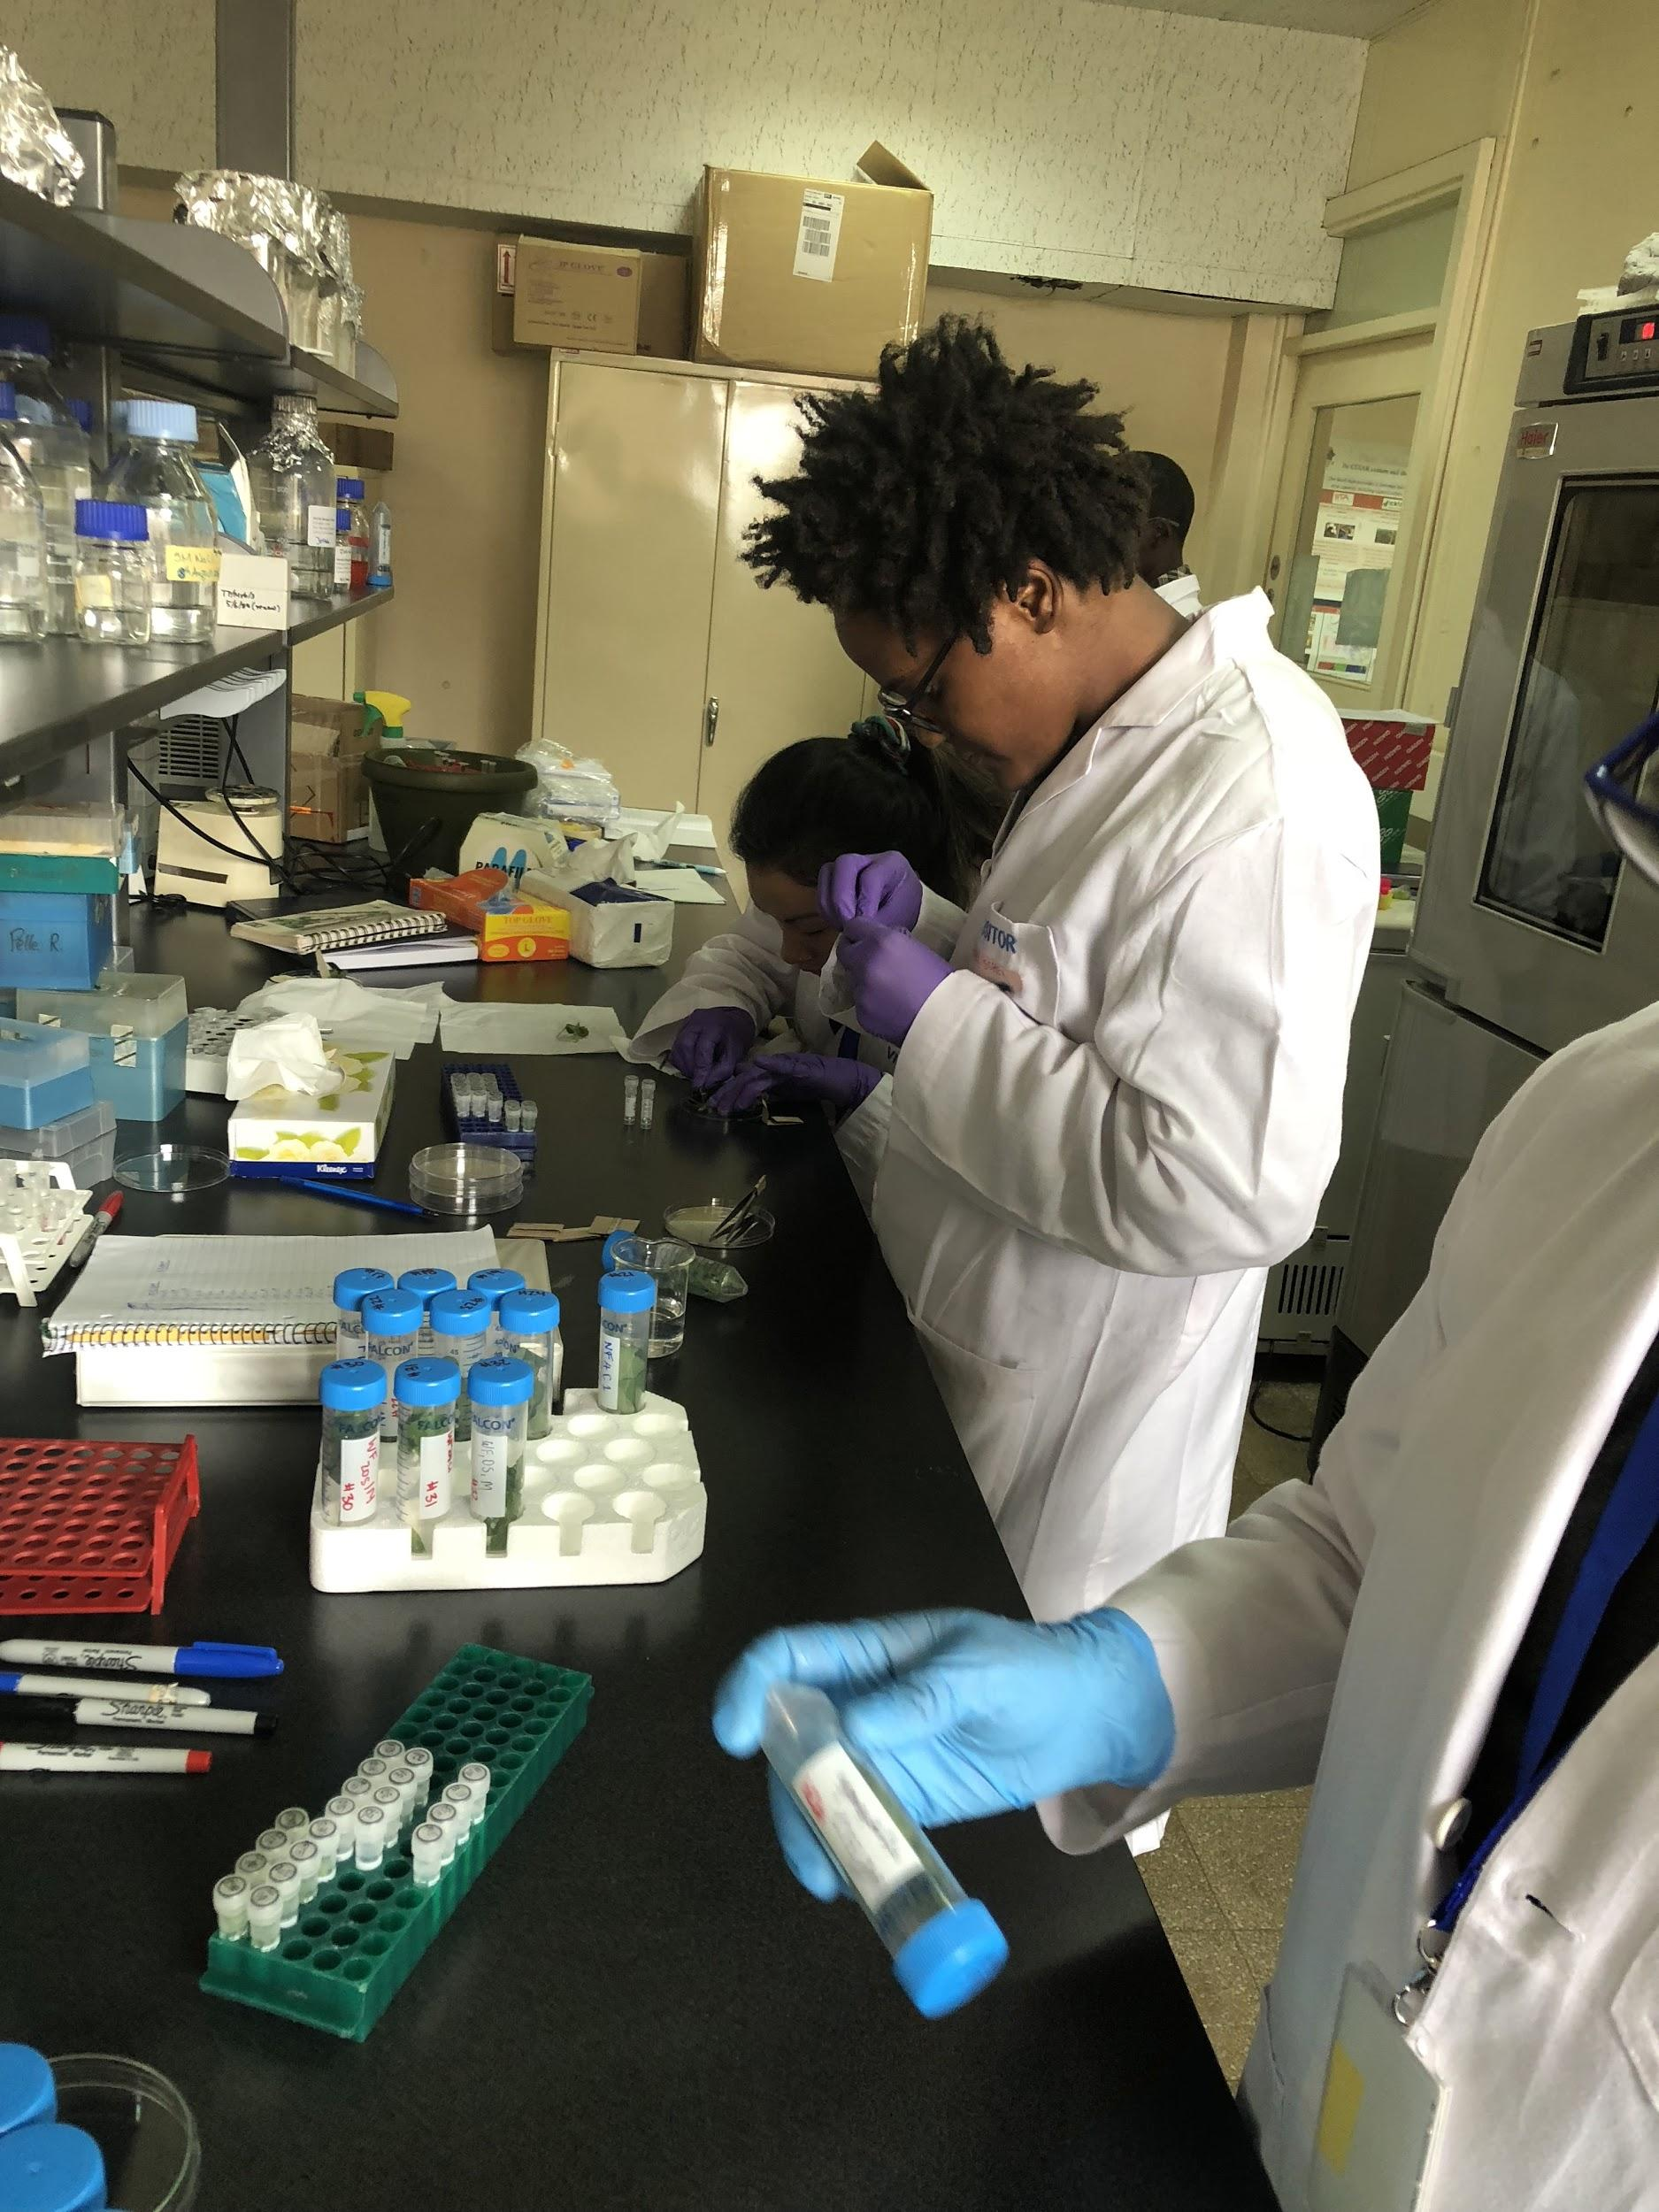
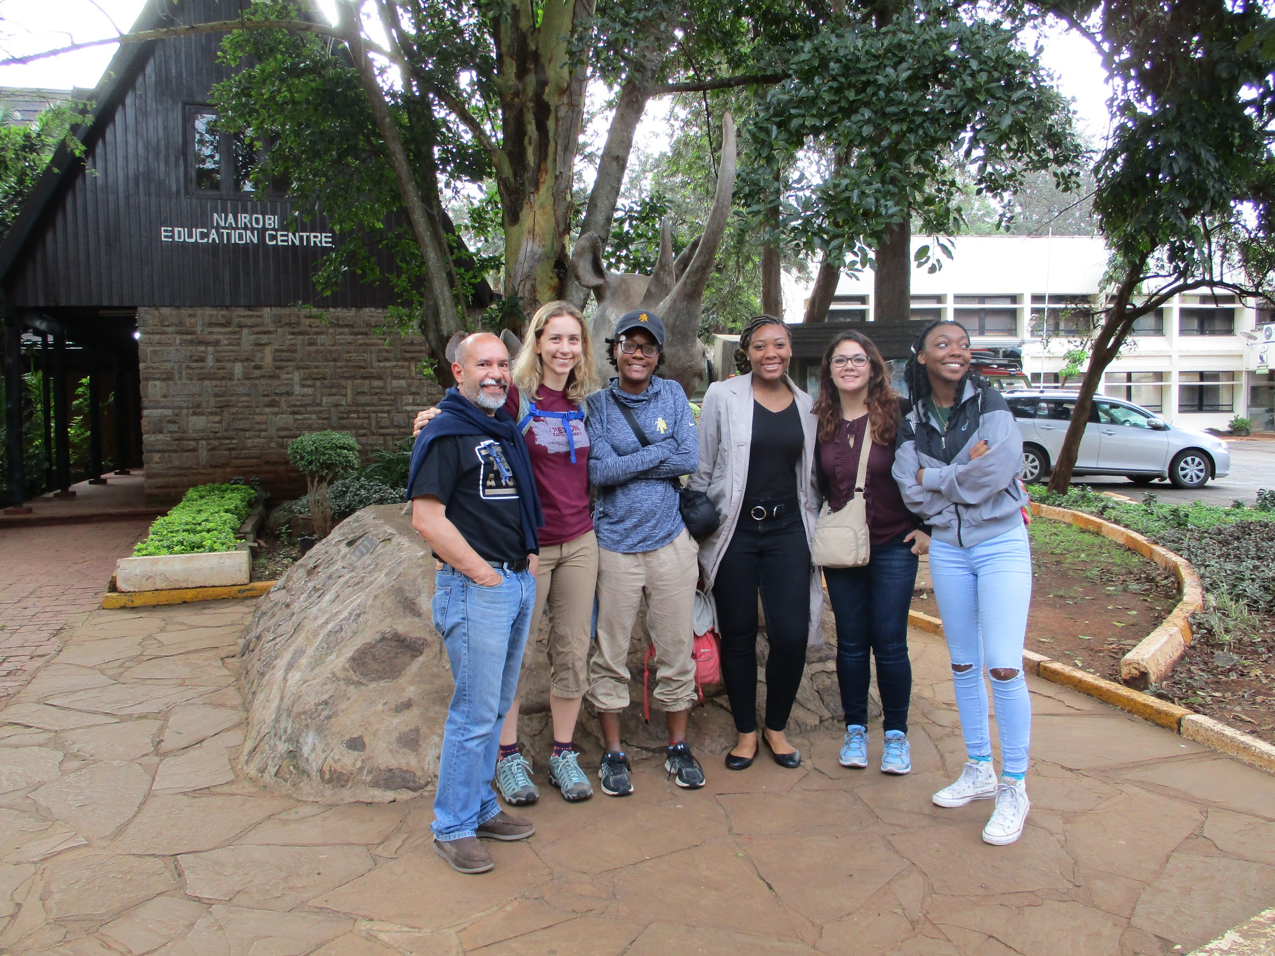
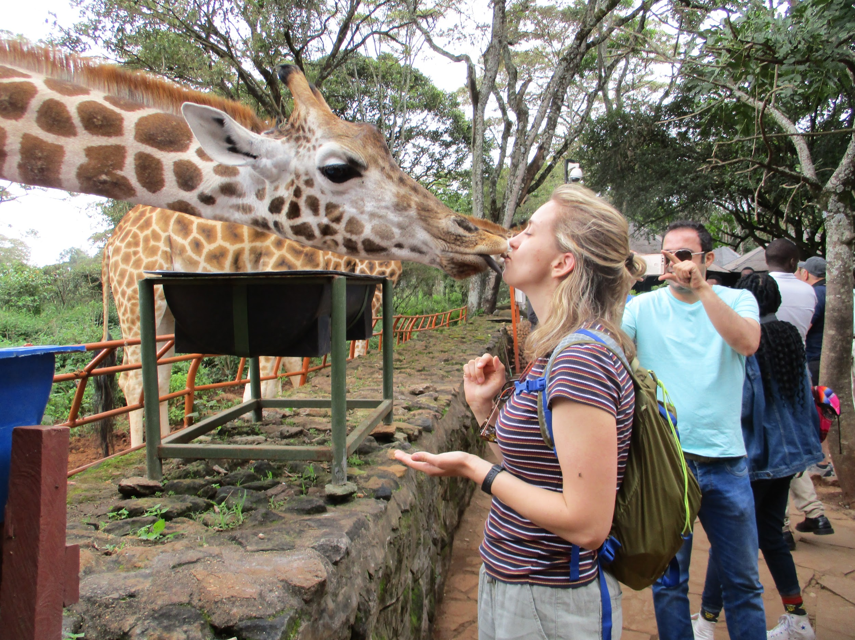
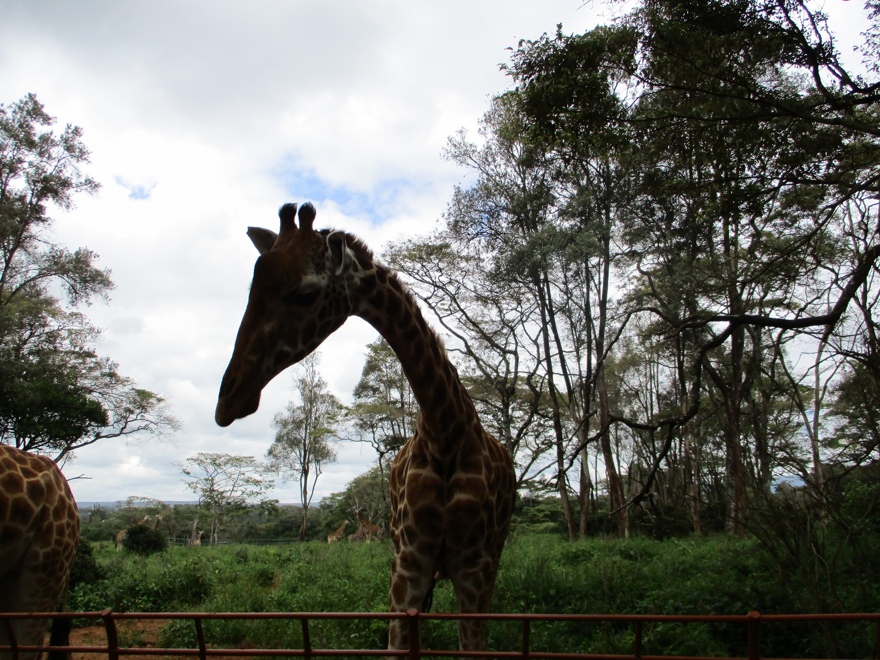
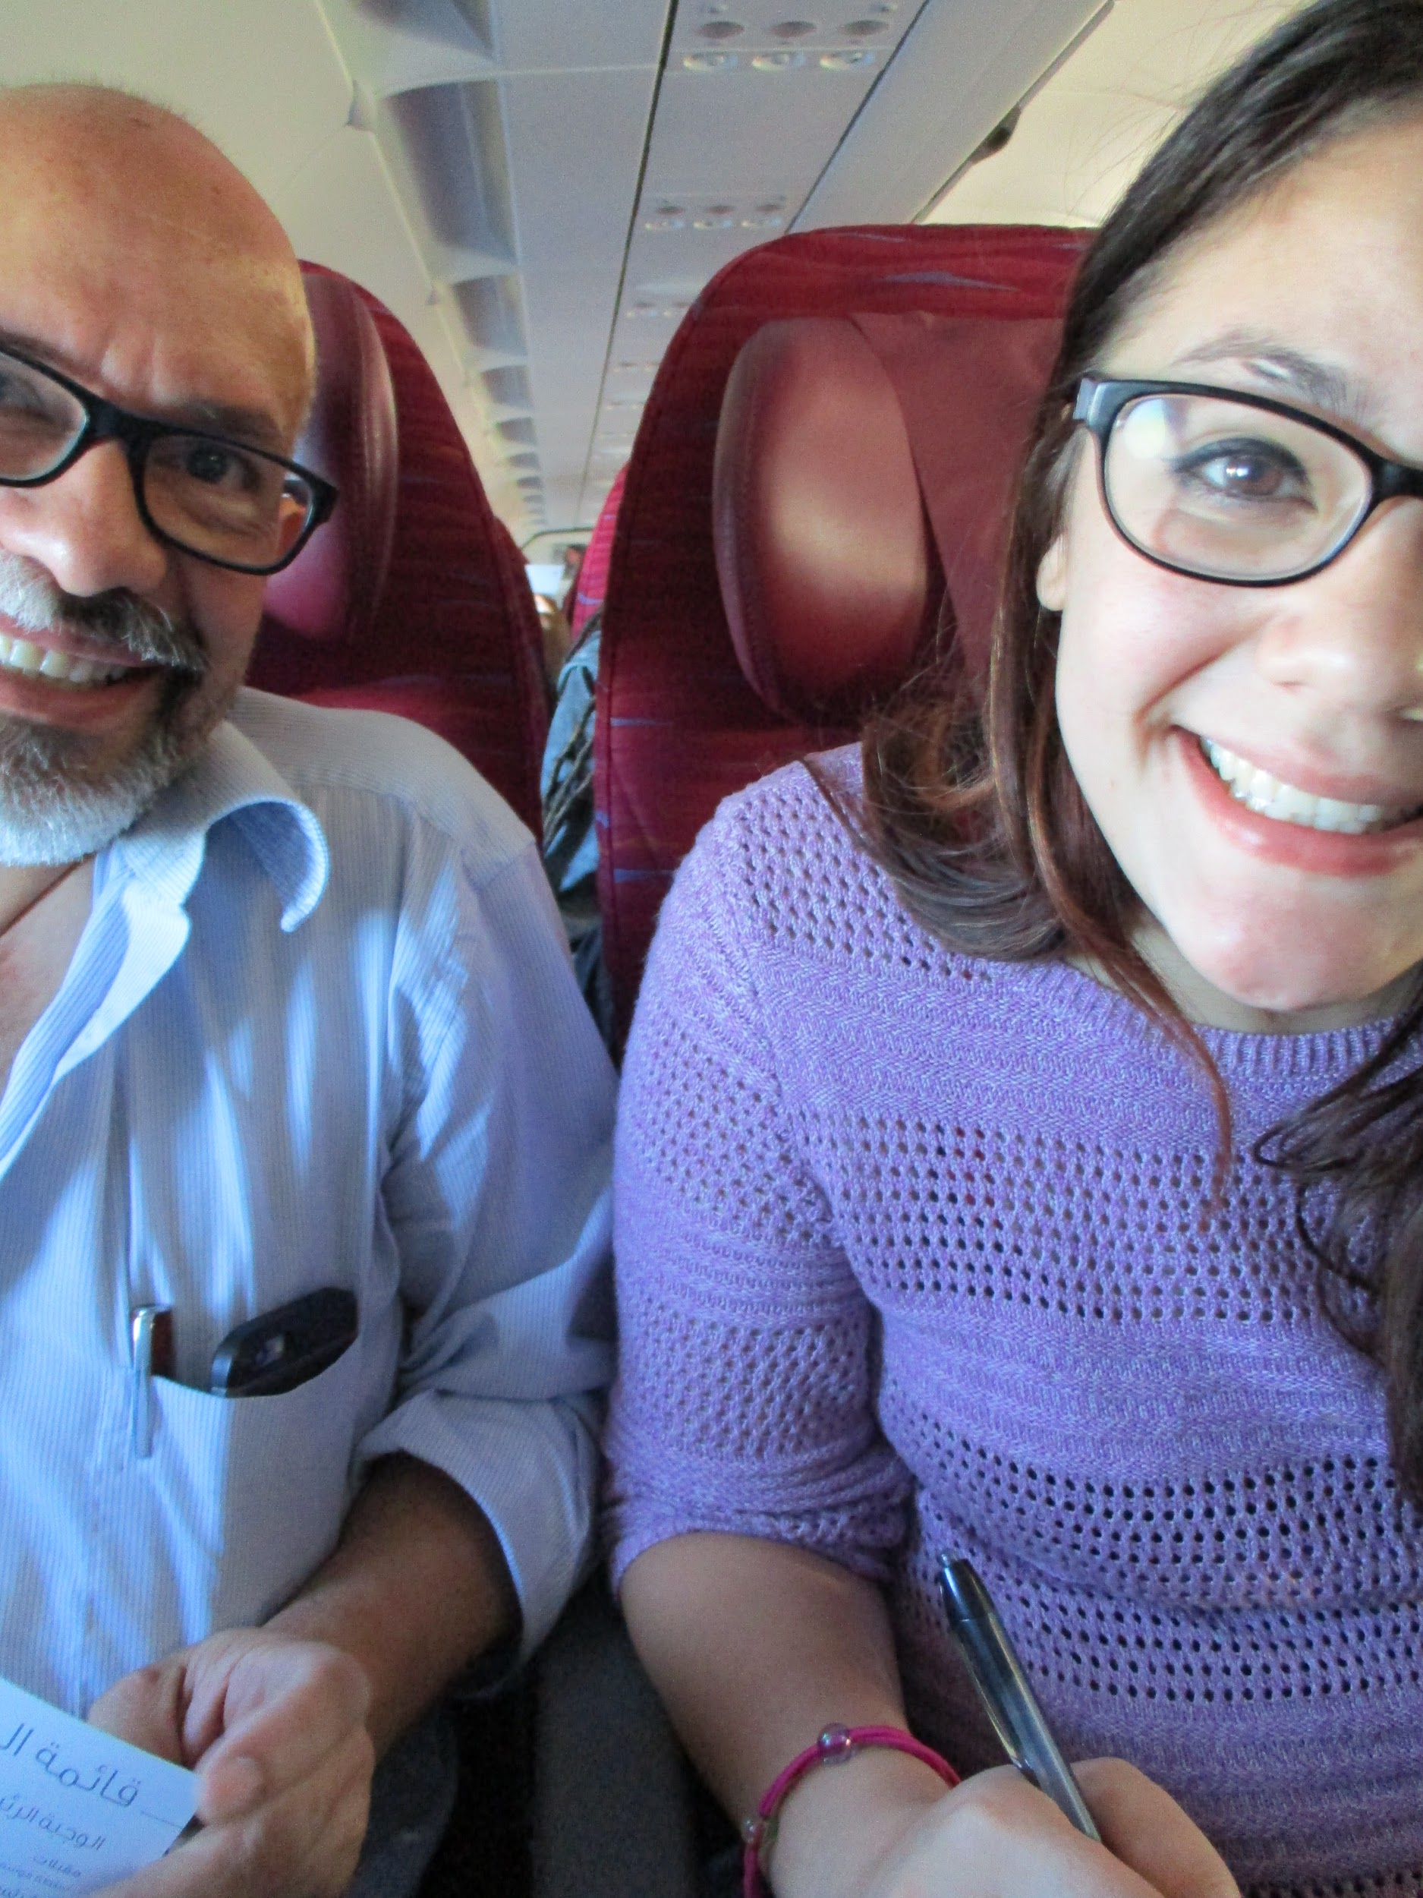
THE END
Asante Sana!

